Slide 1
Secure File Folder
-Term Project Final Presentation-
20103453 Sang-Ho Lee
20103575 Dae-Jin Jung

Slide 2
Motivation
Many Secure System exists in Network.
Secure File System in Windows is needed!!!
Windows is very popular OS.
However, relatively rare in File systems.

Slide 3
Problem Statement 1
User-level Security
- very easy for attacker to modify the data. - “Not Familiar Interface” • hard to encrypt/decrypt the data for user. • many problem in real use.

Slide 4
Problem Statement 2
System-level Security
- in Windows, EFS is depend on File System Itself
(it’s supported only at NTFS 3.0)
- not sufficient to communicate with other system

Slide 5
Related Works
1. Matt Blaze, “A Cryptographic file system for UNIX”, ACM 03-05,1993
2. Encrypting File System(EFS) on MS Windows.

Slide 6
Related Works by Matt
Try to encrypt at the system level - It’s more robust than doing at the application level.

Slide 7
Related Works by EFS
1. Use symmetric key(FEK) to encrypt
/decrypt file for efficiency.
2. Use asymmetric key to store FEK safely.
3. It provides limited security.

Slide 8
Approach
I/O Mechanism
I/O manager
IRP
File System Driver
File System Filter Driver
Disk Driver

Slide 9
Approach
IRP Hooking – By Filter Driver
I/O manager
IRP
File System Driver
File System Filter Driver
Disk Driver

Slide 10
Approach
Open Source
Filemon (v.4.34, Sysinternals)
Logs on accessing files
Functionality
Protecting
Hiding
Auto Enc/Decryption
User Transparency

Slide 11
Approach
Encryption Policy
Encrypted System Cache (Hard disk <-> cache & cache <-> App)
Plaintext System Cache (Hard disk <-> cache)

Slide 12
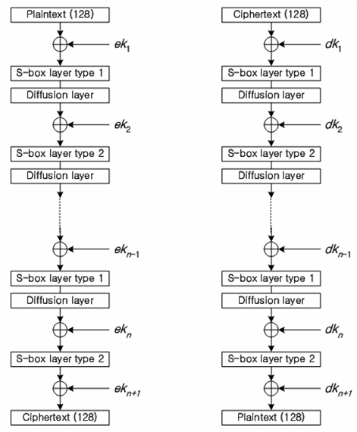
Approach
(cycle/byte)
CPU | ARIA | SEED | AES
Pentium Ⅲ | 37.3 | 42.4 | 23.3
Pentium Ⅳ | 49.0 | 81.3 | 30.5
ARIA
Professor’s recommendation
Involution SPN structure
128 bit Block SIZE
Variable Key Size (128/192/256 bit)

Slide 13
Evaluation - 1
Performance
Test Environment
E6700(@2.66G), 2G RAM, Vmware(7.0, 1 core, 512 RAM)
File copy
Normal
Small 7915 files(618MB) - 106 sec
Large file(617MB) - 33 sec
Driver
Small 7915 files(618MB) - 246 sec
Large file(617MB) - 180 sec

Slide 14
Evaluation - 2
Driver Unload
Basically it doesn’t work (or System crash)
All files are encrypted (with same key)
Information File is also encrypted

Slide 15
Evaluation - 3
System Cache Access
There is nothing we can do!!! (Because of this system design)
No product using encrypted cache data

Slide 16
Future Works
Encrypted Cache Data
There is nothing we can do!!! (Because of this system design)
No product using encrypted cache data

Slide 17
Future Works
Need for Various Authentication
Password(what you know) is not enough
Enhancing performance
Fast Enc/Dec algorithm & implementation

Slide 18
Conclude
Pros
Protect folder using kernel process
Information file is also protected & encrypted
Transparency for users
Cons
Low performance
Further work should be worked on.

Slide 19
Demonstration

