Slide 1
New architecture for enhanced security system in linux
20103112 SUK KI KIM

Slide 2
Contents
1. Introduction
2. Basic Idea
3. New architecture
4. Demo

Slide 3
Introduction
Current Linux system has two security methods
Password security
When we log into the system.
File permission
Access rights to specific users and group users.
The read permission
The write permission
The execute permission

Slide 4
Introduction
Raised question
Are really trusted root user?
If hacker get root account?
If hacker get my account?
Is there any method to protect my own data from hacker?
I want to share my account with my friend. But I don’t want to share my own data. Is there any method to support this?
I suggest a new architecture to solve the raised question.

Slide 5
Basic Idea
Assume that directory ABCD has password which is abcdefg
Ksk3@/TEST# CD ABCD
Enter Password : abcd
Password is wrong.
You are not allowed to enter.
Ksk3@/TEST#
Ksk3@/TEST# CD ABCD
Enter Password : abcdefg
Ksk3@/TEST/ABCD#

Slide 6
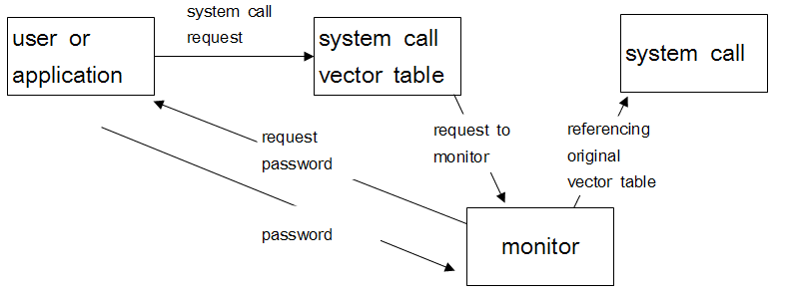
Basic Idea

Slide 7
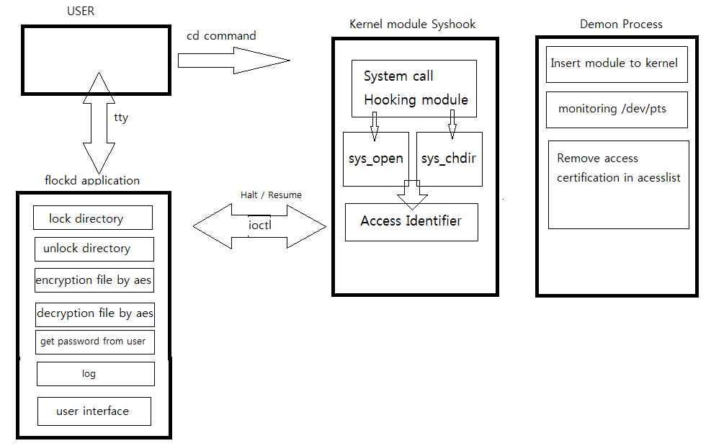
New architecture

Slide 8
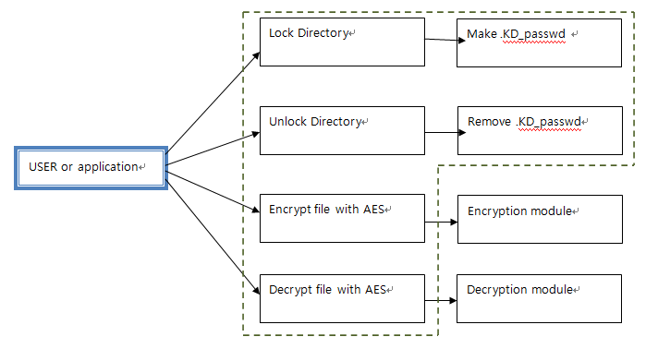
New architecture

Slide 10
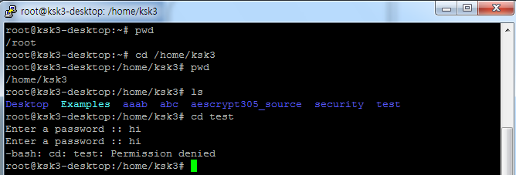
Demo

Slide 11
Q&A

