Slide 1
Security Improvement for IEEE 802.15.4 Enabled Device
Advanced Information Security – Final Project
Made Harta Dwijaksara

Slide 2
outline
Introduction
IEEE 802.15.4 Security
Contribution
Motivation and Related Work
Nonce Design
Security Analysis
Conclusion and Future Work
Reference

Slide 3
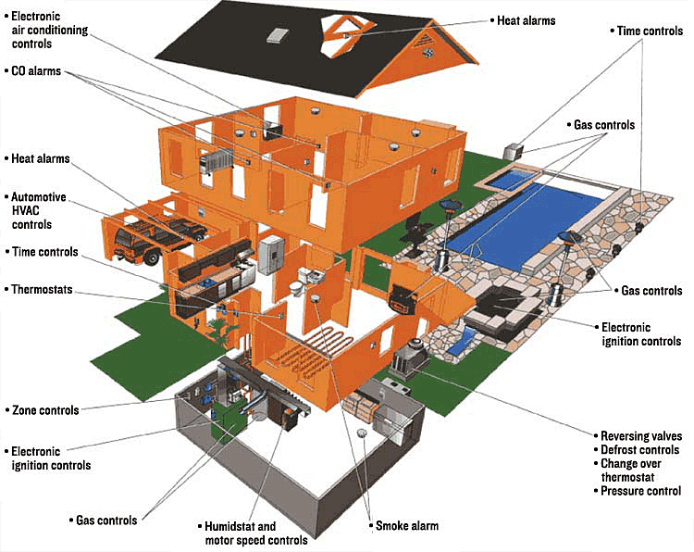
Introduction (1/2)
Pervasive Computing → Internet of things
On ubiquitous computing
era, electronic home
appliances are typically
interconnected
within network to each other
(ZigBee Network, WSN → IEEE 802.15.4 based devices)

Slide 4
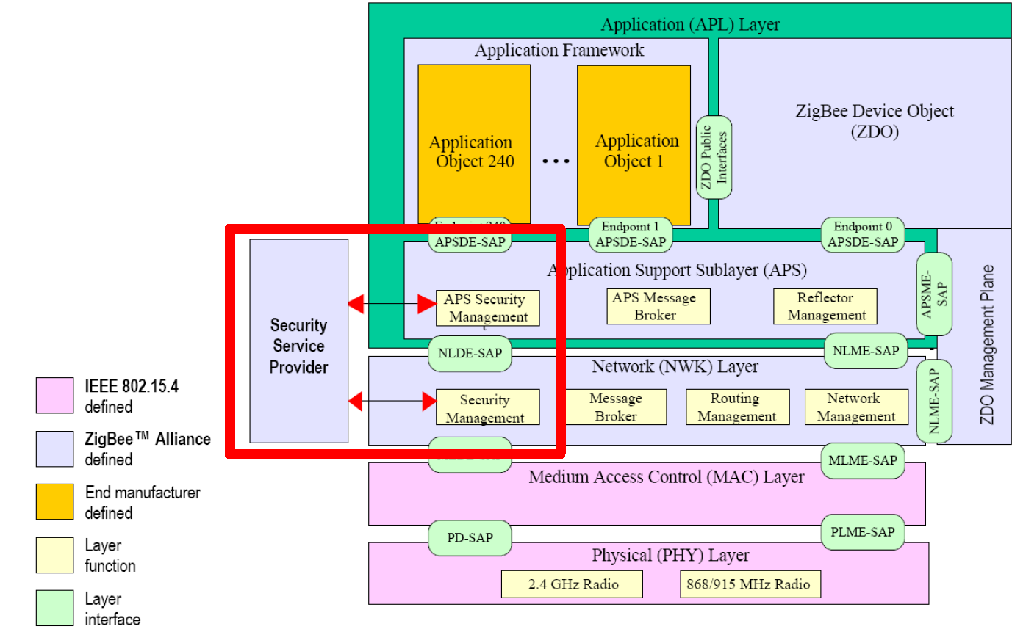
Introduction (1/2)
802.15.4’s role becomes more important
IEEE 802.15.4 is a standard which specifies the physical layer and media access control for low rate wireless
personal area networks (LR-WPAN)
802.15.4

Slide 5
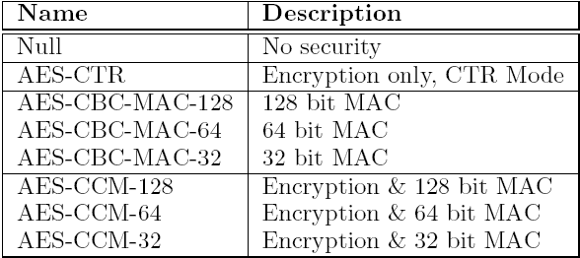
IEEE 802.15.4 Security (1/4)
ACL (Access Control List) and Security Suites *)
Address | Sec. Suite | Key | Last IV | Replay Ctr.
00:b6:d1:45:01:76:44:c4 | AES-CCM-64 | b5a3d4 | 3456 | 3460
2a:c4:5d:6f:11:88:87:b5 | AES-CTR | 98ab4f | 3678 | 3687
…. | …. | …. | …. | …..
…. | …. | …. | …. | …..
255 ACL
entries
…. | …. | …. | …. | …..
…. | …. | …. | …. | …..
…. | …. | …. | …. | …..
…. | …. | …. | …. | …..
98:3d:c4:fc:56:45:4c:87 | AES-CBC-MAC-64 | 76bc32 | 3542 | 3521
*) IEEE, “Wireless Medium Access Control (MAC) and Physical Layer (PHY) Specification for Low-Rate Wireless Personal Area Networks (WPANs)” IEEE Computer Society, 2006

Slide 6
IEEE 802.15.4 Security (2/4)
Integrity and Confidentiality
Message Integrity : AES-CBC-MAC-{4/8/16}
Encryption : AES-128
MIC generation
Encryption mechanism
Source Address (8 bytes) | Frame Counter (4 bytes) | Key Counter (1 bytes)
CCM nonce format (13 bytes)

Slide 7
IEEE 802.15.4 Security (3/4)
Medium Access Control payload format for each security suites
Frame Counter (4 bytes) | Key Counter (1 bytes) | Encrypted Payload (variable)
AES-CTR (Encryption only)
Payload (variable) | MIC (4/8/16 bytes)
AES-CBC-MAC (Integrity only)
Frame Counter (4 bytes) | Key Counter (1 bytes) | Encrypted Payload (variable) | Encrypted MIC (4/8/16 bytes)
AES-CCM (Encryption & Integrity)

Slide 8
IEEE 802.15.4 Security (5/4)
Security threats related to nonce
Same key in multiple ACL entries
No Support for Group Keying
Network Shared Keying Incompatible with Replay Protection
Loss of ACL state due to Power Interruption
If same key is used for different ACL entry → reuse nonce
c1 = Ek(key, nonce) xor m₁
c2 = Ek(key, nonce) xor m₂
c1 xor c2 = m1 xor m2
This completely breaks the confidentiality property
if network shared key is used → default ACL
Default ACL entry will record:
security suite, key and replay counter
A send message to C → replay counter 0..n
C will record the highest watermark → n
B send message to C → no clue about n
If B’s replay counter < n, all B packet will be rejected

Slide 9
Contribution
Point out several attacks possible on the 802.15.4 enabled device due to incomplete design of nonce
Elaborate the requirements for nonce design in 802.1.5.4 standard
Design a new nonce format
Provides comparison to the existing nonce design

Slide 10
Motivation and related work
Nonce has really important role but the current nonce design is still incomplete
Sastry Naveen and Wagner David *) propose that the nonce (replay counter) should be exposed to higher layer so the application could manage their own counter high water mark per each sender
Yang Xiao, Hsiao-Hwa Chen and Bo Sun **) suggest to use timestamp as nonce
*) IEEE, “Wireless Medium Access Control (MAC) and Physical Layer (PHY) Specification for Low-Rate Wireless Personal Area networks (WPANs)” IEEE Computer Society, 2006
**) Yang Xiao, Hsiao-Hwa Chen and Bo Sun, “Security Services and Enhancement in the IEEE 802.15.4 Wireless Sensor Networks”, IEEE BLOBECOM, 2005

Slide 11
Nonce design (1/6)
Nonce requirements
Nonce should contain source of the packet to make it unique per device
The value for nonce should also be unique per each packet sent
Its value should also sequentially increase each time used
Having holds those requirements combination of source address and timestamp is the best choice

Slide 12
Nonce design (2/6)
New nonce’s format
Source Address (8 bytes) | Timestamp (5 bytes)
mth dt hrs min sec ms
Bit [0:4] | Bit [5:9] | Bit [10:15] | Bit [16:21] | Bit [22:27] | Bit [28:40]
Where:
mth (4 bits long) : month (1 ~ 12)
dt (5 bits long) : date (1 ~ 31)
hr (5 bits long) : hour (0 ~ 24)
min (6 bits long) : minute (0 ~ 60)
sec (6 bits long) : second (0 ~ 60)
ms (13 bits long): millisecond (0 ~ 1000)

Slide 13
Nonce design (3/6)
New ACL entry
New MAC packet payload
Address | Security Suite (ID) | Key | Sent TS | Rcv. TS
Timestamp (5 bytes) | Encrypted Payload (variable)
AES-CTR (encryption only)
Timestamp (5 bytes) | Encrypted Payload (variable) | Encrypted MIC (4/8/16 bytes)
AES-CCM (encryption and integrity)

Slide 14
Nonce design (4/6)
Verification
Threshold value (δ)
Maximum end-to-end (eT)
Minimum time to finish cryptography process (cT)
Estimation of local and global clock difference (tT)
Packet’s timestamp (PT) should be: PT > Rcv TS Current Local Times – PT < δ
δ = eT + cT + tT

Slide 15
Nonce design (5/6)
End-to-end delay (ns2 simulation result)
cryptography process *) : at least 3.75ms
clock difference : precision within millisecond
ms
End-to-end delay
for 802.15.4 network
Will depend on deployment
Environment of
802.15.4 network
simulation time (s)
*) Vitaletti Andrea, Palombizio Gianni, “Rijndael for Sensor Networks: Is Speed the Main Issue?”,Electronic Notes in Theoretical Computer Science, Elsevier, 2007

Slide 16
Nonce design (6/6)
Communication with acknowledgement
The maximum waiting time for (macAckWaitDuration)
The number attempt allowed (n)
Clock Synchronization → Global vs Local
Precision within milliseconds (very relax)
Elson *) and Denis **) claim can get 1µs and 61µs
Clock synchronization is not a problem
Δ = δ + (macAckWaitDuration * n)
*) Elson, Jeremy and Estrin, Deborah, “Time Synchronization for Wireless Sensors Networks”, Workshop on Parallel and Distributed
Computing Issues in Wireless Networks and Mobile Computing, April-2001
**) Cox Denis, Jovanov Emil and Milenkovic Aleksandar, “Time Synchronization for ZigBee”, IEEE, 2005

Slide 17
Security Analysis
Recall the security threats:
Same key in multiple ACL entries
No Support for Group Keying → can be supported
Network Shared Keying Incompatible with Replay Protection
Loss of ACL state due to Power Interruption → when power is recovered assign ACL with current timestamp
If same key is used for different ACL entry
c1 = Ek(key, nonce₁) xor m₁
c2 = Ek(key, nonce₂) xor m₂
c1 xor c2 ≠ m1 xor m2
The value of nonce will never be reused
It is OK if there are same key in multiple ACL entries
if network shared key is used → default ACL
Default ACL entry will record:
security suite, key and replay counter
A send message to C → replay counter : timestamp
C will record the latest timestamp from A
B send message to C → if B send data after A, B’s timestamp must be > A’s timestamp
If B’s replay counter will alwas > n
Network Shared Keying can be well supported

Slide 18
Conclusion and Future work
Even looks very simple nonce has very crucial role in providing security service for 802.15.4 standard
To be well designed, nonce’s value should be unique and sequentially increased
Applying timestamp as part of nonce it is not a trivial work
Further research can be done on group key management for 802.15.4 compliant network

Slide 19
Reference
[1] Craige Robert, “ZigBee Security” ZigBee Alliance ZARC Task Group, 2009
[2] Farahani Shahin, “Zigbee Wireless Networks and Transceiver”, Elsevier, 2008.
[3] IEEE, “Wireless Medium Access Control (MAC) and Physical Layer (PHY) Specification for Low-Rate Wireless Personal Area Networks (WPANs)” IEEE Computer Society, 2006
[4] Sastry Naveen, Wagner David, “Security Consideration for IEEE 802.15.4 Networks”, Proceedings of the 3rd ACM workshop on Wireless security, 2004
[5] Vitaletti Andrea, Palombizio Gianni, “Rijndael for Sensor Networks: Is Speed the Main Issue?”,Electronic Notes in Theoretical Computer Science, Elsevier, 2007
[6] Wikipedia, “IEEE 802.15.4-2006”, http://en.wikipedia.org/wiki/IEEE_802.15.4-2006, accessed March 20th
[7] Yang Xiao, Hsiao-Hwa Chen and Bo Sun, “Security Services and Enhancement in the IEEE 802.15.4 Wireless Sensor Networks”, IEEE BLOBECOM, 2005
[8] FIPS Publication, “Advanced Encryption Standard” U.S. DoC/NIST, 2001
[9] Elson, Jeremy and Estrin, Deborah, “Time Synchronization for Wireless Sensors Networks”, Workshop on Parallel and Distributed Computing Issues in Wireless Networks and Mobile Computing, April-2001
[10] Cox Denis, Jovanov Emil and Milenkovic Aleksandar, “Time Synchronization for ZigBee”, IEEE, 2005

Slide 20
Q&A
Thank You

