Slide 1
The optimal method for data hiding based on LSB Matching using inverted pattern
Advanced Information Security
May 11, 2010
Semin Kim

Slide 2
Contents
1. Introduction of Steganography
2. Previous Works
3. Motivation
4. Proposed Algorithm
Consideration for directions
Application of Inverted Patterns
5. Experimental Results
6. Conclusion

Slide 3
Contents
1. Introduction of Steganography
2. Previous Works
3. Motivation
4. Proposed Algorithm
Consideration for directions
Application of Inverted Patterns
5. Experimental Results
6. Conclusion

Slide 4
The literary history
BC. 5 by a Greece's historian, Herodotus.
Darious
King of Persia
Tattoo
Histiaeus
Tyrant(Lord) of Miletus
Aristagoras

Slide 5
Steganography for Digital Images
Based on Digital Images
Raw(Gradient) Images (BMP, TIFF)
Index Images (BMP, GIF, PNG)
Compressed Images (JPEG)
Two main issues for Steganography
Distortion
Capacity

Slide 6
Contents
1. Introduction of Steganography
2. Previous Works
3. Motivation
4. Proposed Algorithm
Consideration for directions
Application of Inverted Patterns
5. Experimental Results
6. Conclusion

Slide 7
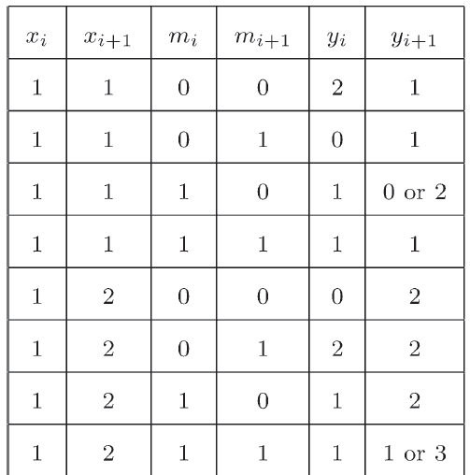
LSB Matching Methods (1/2)
Title: “LSB Matching Revisited”
Jarno Mielikainen
(Lappeenranta University of Technology, Finland)
IEEE Signal Processing Letters, 2006
The Difference between Replacing and Matching for LSB
At most one of two pixels is changed even if the LSBs and secret bits are totally different.
Replacing
Cover Pixels
Secret Bits
Modified Pixels
Pixel1 : 00000001
Pixel 2: 00000001
Bit 1: 0
Bit 2: 0
Pixel1 : 00000000
Pixel 2: 00000000
Matching
Cover Pixels
Secret Bits
Modified Pixels
Pixel1 : 00000001
Pixel 2: 00000001
Bit 1: 0
Bit 2: 0
Pixel1 : 00000010
Pixel 2: 00000001

Slide 8
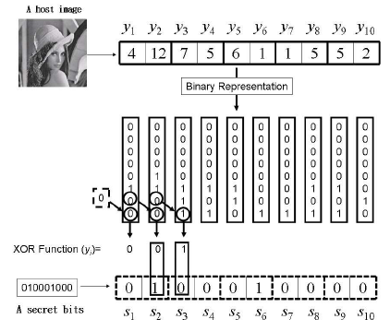
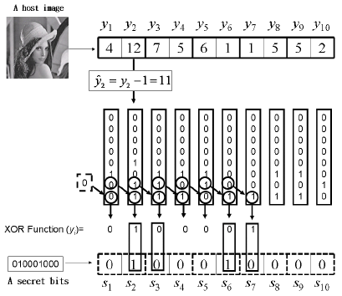
LSB Matching Methods (2/2)
Title: “On Using LSB Matching Function for Data Hiding in Pixels”
Chi-Shiang Chan
(Asia University, Taiwan)
Fundamental Informaticae 96, 2009
Enhanced Version of Mielikainen
No Pair
Reduced the number of modified pixels

Slide 9
Contents
1. Introduction of Steganography
2. Previous Works
3. Motivation
4. Proposed Algorithm
Consideration for directions
Application of Inverted Patterns
5. Experimental Results
6. Conclusion

Slide 10
Motivation
The previous matching methods did not consider the pixel’s direction in an image
Chan’s method has higher performance than Mielikainen’s , but it is not the minimization method for LSB matching

Slide 11
Contents
1. Introduction of Steganography
2. Previous Works
3. Motivation
4. Proposed Algorithm
Consideration for directions
Application of Inverted Patterns
5. Experimental Results
6. Conclusion

Slide 12
Consideration for directions
1. Divide an image into n x n blocks
2. Make each block to two bit string according to directions except the first pixel
The first pixel has the direction of its block at the 2nd LSB bit.
Apply Wang’s method to reduce the distortion
Steganography of capacity required using modulo operator for embedding secret image, Applied Mathematics and Computation 2005
Shiuh-Jeng Wang
Inputted image
n x n blocks
1
2
3
Horizontal String: 23456789
Vertical String : 47258369
Secret bits : s₁, s₂, … , s₉
4
5
6
7
8
9
Block
3 x 3 pixels
0
0
0
0
1
1
1
1
1
Embedding a direction
using replacing
Horizon: 0, Vertical: 1
1
ex.) Direction: Horizon,
Secret Bit 1
Pixel: 00000001
Modified Pixel: 00000000
MSB
8
7
6
5
4
3
2
1
LSB
Embedding a secret bit
using replacing with s₁
Bit planes

Slide 13
Application of Inverted Patterns (1/2)
3. Embedding Secret bit
Before embedding secret bit into pixels, we compare to check which pattern is better between secret bits and inverted secret bits to reduce the distortion
Ex)
“Inverted pattern approach to improve image quality of information hiding by LSB substitution”
Cheng-HsingYang (National Pingtung University of Education, Taiwan)
Pattern Recognition, 2008
Block
Secret bits
1
2
3
0
0
0
0
1
1
1
1
1
4
5
6
7
8
9
1
2
3
4
5
6
7
8
9
Normal
0
0
0
0
1
1
1
1
1
Select bits pattern
having less distortion
using Chan’s method
Inverted
0
1
1
1
0
0
0
0
0

Slide 14
Application of Inverted Patterns (2/2)
4. The sign bit for invert is stored the last pixel for each block.
1
2
3
Last Pixel
9
4
5
6
7
8
9
MSB
LSB
Block
8
7
6
5
4
3
2
1
Bit planes
Embedding a pattern sign
using replacing
Normal: 0, Inverted: 1

Slide 15
Contents
1. Introduction of Steganography
2. Previous Works
3. Motivation
4. Proposed Algorithm
Consideration for directions
Application of Inverted Patterns
5. Experimental Results
6. Conclusion

Slide 16
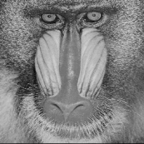
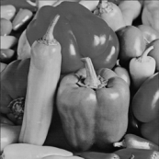
Environment
Cover Images:
512 x 512 images: Babbon, Lenna, Pepper
Secret Bits
Random bits
File name: ‘Bits.01’
Diehard Battery of Tests, Florida State University
http://stat.fsu.edu/pub/diehard/
Compare Methods
Replacing Method
Jarno Mielikainen
Chi-Shiang Chan
Proposed Method
Evaluation Criterion
The number of modified pixels after embedding
PSNR

Slide 17
Experimental Results
Embedded one secret bit into one pixel
Difference (The number of modified Pixels)
PSNR
 | Replacing | Mielikainen | Chan | Ours
Baboon | 130,538 | 97,974 | 87,318 | 80,560
Lena | 131354 | 98,600 | 87,293 | 80,659
Pepper | 131721 | 98,339 | 87,148 | 80,691
 | Replacing | Mielikainen | Chan | Ours
Baboon | 51.16 | 52.41 | 52.91 | 53.07
Lena | 51.13 | 52.38 | 52.91 | 53.06
Pepper | 51.12 | 52.39 | 52.91 | 53.06

Slide 18
Contents
1. Introduction of Steganography
2. Previous Works
3. Motivation
4. Proposed Algorithm
Consideration for directions
Application of Inverted Patterns
5. Experimental Results
6. Conclusion

Slide 19
Conclusion
A new LSB matching is proposed minimizing the distortion
Experimental results show the superiority of the proposed method with the previous methods
Novelty
Consideration for the pixel’s direction
Contribution
Improvement for Chan’s method using the inverted pattern

Slide 20
Q&A
Thank You
Any question?

