Slide 1
Privacy-Preserving Bayes-Adaptive MDPs
CS548 Advanced Information Security Spring 2010
CS548 Term Project
Kanghoon Lee, AIPR Lab., KAIST
2010.05.11.

Slide 2
Contents
Motivation Problems
Introduction
Reinforcement Learning and Markov Decision Processes (MDPs)
Bayes-Adaptive MDPs (BAMDPs)
Privacy-Preserving
Previous Work
Privacy-Preserving Reinforcement Learning (PPRL)
My Approach :
Privacy Preserving Bayes-Adaptive MDPs (PP-BAMDPs)
Conclusion
Future Works

Slide 3
Motivation Problems
Optimized Marketing Problem [1, 7]
Modeling of the customer’s purchase behavior as a MDP
Goal: optimal catalog mailing strategy that maximizes long-term profit
Customer status & mailing records, and their purchase patterns
→ Should be managed separately by two or more enterprises
But, we still want to learn the optimal policy with the data
Load Balancing [1, 8]
Load balancing among competing factories
Each factory wants to accept customer jobs, but may need to redirect jobs when heavily loaded
Each factory observe its own backlog, but they do not share their backlogs
How to make the optimal decision ?

Slide 4
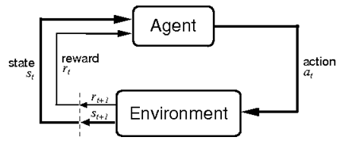
Introduction Reinforcement Learning and MDPs
Reinforcement Learning [2]
Sub-area of machine learning
How an agent ought to take actions to maximize long-term rewards
Markov Decision Processes (MDPs) [2]
Common formulation of reinforcement learning
Tuple
S : set of states
A : set of actions
T : S x A → S, state transition function
R : S x A → R, reward function
γ : discount factor

Slide 5
Introduction Policy and Value Function
Policy
What the agent does in a certain state
Value of a state: expected return starting from that state under policy π
Value of taking an action in a state under policy π
Bellman equation

Slide 6
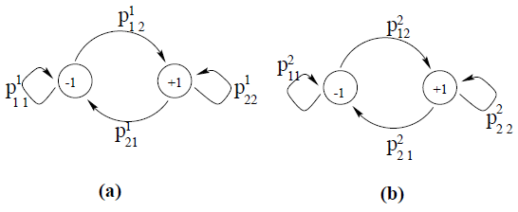
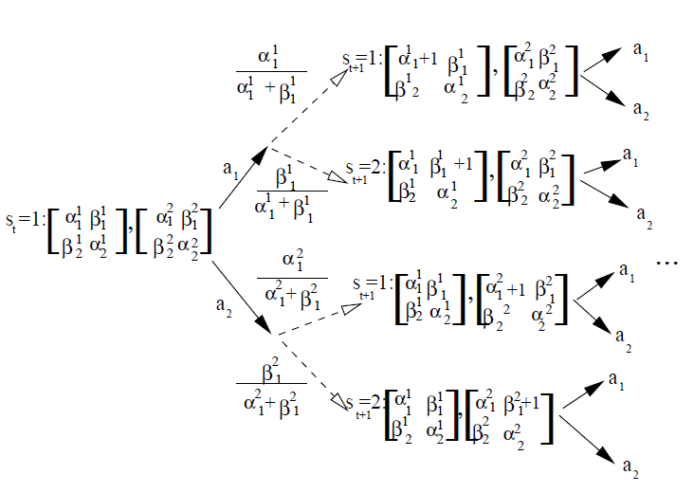
Introduction Bayes-Adaptive MDPs (BAMDPs)
MDP with Bayesian modeling of unknown transition probabilites
Hyperstate <s,x> : physical state s, information state x
2 physical states : s₁ (left), s₂ (right)
4 information states : (α₁¹,β₁¹ ), (α₂¹,β₂¹ ), (α₁²,β₁² ), (α₂²,β₂² )
(α_{i}^{j},β_{i}^{j} ) : Beta distribution parameter that represents transition prob. p_{ii}^{j}

Slide 7
Introduction Privacy-Preserving
Privacy-Preserving algorithms
Learning from environment or data with keeping their privacy
A lot of privacy-preserving algorithms
Privacy-preserving reinforcement learning (ICML 2008) [1]
Privacy-preserving belief propagation and sampling (NIPS 2007) [9]
Privacy preserving learning in negotiation (ACM SAC 2006) [10]
Privacy preserving data mining (Journal of Cryptology 2002) [11]
…
No paper for POMDPs or Bayes-adaptive MDPs, POMDPs
Eventually, extend to Privacy-preserving Bayes-adaptive POMDPs

Slide 8
Previous Work Privacy-Preserving Reinforcement Learning (PPRL)
Q-function
In SARSA learning,
For private preserving, we encrypt the Q-values by following

Slide 9
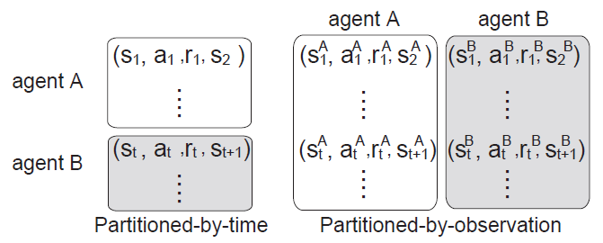
Previous Work PPRL – Two Partitioning Models
Partitioned-by-time
Agent A has perceptions during T^{A} = { 1, …, t-1 }
Agent B has perceptions during T^{B} = { t }
Partitioned-by-observation
Agent A, B have perceptions respectively
Agent A cannot know agent B’s history
Agent B cannot know agent A’s history
More issues
Use public key cryptosystems [6]
Assume all parameter values are rational numbers
→ multiply large integer K to make all values integers

Slide 10
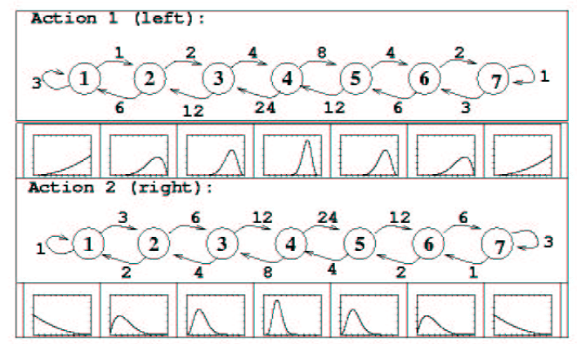
My Approach Privacy-Preserving BAMDPs (PP-BAMDPs)
Bayes-Adaptive MDP with parameterized function approximators [4]
Policy parameterization :
Value function parameterization :
BAMDP find optimal parameter η, θ from sample trajectories
Problem setting
Two agents A, B
Each agent acts independently (in the unknown transition prob. environment)
Two agents want to update private same policy parameter η, θ

Slide 11
My Approach PP-BAMDP Algorithm (1)
* Original Actor-Critic Algorithm
For each hyperstate trajectory,
1. Generate action a from
2. Observe hyperstate
and reward r
3. Update value ftn. Param.
4. Update policy param.

Slide 12
My Approach PP-BAMDP Algorithm (2)
* Privacy-Preserving Actor-Critic Algorithm
For each hyperstate trajectory,
1. Generate action a from
or random action
(if agent has decryp. key) (otherwise)
2. Observe hyperstate
and reward r
3. Update value ftn. Param.
4. Update policy param.

Slide 13
Conclusion
New privacy-preserving algorithm for Bayes-adaptive MDPs
Based on each agent’s sample trajectory, learn the private parameter η, θ using parameterized actor-critic algorithm
All parameters η, θ can be learned by several agents, but they never know the values

Slide 14
Future Works
Extend to partially observable environments
Partially Observable Markov Decision Processes (POMDPs) [3]
Tuple
State cannot be observed, instead perceives an observation
Computationally intractable (NP-hard)
Apply to Bayes-Adaptive POMDPs [5]
An optimal decision-theoretic algorithm for learning and planning in POMDPs under parameter uncertainty
Value function & policy function representation
α-vector representation
Stochastic finite state automata
Need more consideration !!

Slide 15
References
[1] Sakuma, J., Kobayashi, S, and Wright, R. N., Privacy-Preserving Reinforcement Learning, Proceedings of ICML, 2008
[2] Sutton, R. S., and Barto, A. G., Reinforcement Learning: An Introduction, MIT Press, 1998
[3] Kaelbling, L. P., Littman, M. L., and Cassandra, A. R., Planning and acting in partially observable stochastic domains, Journal of Artificial Intelligence, 1998
[4] Duff, M., Design for an Optimal Probe, Proceedings of ICML, 2003
[5] Ross, S., Chaib-draa, B., and Pineau, J., Bayes-Adaptive POMDPs, Proceedings of NIPS, 2007
[6] Damgard, I. and Jurik, M., A Generalization, a Simplification and Some Applications of Paillier’s Probabilistic Public-Key System, Public Key Cryptography, 2001, Springer
[7] Abe, N., Verma, N., Apte, C., and Schroko, R., Cross channel optimized marketing by reinforcement learning, ACM SIGKDD Int’l Conf. on Knowledge Discovery and Data Mining, 2004
[8] Cogill, R., Rotkowitz, M., Van Roy, B., and Lall, S., An Approximate Dynamic Programming Approach to Decentralized Control of Stochastic Systems, LNCIS, 2006
[9] Kearns, M., Tan, J., and Wortman, J., Privacy-preserving belief propagation and sampling, NIPS, 2007
[10] Zhang, S., and Makedon, F., Privacy preserving learning in negotiation, ACM SAC, 2005
[11] Lindell, Y., and Pinkas, B., Privacy preserving data mining, Journal of Cryptology, 2002

