Slide 1
SHA-3 on GPU
By Lee, Jae-song
Notes:
Hello, here I present the result of analysis and implementation of parallel computation of SHA-3, the next-generation hash functions.

Slide 2
What is this
Implements some SHA-3 hash submissions on nVIDIA GPU (CUDA) with reasonable performance
Notes:
Exactly.
Ok, what is GPU and why it matters?

Slide 3
Why GPU
Everyone has own GPU
It supports for great parallel tasks
In ordinary task, we don’t use GPU heavily
Utilize GPU and save CPU usage!

Slide 4
What is CUDA
GPU framework by nVIDIA
You simply can program GPU with familiar C/C++
with extended keywords

Slide 5
CUDA How-to
Steps:
Copy inputs from CPU to GPU
Compute on GPU in parallel
Copy results back from GPU to CPU when done

Slide 6
CUDA Example
CPU (host) code:
void func(int* data1,
int* data2, size_t size) {
func_kernel<<< 1, size>>> (data1, data2);
}
GPU (device) code:
__global__ void
func_kernel(int* data1,
int* data2) {
int i = threadIdx.x;
data1[i] += data2[i];
__syncthreads();
data2[i] ^= data1[i];
}

Slide 7
Problems
Copying GPU ↔ memory is slow
Should be avoided if possible
CUDA is still a bit messy
First, how to debug GPU?
Some annoying bugs reside (v.2.3)

Slide 8
Problems
Design matters
It seems impossible to think (e.g.) SEED in parallel
Also other many Feistels
F

Slide 9
Previous Works
AES on OpenGL/CUDA
by [Rosenberg07]: 0~5% improvements
by [Manavski07]: 5x faster than CPU
AES, ARIA, DES on CUDA by [Yeom08]
SpectralHash(SHA3) by Cudahash
Blue Midnight Wish(SHA3) by [Osa09]

Slide 10
This Work
SHA-3 candidate hash functions
BLAKE, CubeHash (and Skein)

Slide 11
This Work
Why hashes?
Output is small and fixed
Lower overhead to copy GPU → CPU
Has simpler designs than ciphers
no need to “decrypt”
Also, few guys has tried it until now!

Slide 12
SHA-3 Candidates
Most uses modified Merkle-Damgård:
Added “message length” |M| for final block
prevents chosen-prefix attack like md5
M1
M2
M3
Mn
|M |
hash
hash
hash
...
hash
hash
initial
result

Slide 13
SHA-3 Candidates
For each hash function, unique cipher design is used
We can make the component on GPU
M1
M2
M3
Mn
|M |
hash
hash
hash
...
hash
hash
initial
result

Slide 14
BLAKE
A | A | A | A
B | B | B | B
C | C | C | C
D | D | D | D
Simple design
Seems AES-like: 4*4 blocks
For each iterations, do nonlinear function
to columns
to diagonals
A | A | A | A
B | B | B | B
C | C | C | C
D | D | D | D
Notes:
I’ll not try to explain whole specification of each hash functions, rather, I’ll concentrate on the important things only.

Slide 15
BLAKE
A | A | A | A
B | B | B | B
C | C | C | C
D | D | D | D
Nonlinear function ChaCha(a,b,c,d)
Each ChaCha is independent
Do it in parallel!
A | A | A | A
B | B | B | B
C | C | C | C
D | D | D | D

Slide 16
CubeHash
Works on 2^5 = 32 blocks
A[00000], A[00001], ..., A[11111]
For each iteration,
each two blocks are added, rotated, swaped, or XORed
independently.

Slide 17
CubeHash
A[1xxxx] += A[0xxxx]
A[0xxxx] <<<= 7
A[00xxx] ↔ A[01xxx]
A[1xxxx] ⊕= A[0xxxx]
A[1xx0x] ↔ A[1xx1x]
...
For all x.

Slide 18
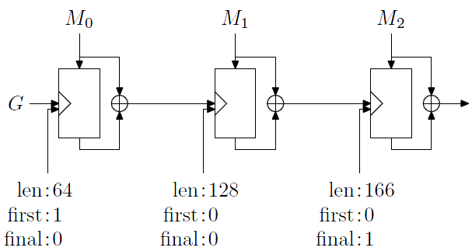
Skein*
Uses “Threefish”: tweakable block cipher
Sets additional three constants
It provides great nonlinearlity
Uses Unique Block Iteration (UBI) mode

Slide 19
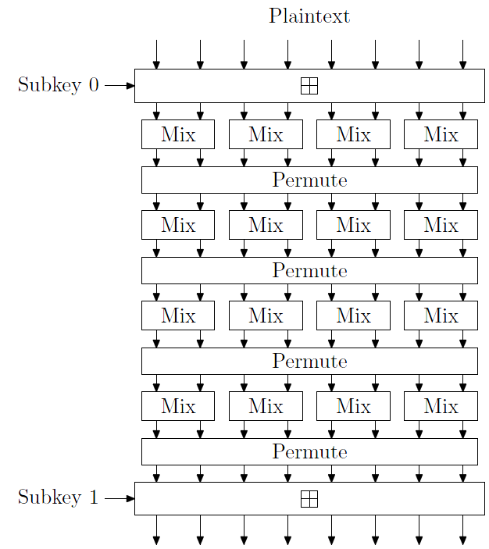
Skein*
Does not use any S-box
Prevents L2 cache side-channel attack
Only uses XOR, Rotation, and Addition (all in Mix)

Slide 20
Skein*
MIX in same row is independent to others
Unroll permutation
P(P(P(P(i)))) = i
Unroll 4 rounds

Slide 21
Implementation Results
Run on
CPU: AMD Athlon 64 X2 5000+ (2.6GHz)
GPU: GeForce 8600GT
Not yet a completely optimized result!

Slide 22
Implementation Results
BLAKE
Tested for basic block
10000 bytes
CPU: 0.1076 sec, 0.1 s/kB
GPU: 0.6223 sec, 0.6 s/kB
Slower, but little CPU usage
It is being tuned – better result expected
Or, time-CPU trade-off

Slide 23
Implementation Results
Whole CubeHash
including CPU-GPU copy workload
1000000 bytes
CPU: 10.1765 sec.
GPU: 7.438631 sec.
1.2~1.3x faster, with little CPU usage

Slide 24
Other possibilities
Other computation frameworks for CPU/GPU
OpenMP, OpenCL, ...
Intel/AMD AES instruction set
Actually, parallelism was one of the goals of AES
Some SHA-3 candidates use the instructions
e.g. ECHO

Slide 25
Closing
GPU is growing and interesting area; it’ll be worth to experience
Naive implementation drops performance So you have to learn deeply to use it
Good crypto designs expose parallelism while not breaking streangth
Questions?

Slide 26
References
[Rosenberg07] http://math.ut.ee/~uraes/openssl-gpu/
[Manavski07] CUDA compatible GPU as an efficient hardware accelerator for AES cryptography
[Yeom08] GPU용 고속 라이브러리 CUDA를 이용한 블록암호 고속 구현
[Osa09] Fast Implementation of Two Hash Algorithms on nVidia CUDA GPU (deadlink?)

