Slide 1
Visual Cryptography
Advanced Information Security
March 11, 2010
Presenter: Semin Kim

Slide 2
Overview
Introduction of Paper
Visual Cryptography
How to make?
Basic Idea
Color Visual Cryptography
Conclusions

Slide 3
Overview
Introduction of Paper
Visual Cryptography
How to make?
Basic Idea
Color Visual Cryptography
Conclusions

Slide 4
Introduction of paper
Title
Visual Cryptography
Conference
Eurocrypt ’94
Authors
Modi Noar, Adi Shamir

Slide 5
Overview
Introduction of Paper
Visual Cryptography
How to make?
Basic Idea
Color Visual Cryptography
Conclusions

Slide 6
Visual Cryptography
What?
It is different from the concept of traditional cryptography
It depends on perception by the human eyes

Slide 7
How to make?
The simplest visual cryptography
Message consists of a collection of black and white pixels.
‘OR’ Operation
Pixel (0)
Pixel (1)

Slide 8
How to make?
The simplest visual cryptography
Each pixel appears in n modified versions (called share).
Each share is a collection of m black and white sub-pixels.
pixel
Example. n = 2, m = 4
m sub-pixels
or
n shares
or
m sub-pixels

Slide 9
How to make?
The simplest visual cryptography
horizontal
shares
vertical
shares
diagonal
shares
Secret
Message

Slide 10
How to make?
The simplest visual cryptography
horizontal
shares
vertical
shares
diagonal
shares

Slide 11
How to make?
The simplest visual cryptography

Slide 12
Basic Idea
(k, n) sharing problem
Extended to k out of n sharing problem
For encrypting written material (printed text or handwritten notes), a perfectly secure way can be decoded directly by the human visual system.
Simplicity

Slide 13
Overview
Introduction of Paper
Visual Cryptography
How to make?
Basic Idea
Color Visual Cryptography
Conclusions

Slide 14
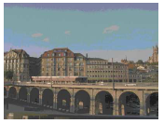
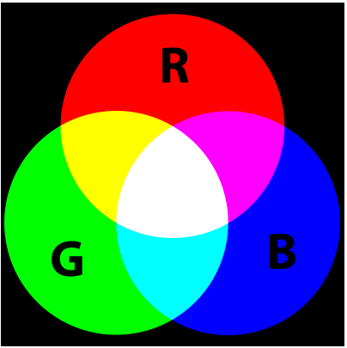
Color Visual Cryptography
XOR
=
Sharing Image 1
Sharing Image 2
Recover Image
RGB color space
Three components: Red, Green, Blue
All values are in the range [0, 1]
In RGB video cards for PC, one component is displayed using 8 bits (256 values)
RGB Addition

Slide 15
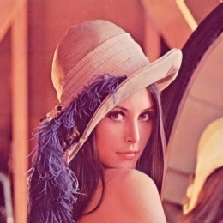
Color Visual Cryptography
RGB Display
Original
Image
Red
Green
Blue
Example. 2 share images
150
1
0
0
1
0
1
1
0
150
1
0
0
1
0
1
1
0
100
0
1
1
0
0
1
0
0
pixel
100
0
1
1
0
0
1
0
0
50
0
0
1
1
0
0
1
0
226
1
1
1
0
0
0
1
0
Bitplanes (Most --------------------Least)

Slide 16
Color Visual Cryptography
Shared
Image 1
Original
Image
Recover
Image
Shared
Image 2

Slide 17
Overview
Introduction of Paper
Visual Cryptography
How to make?
Basic Idea
Color Visual Cryptography
Conclusions

Slide 18
Conclusion
Advantages of Visual Cryptography
No knowledge of cryptography is required to get the secret message from shared images.
The system can be used by anyone.
Lower computational cost since the secret message is recognized only by human eyes and not cryptographically computed.

Slide 19
Q&A
Thank you! Any questions?

