Slide 1
RFID Privacy : Relation Between Two Notions, Minimal
Condition, and Efficient Construction
Changshe Ma, Yingjiu Li, Robert H. Deng, Tieyan Li
Singapore Management University
16th ACM conference on CCS’09
Ha Donghun, Kim Hangyu

Slide 2
Contents
Overview of RFID
Ind-privacy and Unp-privacy
Relationship between two privacies
PRF
New RFID protocol

Slide 3
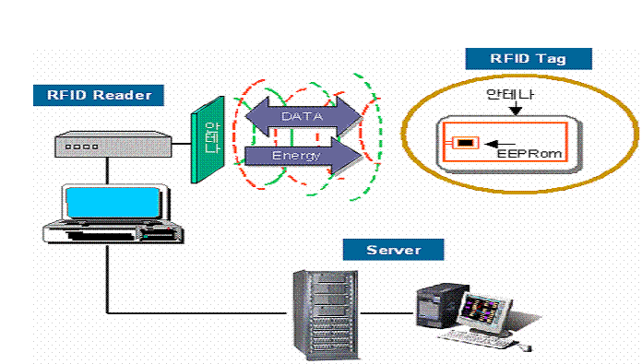
RFID
Concept of RFID
Reader
Tag
c
r
f
Tag : identification device with a chip and antenna
Reader : A transmitter that reads the contents of
RFID tags in the vincinity
1

Slide 4
RFID Privacy Problem
The contents of an RFID tag can be read after the item leaves
the supply chain
RFID tags are difficult to remove
RFID tags can be read without your knownledge
RFID tags can be read a greater ditances with a high-gain antenna
RFID tags with unique serial numbers could be linked to an
individual credit card number
2

Slide 5
Indistinguishability-Based Privacy(1/2)
The indistinguishability-based privacy implies that an adversary
cannot distinguish between any 2 tags in the tag set T that has not
been corrupted.
This definition can be easily extended with many tags.
3

Slide 6
Indistinguishability-Based Privacy(2/2)
Break
Ti,Tj
learning
Adversary
If Tc=Tc’ , then break successes.
Else, break fails.
Ti,Tj
Randomly
selecting
Tc
Adversary
Tc
Tc’
An adversary A (p,t) breaks the ind-privacy if the probability of breaking is at least p and the running time is at most t
If there exists no adversary who can (p,t) break the strong ind-privacy, then the system is (p,t) ind-private.
4

Slide 7
Unpredictability-Based Privacy(1/2)
The unpredictability-based privacy implies that an adversary
cannot recognize a tag with coin tosses.
The only difference is that the adversary is allowed to corrupt
the challenge tag(s) in the learning stage of backward privacy
experiment and in the guess stage of forward privacy experiment,
respectively.
5

Slide 8
Unpredictability-Based Privacy(2/2)
Break
Ti
learning
Adversary
If Tc= Tc’, then break successes.
Else, break fails.
Ti,not Ti
Randomly
selecting
Tc
r,f
Adversary
r,f
Tc’
An adversary A (p,t) breaks the unp-privacy if the probability of breaking is at least p and the running time is at most t
If there exists no adversary who can (p,t) break the strong unp-privacy, then the system is (p,t) unp-private.
6

Slide 9
Relations(1/4)
Extended unp-privacy:
Extended unp-privacy is the same as unp-privacy except one step.
This step is defined as follows:
The adversary is allowed to challenge many test messages rather
than only one test message as in the unp-privacy experiment.
…
Ti,not Ti
Randomly
selecting
Tc
r1,f1
r2,f2
…
r1,f1
r2,f2
Adversary
Tc’
Eunp-Privacy
Unp-Privacy
7

Slide 10
Relations(2/4)
Eunp
Break with sequence of
r
f
Ind
Break with sequence of
r
Not Ind-privacy
If break with successes
r
f
then break with successes, too
Not Unp-privacy
r
But…
8

Slide 11
Relations(3/4)
Polynomial Time Predictable Test(PTPT)
y=f(x)
f(*)
select
y
decide
x
or
T
or
Random y
Random
Pseudo Random Function(PRF) :
Even though the output wouldn’t be truly random, any
adversary in PTPT wouldn’t be able to tell the difference
Indexing: each function has a unique index.
Polynomial time evaluation : given an index and an argument x, F(k,x) is computed in polynomial time.
Pseudorandomness : No PTPT adversary for F.
9

Slide 12
Relations(4/4)
PRF
Unp-privacy
No adversary can decide the key(index) exactly
No PTPT adversary
Eunp-privacy
Ind-privacy
Unp-privacy
PRF
10

Slide 13
New RFID Protocol
New Protocol
Reader
Tag
c(computed randomly)
I=Fk(ctr||pad1)
r1=Fk(c||I) (ctr||pad2)
ctr = ctr +1
r=r1||I
The reader searches for the tuple using I as an index in an exact match
If such tuple does not exist, the reader looks up for a tuple which satisfies the message computing rule in an exhaustive search.
11

Slide 14
Conclusion
This protocol requires less cost for tags than other protocols
This protocol provides more reliable privacy than other protocols
This protocol is most efficient in identifying a tag in normal
situation with provably strong unp-privacy.
12

Slide 15
Thank You

