Slide 1
New Directions In Cryptography
Made Harta Dwijaksara, Yi Jae Park

Slide 2
Contents
Introduction
Conventional Cryptography
Public Key Cryptography
One-Way Authentication
Problem Interrelations
Problem Trap Doors
Computational Complexity
Q&A

Slide 3
Introduction
The best known cryptographic problem is that of privacy: preventing the unauthorized extraction of information from communications over an insecure channel

Slide 4
Conventional Cryptography (1/2)
Symmetric-key algorithms
Encipher: transmitter generates a plaintext P, produces the ciphertext C, C=S_{K}(P)
The key K is transmitted only to the legitimate receiver via a secure channel
Decipher: receiver decipher C by operating: S_{K}⁻¹(C)=S_{K}⁻¹(S_{K}(P))=P
CRYPTANALYST
P
MESSAGE
SOURCE
P
TRANSMITTER
RECEIVER
P=SK ⁻¹(C)
C=SK(P)
K
KEY
SOURCE
Notes:
Section II인 Conventional Cryptography에서는 Terminology와 threat environments를 소개
왜 secure channel을 plaintext P를 주고 받는데 못 쓰냐를 설명 for reasons of capacity or delay.

Slide 5
Conventional Cryptography (2/2)
Computationally secure
Unconditionally secure: one time pad(OTP)
Computationally infeasible
Threats
Ciphertext Only Attack
Known Plaintext Attack
Chosen Plaintext Attack (IFF attack)

Slide 6
Public Key Cryptography (1/4)
Symmetric key algorithm has some problems => Public key cryptography
CRYPTANALYST
P
MESSAGE
SOURCE
P
TRANSMITTER
RECEIVER
P
KEY
SOURCE #1
KEY
SOURCE #2
Flow of information in public key system

Slide 7
Public Key Cryptography (2/4)
Public key cryptosystem: a pair of families {E_{K}}_{K ∈{K}} and {D_{K}}_{K∈{K}} of algorithms representing invertible transformations,
E_{K}:{M}→{M} D_{K}:{M} →{M}
on a finite message space {M}
1) for every K in {K}, E_{K} is the inverse of D_{K} 2) for every K in {K} and M in {M}, the algorithms E_{K} and D_{K} are easy to compute 3) for almost every K in {K}, each easily computed algorithms equivalent to D_{K} is computational in feasible to derive from E_{K} 4) for every K in {K}, it is feasible to compute inverse pairs E_{K} and D_{K} form K

Slide 8
Public Key Cryptography (3/4)
Concepts
Y = a_{X} mod q (1 ≤ X ≤ q-1) Easy to compute
X = log_{a}Y mod q (1 ≤ Y ≤ q-1) Difficult
Key exchange Concepts
User i place this in public: Y_{i} = a^{Xi} mod q
Key in Communication between User i and User j (K_{ij}): K_{ij} = a^{XiXj} mod q
User i obtains K_{ij}: K_{ij} = Y_{j}^{Xi} mod q = (a^{Xj})^{xi} mod q = a^{XjXi} = a^{XiXj} mod q
User j obtains K_{ij}: K_{ij} = Y_{i}^{Xj} mod q
Other User can obtains K_{ij} by “K_{ij} = Y_{i}^{(logaYj)} mod q”. But.

Slide 9
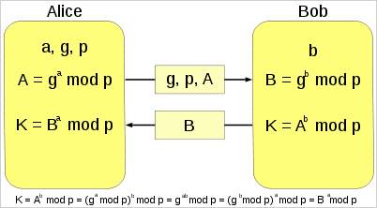
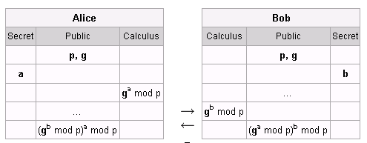
Public Key Cryptography (4/4)
Concepts

Slide 10
One-Way Authentication
Authentication is at the heart of any system involving contracts and billing
It must be easy for anyone to recognize the signature as authentic, but impossible for anyone other than the legitimate signer to produce it
Login problem in a multiuser computer system
One-way function
Public key cryptosystem can be used to produce a true one-way authentication system

Slide 11
Interrelation (1/4)
A cryptosystem which is secure against known plaintext attack (KPA) can be used to produce a one-way function
P₀
Take:
1. {S_{K}:{P} → {C}}_{KE{K}} ➔ secure against KPA
2. Fix P = P₀
Consider:
f:{K} → {C} defined by f(X) = S_{X}(P₀)
Conclusion:
This function is one-way because solving for X given f(X)
is equivalent to cryptanalytic problem of finding the key
from single known plaintext cryptogram pair.
X
Plaintext
Key
Cipher text
Y = f(x)

Slide 12
Interrelation (2/4)
One-way functions are basic to both block ciphers and key generators
A key generator is a pseudorandom bit generator whose output, key stream, is added modulo 2 to message represented in binary form, in imitation of a one-time pad
key
The key is used as “seed”
which determines the
pseudorandom key stream
sequence
Key Generator
10001010101001
added modulo 2 (XOR)
Message
01011110001110
11010100100111

Slide 13
Interrelation (3/4)
For the system to be secure, computation of the key from the key stream must be computationally infeasible
While, they system to be usable, calculation of the key stream from the key must be computationally simple
A good key generator is one-way function

Slide 14
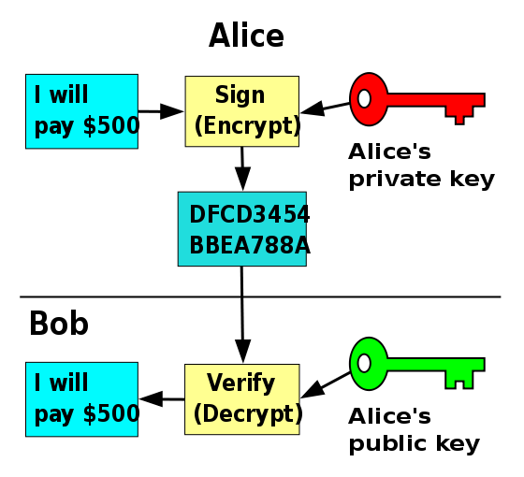
Interrelation (4/4)
A public key cryptosystem can be used to generate a one-way authentication
Authentication ➔ Digital Signature
Alice wants to send M to Bob
computes C = D_{alice’s PriK} (M) → to Bob
Bob received message C and
Computes E_{alice’s PubK} (C) → recover M
Then, Bob can used the value of C as
a proof that the message come from
Alice

Slide 15
Trap Door (1/2)
The previous case shows that without information about deciphering key, by knowing only the enciphering key and the message C → it is computationally infeasible to find message M
As such a public key system is really a set of trap-door one-way functions
For such function, only through knowledge of certain trap-door information can one easily find the easily computed inverse

Slide 16
Trap Door (2/2)
A trap-door cryptosystem can be used to produce a public key distribution system
key
plaintext
B’s trap door
cryptosystem
B’s trap door
cryptosystem
trap door
key
Computed
cryptogram
User A
User B

Slide 17
Computational Complexity (1)
Neither public key cryptosystem nor one-way authentication system can be unconditionally secure because the public information always determines the secret information uniquely among the member of finite set
The cryptosystem is analogous with
set mapping from infinite set to finite set
(because the use of modulus)
With unlimited computation, the problem
could therefore be solved by
Straightforward search
public information
secret information

Slide 18
Computational Complexity (2)
The cryptanalytic difficulty of a system whose encryption and decryption operations can be done in P (polynomial) time can not be greater than NP (non-deterministic polynomial)
Cryptanalytic problem can be solved by
finding key, inverse image, etc → finite set
Choose the key non-deterministically and verify
in P time that it is the correct one
Since, by assumption, encryption takes only P time
the cryptanalysis takes only NP time
NP
P

Slide 19
Conclusion
This paper basically introduces a new away to encrypt/decrypt message
Previous way → one key is used both for encryption and decryption.
New way → used different key for encryption and decryption
There are two things suggested:
Public key system
One-way authentication system based on public key

Slide 20
Q&A
Thank You!

