Slide 1
Markov Ciphers and Differential Cryptanalysis
20103575 Jung Daejin
20103453 Lee Sangho

Slide 2
Contents
DC
Markov
Cipher
PES
IPES

Slide 3
Differential Cryptanalysis (1)
CPA by Biham & Shamir
Analyze the differences to find a secret key from r-round iterated block cipher (particular pairs of plaintexts, corresponding ciphertexts)
Difference (△X = X ⊗ X^{*-1})
i-round Differential (α,β) (△X=α, △Y(i)=β)

Slide 4
Differential Cryptanalysis (2)
Find an (r-1)-round differential (α,β) such that max [P(△Y(r-1)=β|△X=α)]
Choose X, X* that have △X=α
Encrypt X, X* with Z(real key) => Y(r), Y*(r)
Find subkey Z^{(r)} that fits△Y(r-1)=β and count it.
Repeat 2~4 until most-often-counted subkey Z^{(r)} appeared.

Slide 5
Differential Cryptanalysis (3)
Hypothesis of Stochastic Equivalence
For an (r-1)-round differential (α,β),
for almost all subkey values(w₁,…,w_{r-1})
Computation of a differential probability, subkeys are independent & uniformly random
P(△Y(r-1)=β|△X=α) ≫ 2^{-m} iff block cipher with independent subkey round function is vulnerable to DC

Slide 6
Differential Cryptanalysis (4)
Complexity of DC
If stochastic equivalence is true,
m : block length
r : # of encryption
If then DC cannot succeed

Slide 7
Markov Cipher (1)
Markov Chain
Sequence of discrete random variable v₀, v₁, … ,v_{r}
if
Homogeneous
if is independent of i for all α,β

Slide 8
Markov Cipher (2)
Markov Cipher
iterated cipher with round function Y = f(X, Z)
with “right” definition of difference for group operation ⊗
for all choices of α,β(≠e)
is independent of γ
When subkey Z is uniformly random
=> Markov cipher

Slide 9
Markov Cipher (3)
R-round iterated Markov Cipher, subkeys : independent , uniformly random
=> sequence of Differences is homogeneous Markov Chain
(△X : uniformly distributed over non-neutral element )
=> Stationary Markov Chain

Slide 10
Markov Cipher (4)
Transition probability matrix of homogeneous Markov Chain(∏)
(i,j) element of ∏^{(r)} : P(△Y(r)=α_{j}|△X=α_{i}) = p^{(r)}_{ij}
=>r-round differential probability (α_{i,} α_{j} )

Slide 11
Markov Cipher (5)
For all Markov chain △Y(0), △Y(1)… steady-state probability distribution => for every differential (α,β)
If stochastic equivalence holds also, => Secure against DC after sufficiently many rounds.

Slide 12
PES (1)
PES(64)
Block Size : 64 bit
Key Size : 96 bit
X ⊗ Z_{A}^{(i)} =(X₁⊙Z₁^{(i)}, X₂⊙Z₂^{(i)}, X₃⊞Z₃^{(i)}, X₄⊞Z₄^{(i)})
⊙ : multiplication modulo 2^{n}+1
⊞ : addition modulo 2^{n}
n : sub block size(block size/4)
PES is Markov cipher under the definition of difference (△X = X ⊗ X^{*-1} )
Notes:
PES는 세개의 그룹 연산을 가지는 block cipher입니다.
세개의 그룹 연산 : ~~~~~
and Difference를 위해서 하나의 연산을 더 정의한다. 그리고 difference를 위처럼 정의한다.
PES의 standard는 PES64이다. PES64는 위다.

Slide 13
PES (2)
PES(8), PES(16) <n=2, n=4> Same computational graph
Uniform distribution => steady-state probability of differences
PES(8), PES(16) are secure against DC after sufficient many round
Notes:
PES(8)과 PES(16)도 PES64와 똑같은 same computational graph를 가진다.
Because of, 샬라샬라
그리고 PES(8) (16)의 경우에는 uniform distribution 샬라샬라
그래서 이경우에 많은 라운드 후 안전.

Slide 14
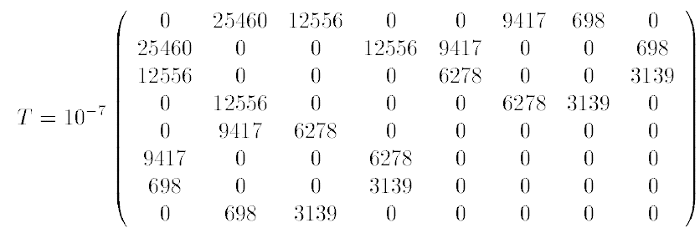
PES (3)
PES(64)
8 most probable one-round differential △X α_{i}=(0,0,0,γ_{i}) (i=1…8)

Slide 15
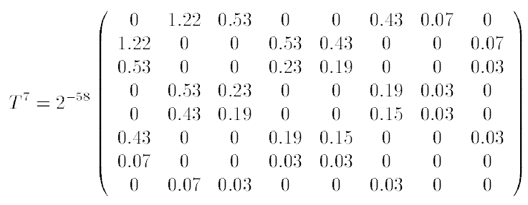
PES (3)
Approximation to 7-round differential
At least 2⁵⁹ Encryption required(1.22×2⁻⁵⁸ is largest)
Symmetric Matrix

Slide 16
PES (4)
Symmetric Matrix
Because of Involution property of round function
If one round differential P(A|B) = P(B|A) P_{2i}(A|A) ≒ [P_{2i}(B|A)]^{2i} P_{2i+1}(B|A) ≒ [P_{2i}(B|A)]^{2i+1}
Transition probability matrix of a Markov cipher should not be symmetric

Slide 17
IPES (1)
Does not change design principle of PES
Only modification => each 7 round permutation => no permutation on last round

Slide 18
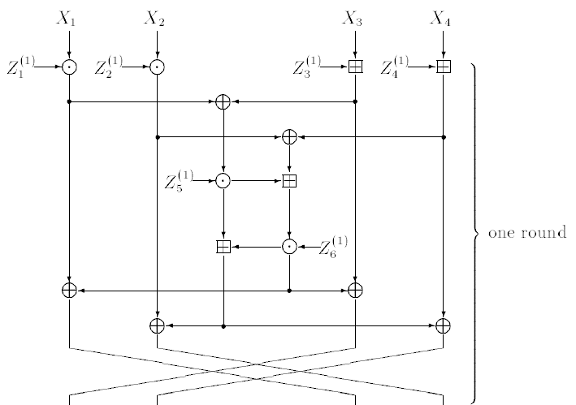
IPES (2)
The First Round of PES

Slide 19
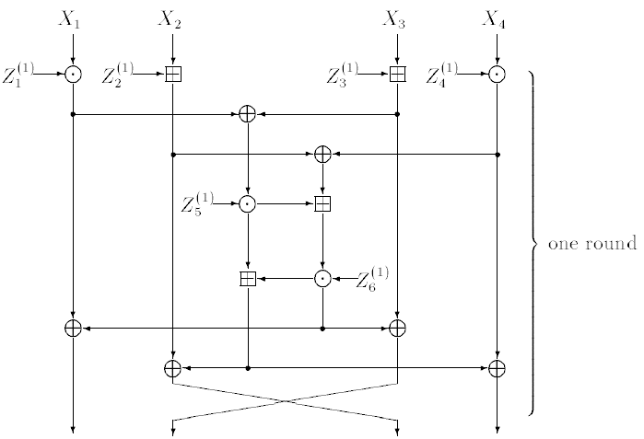
IPES (2)
The First Round of IPES

Slide 20
IPES (3)
Because of modification
1.TPM is not symmetric.
2.The most probable one-round differential
PES : 2⁻⁹
IPES : 2⁻¹⁸
=> after 3-round, the probability << 2⁻⁶⁴

Slide 21
Conclusion
The Secure cipher against DC must be,
1. Markov cipher with “appropriate” difference.
2. TPM should not symmetric.

Slide 22
Thank you!!
Q & A

