Slide 1
Cryptanalysis of C2
Lee, Jae-song

Slide 2
Table of Contents
Intro: Structure of C2
Recovering S-box
Intro to Boomerang Attack
Recovering Key
Recovering Both S-box and Key

Slide 3
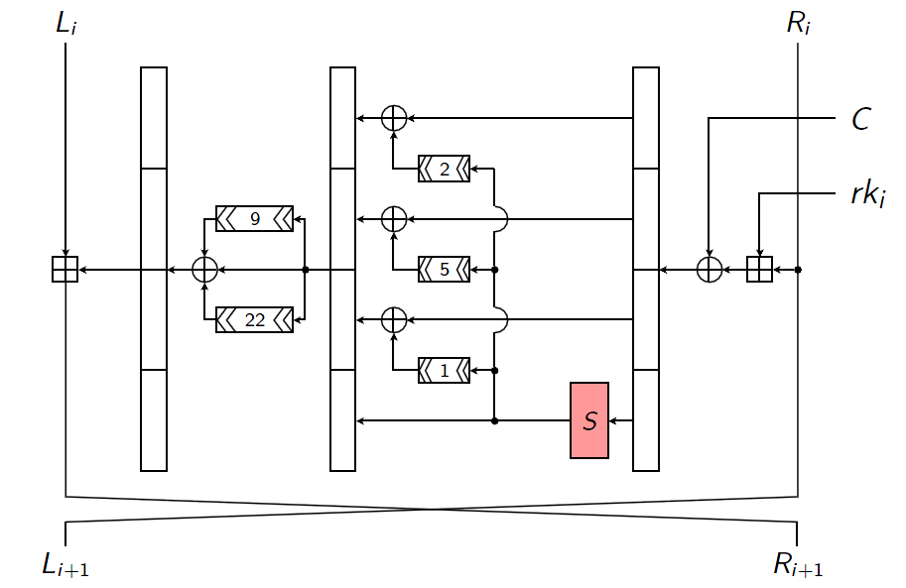
C2 is...
U_{i}
Z_{i}
X_{i}
Feistel-like block cipher
ADD instead of ⊕
64-bit input 54-bit key 10-round
Used in DVD DRM

Slide 4
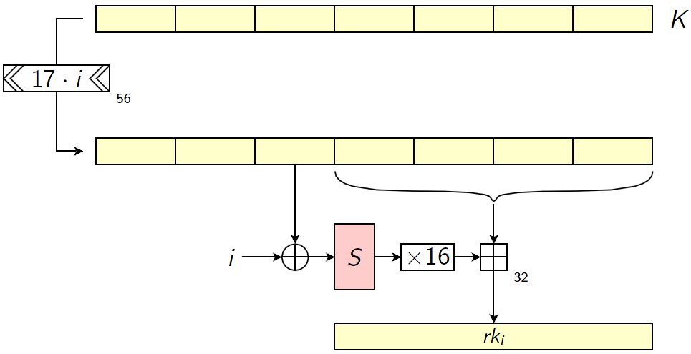
Subkey Generation
10-round → 32-bit 10 subkeys

Slide 5
Cryptanalysis Points
Only ADD and S-box are nonlinear
S-box is trade secret!
We even don’t know any subkey
S-box as part of key: (2⁸)^(2⁸) = 2²⁰⁴⁸ possibilities

Slide 6
Three Attack Scenarios
Unknown S-box (brute-force: 2²⁰⁴⁸)
Chosen-plaintext, Chosen-key (2²⁴)
Known S-box, Unknown Key (2⁵⁶)
Chosen-plaintext (2⁴⁸)
Unknown S-box and Key (2²¹⁰⁴)
Chosen-plaintext (2^{53.5})

Slide 7
Basic of Chosen-key Attack
Generally, Choose “weak key” so each subkey has little encryption effect
However, We don’t know subkeys!

Slide 8
Finding a Weak Master Key
rk_{i} = K[a] + ( S[b] << 4 )
Make only few inputs for S

Slide 9
Master Key
Master Key =
0x40, 0x84, 0x88, 0x40, 0x02, 0x80, 0x09.
Inputs of S-box:
0x88, 0x04, 0x27, 0x27, 0x04,
0x04, 0x27, 0x27, 0x88, 0x88.
If we know S[0x04], S[0x27], S[0x88], we can compute all subkeys

Slide 10
First Attack Scenario
U_{i}
Z_{i}
X_{i}
Let S’ = {0x04, 0x27, 0x88}
3 S-box entries: (2⁸)³ possibilities
For each possibility, precompute “good” plaintext
test if plaintext is encrypted as expected

Slide 11
First Attack Scenario
U_{i}
Z_{i}
X_{i}
If guess is right:
Passes test
If guess is wrong:
Wrongly passes with probability 2⁻²⁹
Totally 2²⁴ computation to recover subkeys

Slide 12
First Attack Scenario
U_{i}
Z_{i}
X_{i}
Now we know all subkeys
Recover remaining S-box entries
Requires <2²⁴ computations

Slide 13
Precomputing Good Plaintext
Finding a “good” plaintext is done at precomputation step
It must not trigger any unknown S-box entry in 7 rounds
How to find them efficiently?

Slide 14
Precomputing Good Plaintext
Fix X₁[0..7], X₂[0..7], X₃[0..7], X₄[0..7] as some arbitrary values of S’
Now, we know
R₁[0..7] ~ R₄[0..7]
L₂[0..7] ~ L₅[0..7] (L_{i+1} = R_{i})
U₂[0..7] ~ U₄[0..7] (R_{i+1} = U_{i}+L_{i})
U_{i}
Z_{i}
X_{i}

Slide 15
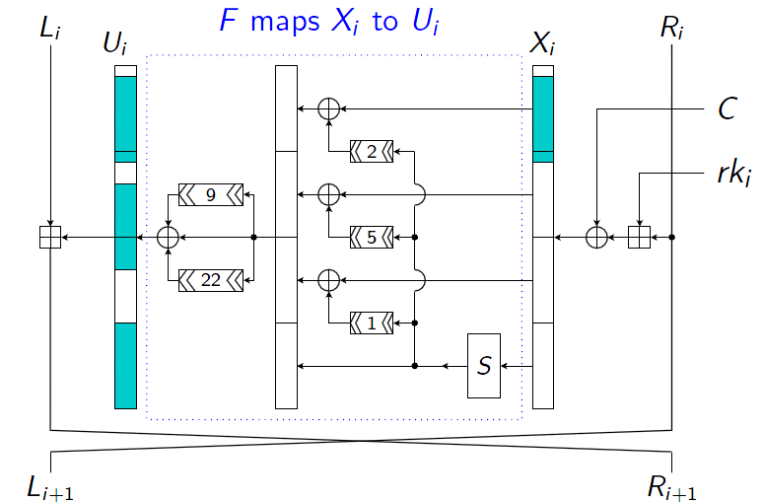
Precomputing Good Plaintext
Let U_{i} = F(X_{i})
For 8-bit z, F(X⊕(z << 23))[0..7] = F(X)[0..7]⊕z
Useful to “adjust” X_{i} values

Slide 16
Precomputing Good Plaintext
Choose X₂[8..31] and X₃[8..31] randomly
Adjust X’₂, X’₃ s.t.
X’₂ = X₂ ⊕ (x << 23)
X’₃ = X₃ ⊕ (y << 23)
F(X₂)[0..7] ⊕ x = R₁[0..7] + R₃[0..7] (= F(X’₂)[0..7])
F(X₃)[0..7] ⊕ y = R₂[0..7] - R₄[0..7] (= F(X’₃)[0..7])

Slide 17
Precomputing Good Plaintext
Compute L’₀, R’₀ from X’₂, X’₃
This safisties the condition for round 2 ~ 5
Compute many values to find the value which satisfies the condition for round 1, 6, 7
Complexity: (256/3)^3 = 2^19.25

Slide 18
Recovering S-box
Now we know three entries of S-box
Recover last 3 subkeys and corresponding S-box entries
Now 3~6 entries recovered

Slide 19
Recovering S-box
Generate plaintext which only trigger known S-box entries in 7 rounds (same as previous method)
Recover S-box of round 8 ~ 10
Do it again until all values are recovered
Complexity = 2^20.2

Slide 20
Boomerang Attack
In the second and third attacks, we will use an extended diffential attack called Boomerang attack
Chosen-plaintext & chosen-ciphertext

Slide 21
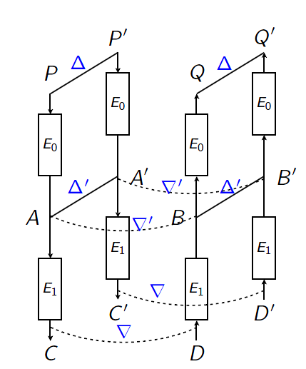
Boomerang Attack
Let P, P’, Q, Q’ four plaintext
C = E(P), C’ = E(P’), D = E(Q), D’ = E(Q’)
Break whole cipher into two parts: E(P) = E₁(E₀(P))
Ex) n/2 rounds each

Slide 22
Boomerang Attack
Δ = P⊕P’, E₀(P’)=E₀(P)⊕Δ’
∇ = C⊕D, E₁⁻¹(D)=E₁⁻¹(C)⊕∇’
Suppose (Δ, Δ’) and (∇, ∇’) are two characteristics for E₀ and E₁⁻¹

Slide 23
Boomerang Attack
E₀(Q) ⊕ E₀(Q’) = B ⊕ B’ = E₁⁻¹(D) ⊕ E₁⁻¹(D’) = E₁⁻¹(C⊕∇) ⊕ E₁⁻¹(C’⊕∇) = A⊕∇’ ⊕ A’⊕∇’ = A ⊕ A’ = Δ’
Then Q ⊕ Q’ = Δ

Slide 24
Differential Characteristic of C2
U_{i}
Z_{i}
X_{i}
We need differntial characteristic independent to S-box.
Δ[0..7] = R_{i}[0..7] ⊕ R’_{i}[0..7] = 0

Slide 25
Differential Characteristic of C2
U_{i}
Z_{i}
X_{i}
The best diffential for 5-round is Δ = (α, β) = (00020800, 80200100) Δ‘ = (β, α) = (80200100, 00020800) with p > 2⁻¹²

Slide 26
Second Attack Scenario*
For a semi-fixed plaintext,
Some keys have boomerang
The others don’t
Try to find boomerang
Its existence gives key bit information

Slide 27
Second Attack Scenario*
Let (L₀, R₀), (L₀⊕α, R₀⊕β) two plaintext
where Δ = (α, β) → Δ’ = (β, α) with p > 2⁻¹²
If diffential holds, difference of L₁ is β = (R₀ + rk₀) ⊕ ((R₀ ⊕ β) + rk₀)
Let c(a,b) the carry bits of a+b
a+b = a ⊕ b ⊕ c(a,b)

Slide 28
Second Attack Scenario*
β = (R₀ + rk₀) ⊕ ((R₀ ⊕ β) + rk₀) = (R₀ ⊕ rk₀ ⊕ c(R₀, rk₀)) ⊕ ((R₀ ⊕ β) ⊕ rk₀ ⊕ c(R₀ ⊕ β, rk₀)) = c(R₀, rk₀) ⊕ β ⊕ c(R₀ ⊕ β, rk₀)
c(R₀, rk₀) = c(R₀ ⊕ β, rk₀)
β[i] rk₀[i] = β[i] c(R₀, rk₀)[i-1]
Whenever β[i] = 1, rk₀[i] = c(R₀, rk₀)[i-1]

Slide 29
Second Attack Scenario*
Whenever β[i] = 1, rk₀[i] = c(R₀, rk₀)[i-1]
β[7] = 1. Fix R₀[0..7] = 0 then c[7] = 0
Therefore, rk₀[8] = 0 if and only if diffential holds if boomerang works
Try to find boomerang and conclude value of rk₀[8]

Slide 30
Second Attack Scenario*
Now we know rk₀[8]
let R₀[0..7] = 0100 0000
If rk₀[8] = 0, c[7] = 0 iff rk₀[7] = 0
If rk₀[8] = 1, c[7] = 0 iff rk₀[7] = 1
Recursively find rk₀[0..7] and similarily rk₀[21..8]
We can’t recover rk₀[22] since β[23..] = 0

Slide 31
Second Attack Scenario
Mount Boomerang to recover 22 bits of first round key (Complexity: 2⁴⁸, probability 0.5)
Recover 8 bits of master key
Brute-force remaining 48 bits (2⁴⁸)

Slide 32
Third Attack Scenario
Combine previous two attacks!
Recover key
Recover S-box

Slide 33
Third Attack Scenario
Mount Boomerang to recover 22 bits of first round key (2^{50.59}, probability 0.99)
Mount Boomerang upside down to recover 22 bits of last round key (2^{50.59})
Recover remaining bits of two round keys and one S-box entry (2*2⁵²)

Slide 34
Third Attack Scenario
Recover second round key (2^{45.3})
Recover master key from 3 subkeys
Recover 4 more S-box entries (4*2⁴⁴)
Recover whole S-box (2¹⁴ * 2²⁴)
Overall complexity: 2^{53.5}

Slide 35
Closing
S-box did not helped diffusion well
If Add is changed to XOR, the diffential has probability 1 (!)
Placing secret value inside cipher is not very useful
Consider Longer key instead
Questions?

Slide 36
References
Cryptanalysis of C2. Julia Borghoff et al. CRYPTO 2009.
Cryptanalysis of C2 (slides).
The Boomerang Attack. David Wagner.

