Slide 1
EPC RFID Tag Security Weaknesses and Defenses: Passport Cards, Enhanced Drivers Licenses, and Beyond
Made Harta Dwijaksara
Park, Yi Jae

Slide 2
Contents
Introduction
Experimental Evaluation of Passport Card and EDLs
Defensive Directions: Backward Compatible Cloning Defense
Co-opting KILL
Co-opting ACCESS
Advantage and Limitation
Experiments with and Extensions to KILL-Based Authentication
Conclusion

Slide 3
Introduction
Explore the systemic risks and challenges created by the increasingly common use of EPC for security applications
Implications of vulnerabilities to overall system security
Suggestions for improvement
Anti-cloning techniques for off-the-shelf EPC tags

Slide 4
Introduction EPC (Electronic Product Code) Tag
Industry-standard RFID devices
Supplant optical barcodes
Identify each item manufactured
Low cost and Relatively Long read range
Class-1 Gen-2 tag
EPC: Creation of Auto-ID Labs, currently managed by EPCglobal

Slide 5
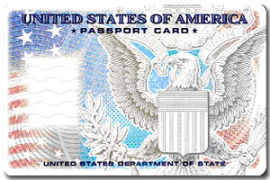
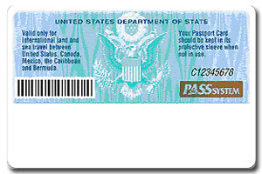
Introduction Passport Card & EDL
EPC tags are now seeing a landmark deployment in the U.S. in identity documents used at national border crossings
Passport Card, EDL

Slide 6
Introduction Passport Card & EDL
Passport Card
Alternative to an ordinary U.S. passport booklet for land and sea travel within North America
Cannot be used for international air travel
Incorporate an EPC tag
EDL (Enhanced Driver’s Licenses)
Regular driver’s license + Passport card
Authors use Washington State EDLs (WA EDLs)

Slide 7
Introduction Vulnerability Analysis
Cloning
The publicly readable data can be straight-forwardly cloned after a single read
Tag Identifier (TID): tag-specific serial number
Readability
Other attacks
EDLs are vulnerable to denial-of-service and covert-channel attacks

Slide 8
Experimental Evaluation of Passport Card and EDLs
Weakness in the TID-based anti-cloning mechanism
Other memory banks
Kill-PIN selection
Read-range experiments

Slide 9
Experimental Evaluation of Passport Card and EDLs Weakness in the TID-based anti-cloning mechanism
The U.S. Department of Homeland Security think that TID can be used to remove the risk of cloning
However, Gen-2 standard only requires TID identify the manufacturer and information about the tag’s capabilities
Authors have cloned a Passport Card and a WA EDL
Also, tag-specific TID does not prevent the emulation of an EPC tag (logical copying)

Slide 10
Experimental Evaluation of Passport Card and EDLs
Other memory banks
The entire EPC memory bank which contains the card’s unique EPC value is readable
Kill-PIN selection
Kill-PIN is unprogrammed and not locked on WA EDLs
Can directly write 32-bit Kill-pin
Can kill a cloned EDL

Slide 11
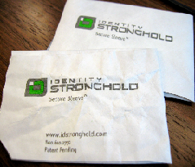
Experimental Evaluation of Passport Card and EDLs Read-range experiments
Read ranges: a major determinant of the vulnerability of an EDL or Passport Card to clandestine cloning attacks and attacks against privacy
Single scan of a tag is sufficient to create a clone
Radio-opaque shielding sleeve
uncertain that EDL and Passport
Card bearers will consistently use
their protective sleeves

Slide 12
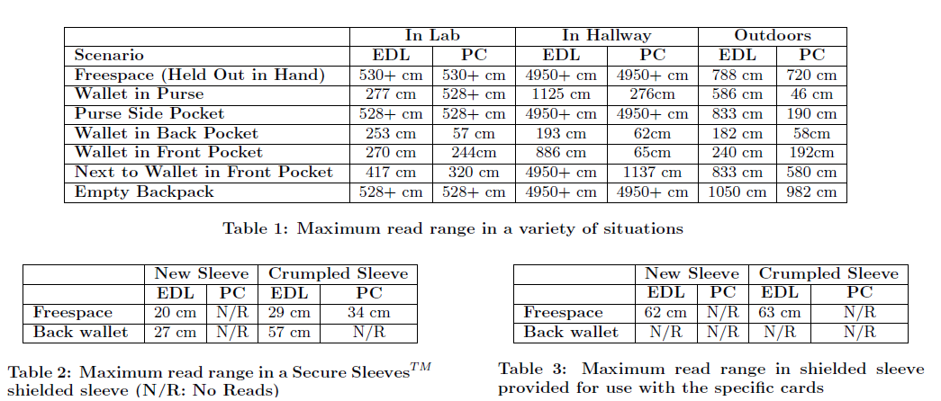
Experimental Evaluation of Passport Card and EDLs Read-range experiments

Slide 13
Defensive Directions: Backward Compatible Cloning Defense
Class-1 Gen-2 has no explicit anti-cloning feature
Co-opting of two Gen-2 access control commands for authentication tag are proposed
Co-opting KILL for tag authentication
Co-opting ACCESS for tag authentication

Slide 14
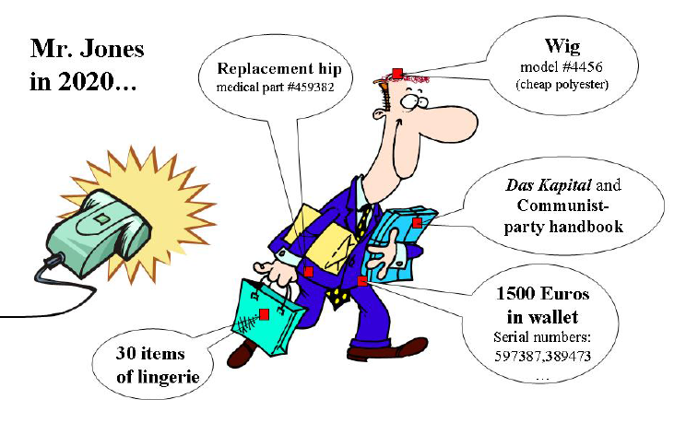
Co-opting KILL (1/3)
The KILL command is an EPC feature designed to
protect consumer privacy by allowing tag to be
disable at the point of sale in retail environments
When the kill command received along with a tag-specific 32-bit KILL PIN P_{kill}, tag becomes permanently inoperative.
This operation is a power intensive operation
Image source: Ari Juels, “RFID Security and Privacy: A Research Survey”. Journal of Selected Areas in Communication (J-SAC), 24(2):381-395, February 2006.

Slide 15
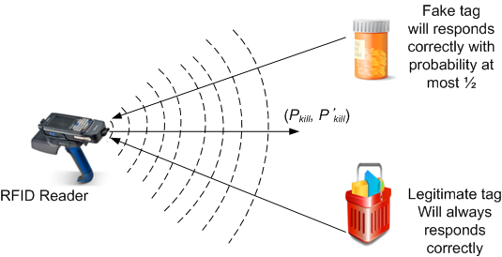
Co-opting KILL (2/3)
A reader with knowledge of P_{kill} can authenticate a tag by
constructing an invalid PIN P’_{kill} and transmitting the pair
(P_{kill} ,P’_{kill}) in random order
A valid tag will acknowledge the correct PIN and reject the
incorrect PIN, an invalid one can respond correctly with the
probability at most ½ (KBA – Kill Based Authentication)
Notes:
While a detection probability of ½ is not high enough for an individual tag, it is high enough for detection of cloning on a systemic basis

Slide 16
Co-opting KILL (3/3)
The challenge of KBA is the reliable transmission of
command in the low-power regime of a target
Too much power and the tag will be killed (permanently
inoperative)
Too little power, and the tag will not respond

Slide 17
Co-opting ACCESS (1/2)
EPC tags can carry secret data D with read-access
control
Such data are readable only through use of the ACCESS
command, with an accompanying tag-specific 32-bit PIN
P_{access}
The Passport Card which analyzed here has both P_{kill} and P_{access} set and locked
But Washington State EDL could have its P_{kill} set and
locked over the air (its P_{access} is already set and locked)

Slide 18
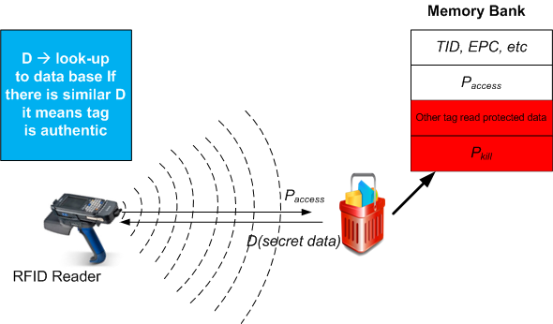
Co-opting ACCESS (2/2)
An entity with knowledge of P_{access} for tag as well as D can
authenticate the tag by checking D
An entity without knowledge of P_{access} cannot extract D
without physically attacking the tag
Known as ACCESS-based authentication (ABA)
Challenge and
Response
Mechanism using
ABA

Slide 19
Advantage and Limitation
KBA is of interest for two reason
ACCESS is optional command in EPC standard
It is possible to deploy ABA and KBA independently
KBA if not carefully implemented may actually kill the
card as side-effect
Neither technique is resistant to eavesdropping, cause
they are ad hoc tools meant to allow authentication in
the absence of cryptography or other supporting features
The most compelling feature of KBA and ABA is their
backward compatibility

Slide 20
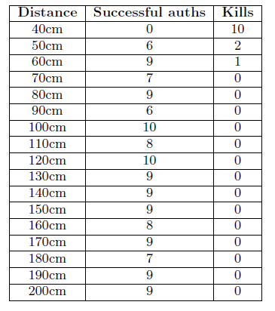
Experiments with and Extensions to KILL-Based Authentication
Simple KILL-based authentication
Reader ramps up the power until it
receives response from a tag
15dBm to 30dBm in 0.25bB increments
When reader successfully receives a replay from the target tag, the power level is fixed
The reader then send N KILL commands,
With N-1 bogus PINs, and 1 real PIN

Slide 21
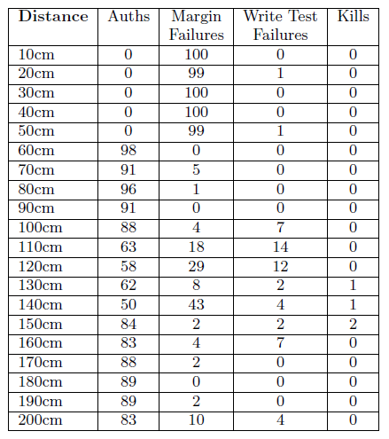
Experiments with and Extensions to KILL-Based Authentication
Scaled KILL-based authentication
Determine the minimum reader power level PW R_{R} to read target
Determine the minimum reader
power level PW R_{W} to write target
Verify PW R_{W} - PW R_{R} ≥ µ (minimum power-margin parameter)
Scale the reader’s power level
PW R_{W} + δ(PW R_{W} - PW R_{R}), δ Є [0,1]
Ensure the power level selected doesn’t allow a tag to write itself

Slide 22
Conclusion
Class-1 Gen-2 tag can be cloned, need multiple security
layer for supporting anti-counterfeiting not just using TID (authentication)
In case of Passport Cards and Enhanced Driver license
implication in the operational setting of border control
are themselves some what more complicated
Employing RFID technology in security sensitive
environment needs government regulation to ensure the security

