Slide 1
Provable Security

Slide 2
Examples: one-wayness
Given a ciphertext, find the corresponding plaintext.

Slide 3
Example : Indistinguishability
Distinguish between encryptions of 2 chosen plaintexts.

Slide 4
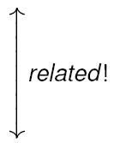
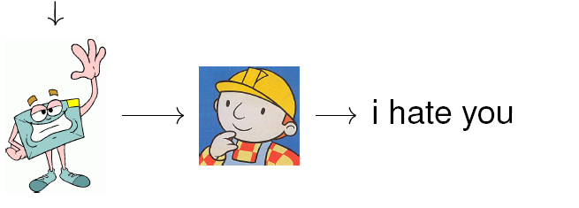
Example : Non-malleability
Given a ciphertext, find another ciphertext s.t.2 ciphertexts related.

Slide 5
History of Provably Secure
Public-key Cryptosystems (Encryption）
1976 1978 1979 1982 1984 1990 1991 1994 1998
DH
RSA
Rabin
GM
NY
DDN
BR
EPOC
CS
(OW-CPA)
(IND-CPA)
(IND-CCAI)
(NM-CCA2)
(Random oracle model)
Concept of public-key
cryptosystem
Proposal of various tricks
Provable security
(Theory)
Practical approach
by random oracle model
Practical scheme
in the standard model

Slide 6
How can we be confident that a given cryptosystem is secure?
Attack found
Try to find an attack
Yes No
Insecure ?
Attack found
Prove the absence of attacks
under some assumptions
Yes
Assumption was false
Notes:
Provable-security is sort of an amazing thing, because at first it seems unbelievable. The usual way to validate a cryptosystem is to search for attacks. If you find you know the cryptosystem is insecure, but as long as you don’t there is always a possibility that there an attack out there, and someone else will find it. Provable security says it is possible to get rid of the question mark; it guarantees there are no attacks. It almost sounds too good to be true, and stated like this it is; there are actually many caveats, which is why we will have to spend time understanding what it is about. But even when all the caveats are taken into account it still delivers something powerful and useful.

Slide 7
Provable Security - Why
Ad hoc security arguments are too skeptical to believe and convince
Proofs improves constructions
Proofs are something everyone can verify (well…)

Slide 8
Provable Security - What
Provable security is composed of
A scheme
A security model
Assumptions
A construction
Theorems
Proofs !
They are tightly coupled into one piece

Slide 9
Provable Security - How
In a nutshell, construct an algorithm, which:
Assume the existence of a winning adversary
Accepts a hard problem instance
Simulate an environment for the adversary according to the model
Using the adversary, answers the hard problem instance
Thus arriving at a contradiction

Slide 10
How to Prove the Security of Cryptosystems
To prove the security (intractability of breaking) directly
･･･very hard (as hard as to solve the P vs NP problem)
To prove the security relatively
(e.g., A cryptosystem is secure assuming that
factoring is hard.)

Slide 11
Limitations in Provable Security
Models are abstractions
They simplify the problem, by omitting subtleties
Some ignores
Protocol composition
Real-world deployment
Will not help if
Implementation is incorrect
Keys are compromised
There are real attacks not covered in the model
Proof is incorrect
Scheme is misused. …

Slide 12
Evolution of provable security: 1982-1995
Theoretical foundations
Glodwasser-Micali: Probabilistic Encryption
Hardcore bits for RSA & other one-way functions
Existence of provably secure schemes
Some efficient schemes e.g. Blum-Goldwasser
But minimal impact on practice
Notes:
The field has been changing. It originated in the work of Goldwasser and Micali and at first it was mostly a domain of theoreticians. Practioners did not seem to care much, and meanwhile theoreticians had their hands full solving the hard foundational problems associated with the development of so powerful an idea, and so they weren’t looking too much at practice either. In fact by the nineties, theory and practice were diverging, both technically and socially.

Slide 13
Evolution of provable security: 1995-present
Efficient proven secure schemes: RSA-OAEP, Cramer-Shoup
Adoption of proven-secure cryptosystems in Standards:
- RSA-OAEP in PKCS#1 v2.0, P1363a
- DHIES in ANSI X 9.63, P1363a, SECG
Standards bodies and even NIST ask for proofs supporting submissions.
Provably secure cryptosystems are widely deployed.
Notes:
Today, it’s not like that. Proofs are popular in practice. Provably-secure cryptosystems are being put into standards. Standards bodies, both industrial and
Government, even ask that submissions be supported by proofs or that designs target theoretical notions of security. Due to the standardizations, provable-secure cryptosystems are in widespread use.
What is making this happen? Well, it is sort of a case of supply meeting demand. In the mid-nineties electronic commerce was the big thing and demand for cryptography as well as security concerns were growing rapidly. This lead to technical developments and also to greater efforts to communicate between theoreticians and practioners.

Slide 14
A growing audience
Provable-security is no longer just for theoretical
cryptographers. Product developers, security architects and users want to know:
Which systems to use
How different cryptosystems compare
Notes:
A consequence of this is that more people and different types of people as compared to before want to understand something about provable-security. An application designer wanting to use a cryptosystem sees several proven-secure choices with competing claims: which is better? A user wanting to install a cryptosystem is in the same position. There are press articles suggesting one scheme might be better than another; to believe or not?
So the goal of this talk is to try to tell you something about this approach and especially about the practical side of it. In deciding how to do this I decided to begin at the beginning, in part due to this fact that the audience is growing, meaning I will explain how it works from scratch, hopefully not boring the experts too much.

Slide 15
A public-key encryption scheme is specified by 4 algorithms:
[Setup] Select security parameter, 1^{k}
[KeyGen] Key generation algorithm K
[Encryption] algorithm E
[Decryption] algorithm D
k
coins
K
(pk, sk)
pk
M
sk
M
E
C
C
D
channel
coins
Adversary
Notes:
The first thing we do is fix the type of objects we are dealing with. These are public-key encryption schemes. Any such scheme is specified by three algorithms, namely the ones indicated. Certification of keys is not part of the current problem; assume this has been correctly done and anyone holding a public key is asssured it is authentic.

Slide 16
How to Prove IND-CCA

Slide 17
Ideal Worlds
To prove the security of efficient schemes, cryptographic primitives are replaced by their ideal counterparts.
Random oracle model: hash function=random function
Ideal cipher model: block cipher=random permutation
Generic model: concrete group= blackbox group
There are cryptosystems which are (probably) secure in the random oracle model, but insecure when the random function is replaced by a concrete hash function. All known examples are pathological.

Slide 18
How to prove IND-CCA
C*
Simulating the answers of DO without the secret key
C
Adv
DO
Secret key
m /invalid
Attack result on C*
IND-CPA
（indistinguishable against passive attacks ）
IND-CCA

Slide 19
Defining IND
Informally
Key generator generates a key pair
Message finder F get the public key and chooses 2 messages, m₀, m₁.
Line tapper T gets 2 plaintexts and the encryption of one of them and answers 0 if he thinks the encrypted message is m₀ and 1(null) otherwise.
Both message finder and line tapper may encrypt (polynomially many) plaintexts with arbitrary keys (CPA)
When m₀ is encrypted the probability that T answers 0 should be negilibly bigger than when m1 is encrypted.

Slide 20
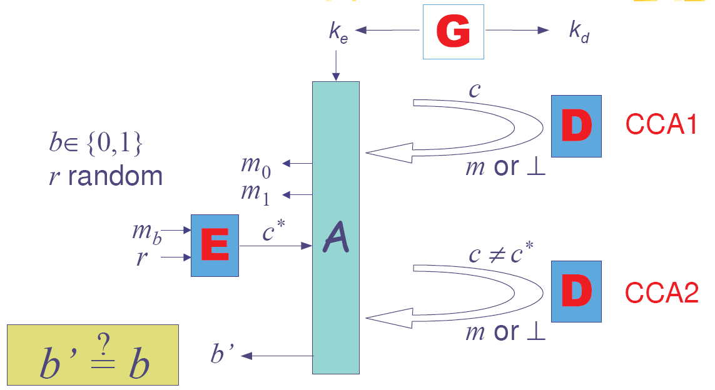
IND-CCA2

Slide 21
RSA
OW-CPA (RSA Problem)
OW-CCA2 : no (ciphertext binding)
IND-CPA: no (encrypt the 2 plaintexts and compare)

Slide 22
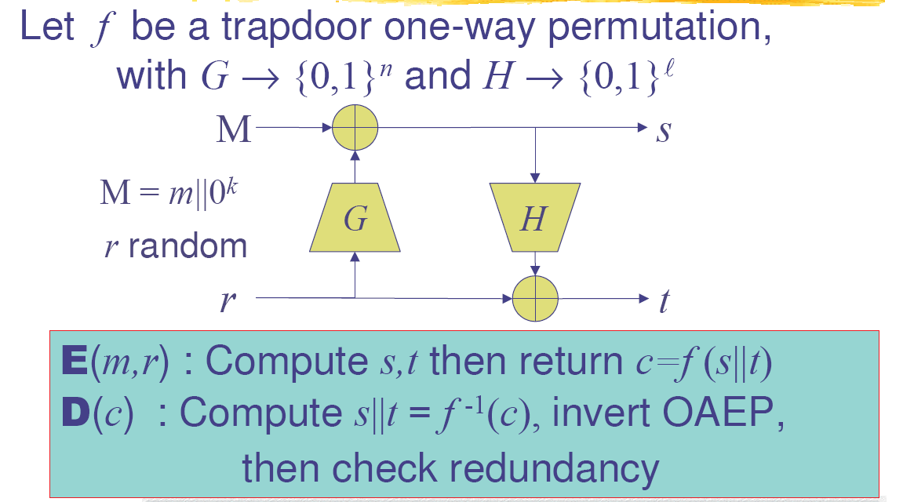
OAEP –[BR94]

Slide 23
RSA-OAEP

Slide 24
OAEP: Security Level

Slide 25
Micali-Goldwasser
Encryption (basically):
1 -> 0 a random square modulo n
0 -> a random non-square modulo n
Security
IND-CPA : reduction to QRA
OW-CCA2: no (multiplying- y attack)

Slide 26
ElGamal

