Slide 1



Public Key Cryptography
History
Elementary Number Theory
RSA
DH
ECC
Others

Slide 2
Problem of Sym. Cryptosystems
Key management
  Keep secret (private) key must be stored in safe !!
  Over complete graph with n nodes, _{n}C₂ = n(n-1)/2 pairs secret keys are required.
  (Ex.) n=100, 99 x 50 = 4,950 keys
a
b
e
(a,b), (a,c), (a,d), (a,e), (b,c),
(b,d), (b,e), (c,d), (c,e), (d,e)
c
d

Slide 3
Merkle’s Puzzle (I)
Merkle registered Fall 1974 for L. Hoffman’s course in computer security at UC, Berkeley.
Hoffman wanted term papers & proposal.
Merkle addressed “Establishing secure communications between separate source sites over insecure communication lines”
Hoffman didn’t understand Merkle’s proposal and asked him to write precisely 2 times.
Merkle dropped the course, but continued working.
Key idea : Hiding a key in a large collection of puzzles. (Later he proposed knapsack PKC) Secure Communication over Insecure Channels” CACM, pp.294-299,1978.

Slide 4
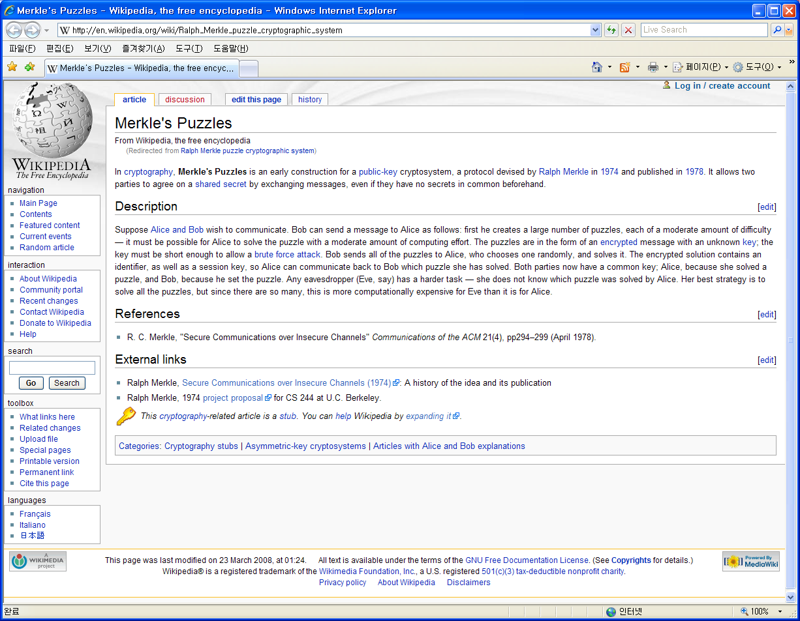
Merkle’s Puzzle (II)

Slide 5
Concepts of PKC(I)
One-way function
  Given x, easy to compute f(x).
  Difficult to compute f⁻¹(x) for given f(x).
Easy to f(x)
x
f(x)
Difficult to x !!!
Ex) f(x)= 7x²¹ + 3x³ + 13x²+1 mod (2¹⁵-1)

Slide 6
Concepts of PKC(II)
Trapdoor one-way function
  Given x, easy to compute f(x)
  Given y, difficult to compute f⁻¹(y) in general
  Easy to compute f⁻¹(y) for given y to only who knows certain information called as “trapdoor information”
Easy to f(x)
x
f(x)
Easy ^^
Trapdoor info.

Slide 7
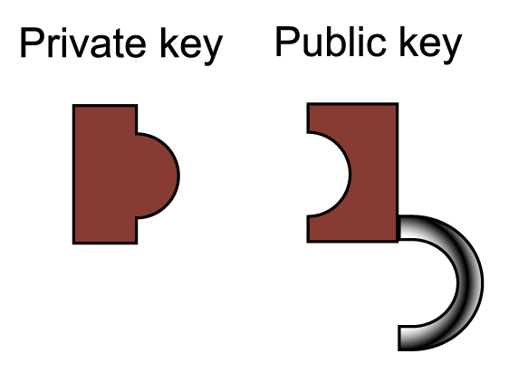
History of PKC
Diffie & Hellman, “New directions in Cryptography”, IEEE Tr. on IT. ,Vol. 22, pp. 644-654, Nov., 1976.(*)
Terminology
  2-key or Asymmetric Cryptosystem
    private(secret) key, public key
Properties
  Need Public-key Directory or CA(Certificate Authority)
  Slow operation relative to symmetric cryptosystem
* James Ellis, “The possibility of non-secret encryption”, 1970, - released by British GCHQ (Gov’t Comm. Headquarters), Unclassified 1997

Slide 8
Usage of PKC (I)
For Confidentiality
- Encrypt M with Bob’s public key : C = e_{K}(M, B_{p} )
- Decrypt C with Bob’s private key : D = d_{K}(C, B_{s})
* Anybody can generate C, but only B can recover C to M.
C
M
e_{k}( , )
d_{k}( , )
M
Public directory
Alice : A_{p}
Bob : B_{p}
Chaum : C_{p}
.
.
B_{S}
B_{P}

Slide 9
Usage of PKC (II)
For authentication (Digital Signature)
Encrypt M with Alice’s private key : C = e_{K} (M, A_{s})
Signing
Decrypt C with Alice’s public key : D = d_{K} (C, A_{p})
Verification
* Only Alice can generate C, but anybody can verify C.
C
M
M
e_{k} ( , )
d_{k}( , )
Public directory
Alice : A_{p}
Bob : B_{p}
Chaum : C_{p}
.
.
A_{s}
A_{p}

Slide 10
Usage of PKC (III)
Using together with symmetric cryptosystem
  Data encryption – symmetric
  Key agreement - asymmetric
Digital Signature
Applicable to other cryptographic protocols
  e-mail,
  e-cash,
  e-voting,
  e-commerce , etc.

Slide 11
Known PKC
Number theory-based PKC
  Diffie-Hellman(’77)
  RSA scheme (‘78) : R.L.Rivest, A.Shamir, L.Adleman, “A Method for Obtaining Digital Signatures and Public Key Cryptosystems”,CACM, Vol.21, No.2, pp.120-126,Feb,1978
  Rabin scheme (‘79): breaking Rabin = factorization
  ElGamal scheme (‘85): probabilistic
Knapsack-based PKC (NP problem)
  Merkle-Hellman(79), Chor-Rivest(’83), etc
McEliece scheme (‘78) : coding theory
Elliptic Curve Cryptosystem(‘85): Koblitz, Miller
Polynomial-based PKC
  C*(’90-) : Matsumoto-Imai, Patarin
  Lattice Cryptography(’97-): NTRU
Non Abelian group Cryptography(’00-): Braid group

Slide 12
Elementary Number Theory

Slide 13
Division
Let Z denote the set of all integers.
Division Theorem (a,b∈ Z)
  For nonzero b, ∃ q,r ∈ Z s.t. a=qb+r, 0 ≤ r <b
Divide
  b divides a, or b|a iff ∃ c∈Z s.t. a=bc (i.e. r=0)
  If a|b, then a|bc
  If a|b and a|c, then a|(bx+cy)
  If a|b and b|a then a= ±b
  If a|b and b|c, then a|c
Prime
  An integer p is called prime if its divisors are ±1 and ±p
  If a prime p divides ab, then p|a or p|b

Slide 14
Congruence
Congruence
  Def) a ≡ b (mod n) iff n|(a-b) (i.e. (a%n)=(b%n))
  a ≡ a
  a ≡ b iff b ≡ a
  If a ≡ b and b ≡ c then a ≡ c
Residue Class Group: Z_{n}={x∈Z| 0 ≤ x< n}
  Addition: a+b = (a+b mod n)
  Multiplication: ab =(ab mod n)
  Closed under addition, subtraction, and multiplication
  Closed under division if n is prime

Slide 15
Euclid Algorithm
a=qb+r ➔ gcd(a,b)=gcd(b,r)
Find gcd(a,b)
  a₀=a, b₀=b
  For j ≥ 0, a_{j+1}=b_{j}, b_{j+1}=a_{j}%b_{j}
  When b_{k}=0, stop and return gcd(a,b)=a_{k}
  The number of iterations will be at most 1+2log₂min{a,b}
  E.g.) gcd(4200,1485)
Extended Euclidean Algorithm (EEA)
  Find s and t such that gcd(a,b)=sa+tb
Multiplicative inverse of a ∈ Z_{m}
  The multiplicative inverse of a is a⁻¹ ∈ Z_{m} s.t.
  aa⁻¹=a⁻¹a=1 mod m
  a⁻¹=s if sa+tb=1

Slide 16
Fermat Little Theorem
Euler totient function
  ϕ(n)=the number of positive integers < n with gcd(x,n)=1
  ϕ(p^{e})=p^{e}-1
  ϕ(nm)= ϕ(n) ϕ(m)
  ϕ(pq)=(p-1)(q-1)
  m=Π_{i=1}^{n} p_{i}^{ei}, ϕ(m)=Π_{i=1}^{n}(p_{i}^{ei -} p_{i}^{ei -1})
Fermat Little Theorem
  a^{p-1}=1 mod p if gcd(a,p)=1
Euler Theorem
  a^{ϕ(n)}=1 mod n if gcd(a,n)=1
  a^{ϕ(n)-1} is the multiplicative inverse of a mod n

Slide 17
RSA

Slide 18
Who is RSA ?

Slide 19
RSA Scheme (I)*
For large 2 primes p,q
n=pq , φ(n)=(p-1)(q-1) : Euler phi ft.
  φ is a one-way function
Select random e s.t. gcd(φ(n), e) = 1
Compute ed = 1 mod φ(n) -> ed = kφ(n) +1
Public key = {e, n}, private key = {d, p,q}
For given M in [0, n-1],
  Encryption, C = Me mod n
  Decryption, D = C^{d} mod n
  (Proof) C^{d} = (Me)^{d} = M^{ed} = M^{kφ(n) +1} = M {M^{φ(n)}}^{k} = M
* Clifford Cocks, “A note on non-secret encryption”, 1973
Unclassified by British GCHQ (Gov’t Com. Headquarters), 1997

Slide 20
RSA Scheme (II)
p=3, q=11
n = pq = 33, φ(n) =(p-1)(q-1)=2 x10 = 20
e = 3 s.t. gcd(e, φ(n) )=(3,20)=1
Choose d s.t. ed =1 modφ(n), 3d=1mod 20, d=7
Public key ={e,n}={3,33}, private key ={d}={7}
M =5
  C = Me mod n = 5³ mod 33 =26
  M =C^{d} mod n = 26⁷ mod 33= 5

Slide 21
RSA Scheme (III)
p=2357, q=2551
n = pq = 6012707
φ(n) = (p-1)(q-1) = 6007800
e = 3674911 s.t. gcd(e, φ(n) )=1
Choose d s.t. ed =1 modφ(n), d= 422191
M =5234673
  C = Me mod n = 5234673 ³⁶⁷⁴⁹¹¹ mod 6012707
  = 3650502
  M =C^{d} mod n = 3650502 ⁴²²¹⁹¹ mod 6012707
  = 5234673

Slide 22
Fast Exp. Algorithm(I)
Square-and-multiply
INPUT : g ∈Z_{n}, e=(e_{t}e_{t-1}…e₁e₀)₂ ∈ Z_{n-1}
OUPTUT : g^{e} mod n
1. A =1
2. For i from t down to 0 do the following
2.1 A = A • A mod n
2.2 If e_{i}=1, then A = A • g mod n
3. Return(A)

Slide 23
Fast Exp. Algorithm(II)
(Ex) g^{283,} t=8, 283=(100011011)₂
i 8 7 6 5 4 3 2 1 0
e_{i} 1 0 0 0 1 1 0 1 1
A g g² g⁴ g⁸ g¹⁷ g³⁵ g⁷⁰ g¹⁴¹ g²⁸³
Complexity
  t+1 : bit length of e
  wt(e) : Hamming weight of e
    t+1 times: A*A mod n , wt(e)-1 times: g * A mod n
    0 ≤ wt(e)-1 < |e| ➔ |e|/2 in average
  e.g.) |n|=1024 ➔ requires 1536 modular multiplication

Slide 24
Fast Decryption using CRT
Those who know p and q want to compute M=C^{d} mod n where n = pq efficiently.
Compute C^{d} mod p, C^{d} mod q using Chinese Remainder Theorem(CRT)
  d₁=d mod (p-1) ➔ M₁=C^{d} mod p=C^{d1} mod p
  d₂=d mod (q-1) ➔ M₂=C^{d} mod q=C^{d2} mod q
  Use CRT to compute M from M₁ and M₂
  since M=M₁ mod p and M=M₂ mod q
4 times faster than direct computation

Slide 25
RSA Challenge
Digits
Year
MIPS-year
Algorithm
RSA-100
RSA-110
RSA-120
RSA-129
RSA-130
RSA-140
RSA-155
RSA-160
RSA-174^{*2}
RSA-200
‘91.4.
‘92.4.
‘93.6.
‘94.4.(AC94)
‘96.4.(AC96)
‘99.2 (AC99)
’99.8
’03.1
’03.12
‘05.5
7
75
830
5,000
?
?
8,000
Q.S.
Q.S
Q.S.
Q.S.
NFS
NFS
GNFS
Lattice Sieving+HW
Lattice Sieving +HW
GNFS+HW
MIPS : 1 Million Instruction Per Second for 1 yr = 3.1 x 10¹³ instruction.
*2: 576bit http://www.rsasecurity.com./rsalabs , 768-bit by 2010 (published),
expected: 1024-bit by 2018

Slide 26
RSA-160
Date: Tue, 1 Apr 2003 14:05:10 +0200
From: Jens Franke
Subject: RSA-160
We have factored RSA160 by gnfs. The prime factors are: p=45427892858481394071686190649738831\ 656137145778469793250959984709250004157335359 q=47388090603832016196633832303788951\ 973268922921040957944741354648812028493909367
The prime factors of p-1 are 2 37 41 43 61 541 13951723 7268655850686072522262146377121494569334513 and 104046987091804241291 . The prime factors of p+1 are 2^8 5 3 3 13 98104939 25019146414499357 3837489523921 and 128817892337379461014736577801538358843 .
The prime factors of q-1 are 2 9973 165833 11356507337369007109137638293561 369456908150299181 and 3414553020359960488907.
The prime factors of q+1 are 2^3 3 3 13 82811 31715129 7996901997270235141 and 2410555174495514785843863322472689176530759197.
The computations for the factorization of RSA160 took place at the Bundesamt für Sicherheit in der Informationstechnik (BSI)
in Bonn. Lattice sieving took place between Dec. 20, 2002 and Jan. 6, 2003, using 32 R12000 and 72 Alpha EV67.
The total yield of lattice sieving was 323778082. Uniqueness checks reduced the number of sieve reports to 289145711.
After the filtering step, we obtained an almost square matrix of size with 5037191 columns.
Block Lanczos for this matrix took 148 hours on 25 R12000 CPUs.
The square root steps took an average of 1.5 hours on a 1.8 GHz P4 CPU,
giving the factors of RSA160 after processing the 6-th lanczos solution.
F. Bahr J. Franke T. Kleinjung M. Lochter M. Böhm
http://www.loria.fr/~zimmerma/records/rsa160

Slide 27
RSA-200
Date: Mon, 9 May 2005 18:05:10 +0200 (CEST)
From: Thorsten Kleinjung
Subject: rsa200
We have factored RSA-200 by GNFS. The factors are
p=35324619344027701212726049781984643686711974001976\ 25023649303468776121253679423200058547956528088349 and
q=79258699544783330333470858414800596877379758573642\ 19960734330341455767872818152135381409304740185467
http://www.loria.fr/~zimmerma/records/rsa200

Slide 28
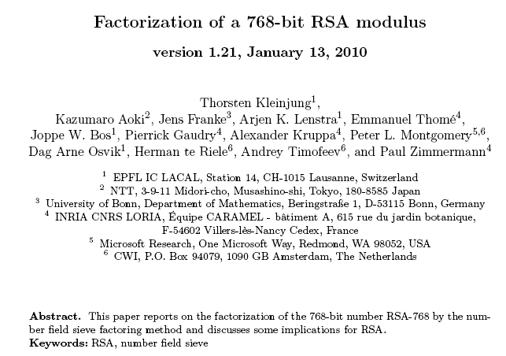
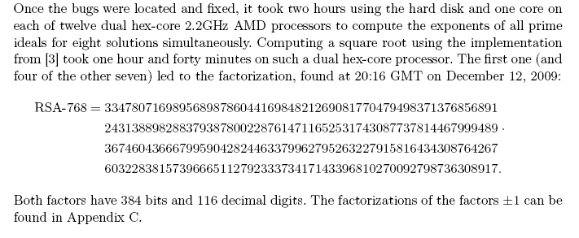
RSA-232 (768 bit)

Slide 29
Choosing p and q for RSA Scheme
|p| ≈ |q| to avoid ECM
p-q must be large to avoid trial division
p and q are strong prime
  p-1 has large prime factor r (Pollard’s p-1)
  p+1 has large prime factor (William’s p+1)
  r-1 has large prime factor (cyclic attack)

Slide 30

Security of RSA Scheme(I)
Common modulus attack
  use m pairs of (e_{i}, d_{i}) given n=pq
(Cryptanalysis)
  User m₁ : C₁ = M^{e1} mod n
  User m₂ : C₂ = M^{e2} mod n
  If gcd(e₁,e₂)=1, there are a and b s.t. ae₁ + be₂ = 1.
  Then, (C₁)ª(C₂)^{b} mod n = (M^{e1})ª(M^{e2})^{b} mod n
  = M^{ae1+be2} mod n = M mod n

Slide 31
Security of RSA Scheme(II)
Bit Security : partial information like {Jacobian, LSB, parity, half} of m leaked by the ciphertext c= m^{b} mod n → Semantic Security!
Non-malleabilty (NM) : difficulty to get partial information
(or distinguishability of 2 ciphertexts) under certain computational assumption
Special Attack
  Cyclic attack f^{p}(C)=C where f(x) = x^{e} mod n
  ; if we know cycle p, we can recover the plaintext at collusion point.
  Special form
    Pr{C= k⋅ p or m⋅ q} = 1/p + 1/q -1/pq
    Pr{C= M} = 9/pq
  Exhaustive search of n or solve quadratic equation
  Low encryption exponent(e=3) ⬅ Lattice attack
  Multiplicative attack : (M₁e) (M₂e) mod n = (M₁ x M₂ ) ^{e} mod n
  → Homomorphism: Good or Bad !!!

Slide 32
OAEP(I)
OAEP(Optimal Asymmetric Encryption Padding) by Bellare and Rogaway in EC94 suggested ad hoc methods of formatting blocks prior to RSA encryption.
OAEP ties the security of RSA encryption closely to that of the basic RSA operation.
While existing message formatting methods for RSA encryption have no known flaw, the provable security aspects of OAEP are very appealing.
PKC #1 V2.0 (1998)

Slide 33
OAEP(II)
Let n=k-k₀-k₁ and f,G,H be such that
  f : {0,1}^{k} -> {0,1}^{k} ; trapdoor permutation,
  G : {0,1}^{k0} ->{0,1}^{n+k1} ; random generator,
  H :{0,1}^{n+k1} ->{0,1}^{k0} ; random hash function
To encrypt x∈ {0,1}^{n}, choose a random k₀-bit r and compute the ciphertext y as y=f(x0^{k1}⊕ G(r) || r ⊕ H(x0^{k1} ⊕ G(r)))
The above encryption scheme achieves non-malleabibility and chosen-ciphertext security assuming that G and H are ideal (IND-CCA2).
OAEP+ by Schoup’01

Slide 34
RSA Variants

Slide 35
Rabin Scheme(I)
Scheme
  Select s.t. p and q = 3 mod 4
  n=pq, public key =n, private key =p,q
  y= e_{k}(x)=x (x+b) mod n
  x=d_{k}(y)= √y mod n
  Choose one of 4 solutions using redundancy
Square root
  No known deterministic poly alg. to compute square roots of quadratic residues mod p. (but Las Vegas Algorithm exists)
  If p=3 mod 4, (±C^{(p+1)/4})²=C mod p
  If n=pq, there are four square roots of a quadratic residue.
Security = Factorization (provable security)

Slide 36
Rabin Scheme(II)
(Ex) p=7, q=11, n=p q=77, b=9
e_{k}(x)=x(x+9) mod 77
d_{k}(y)= √(1+y)-43 mod 77
(Decryption)
(1) If ciphertext y=22,
√(1+y) mod 77= √23 mod 77 → ±10, ± 32 mod 77 by CRT
(2) Then, choose one of
10-43 mod 77=44, (77-10)-43 mod 77=24,
32-43 mod 77=66, (77-32)-43 mod 77=2
using redundancy of plaintext

Slide 37
Discrete Logarithm Problem

Slide 38
Cryptography based on Groups
G is a group under a binary operation *
  G is closed under *
  * is associative
  Existence of identity and inverse
  (Abelian) a*b=b*a for arbitrary a and b in G
Example: (Z,+), ((Z/p)*, ×)
Discrete Logarithm Problem (DLP) on G
  G is a group and h, g ∈ G
  Determine the least positive integer x satisfying h=g^{x}

Slide 39
Diffie-Hellman Key Exchange
Goal : Agree on shared secret over insecure channel
Key Generation
  Take an Abelian group G under which DLP is intractable
  Take a generator g of G
Alice
  Take a random integer a and send gª to Bob
Bob
  Take a random integer b and send g^{b} to Alice
Shared Key: g^{ab}=(gª)^{b}=(g^{b})ª

Slide 40
Hard Problems on a group
G: Abelian group with prime order p and g∈G
  DLP: Given h ∈G, find x s.t. g^{x}=h
  CDH: Given g, gª, g^{b} find g^{ab}
  DDH: Given g, gª, g^{b}, g^{c} decide if c=ab mod p
  The problems can be defined on a group with composite order, but their security depends on the largest prime divisor of the order.
Problem Reductions
  IFP > RSA
  DL > CDH > DDH

Slide 41
Which Group is Used
Criteria
  Abelian groups
  The group operation should be simple to realize
  DLP is intractable
Consider the group operation given by simple algebraic formulae
  G is a commutative finite algebraic group
  Equivalent to the product of copies of (add or mult.) finite fields and Jacobians of curves.
Instances
  The multiplicative group of Finite Fields
  Elliptic Curves
  Hyperelliptic Curves

Slide 42
Attack on DLP

Slide 43

Solving DLP
Exhaustive Search : O(p) time, O(1) space
Precomputed Table : O(1) time, O(p) space
Time-memory Tradeoff by Shanks’ BSGS:
O(1) time, O(p) pre-computation, O(p) memory
Square-root method
  Can be applied to any DLP
  Pollard rho: random walk by one kangaroo
  Pollard lambda: Use two kangaroo’s

Slide 44
Shanks’ Baby Step Giant Step
Input : p, α, β,
Output : a where αª = β mod p.
Let m = ⎡√(p-1)⎤
1.compute α^{mj} mod p, 0 ≤ j ≤ m-1
2.sort m ordered pairs (j, α^{mj} mod p) w.r.t. 2nd coordinates,
obtaining list L₁
3.compute βα^{-i} mod p, 0 ≤ i ≤ m-1
4.sort m ordered pairs (i, βα^{-i} mod p) w.r.t. 2nd coordinates,
obtaining list L₂
5.find a pair (j,y) ∈ L₁ and a pair (i,y) ∈ L₂ (i.e., a pair having
identical 2nd coordinates)
6.output mj +i mod(p-1).(α^{mj} =y= βα^{-i}, α^{mj +i=}β →log_{α}β =mj+i)
* Complexity : O(m) time, O(m) memory

Slide 45
Shanks’ algorithm : Example
(Ex.) p=809, find log₃525.
1. α=3, β=525, m = ⎡√(808) ⎤=29
2. α²⁹ mod 809 = 99.
3. ordered pairs (j, 99^{j} mod 809) for 0≤ j ≤ 28
(0,1),…,(10,644),…,(28,81).
4. ordered pairs (i, 525 x(3^{i})⁻¹mod 809), 0 ≤ i ≤ 28
(0,525),…, (19,644),…,(28,163).
5. find match (10,644) in L₁ and (19,644) in L₂
6. thus, log₃525 = 29x10 + 19 =309
7. (Confirmation) 3³⁰⁹ = 525 mod 809

Slide 46
Index Calculus Method
  Input: generator g of cyclic group G of order n and h=gª in G
  Output: a mod n
  (Select a factor base S) Choose a subset S={p₁,p₂,..,p_{t}} of F s.t. a significant proportion of all elements in G can be efficiently expressed as a product of elements from S
  (Collect linear relations)
    Select a random integer k with 0=<k<n, and compute g^{k}
    Try to write g^{k} as a product of primes in S
    Repeat steps 1 and 2 until t+c relations are obtained (c =10)
  (Find the logarithms of elements in S)
    Working modulo n, solve the linear system of t+c equations (in t unknowns) to obtain log_{g}p_{i}
  (Compute a)
    Select a random integer k with 0=<k<n, and compute hg^{k}
    Write hg^{k} as a product of elements in S
    Compute a from the above relation and log_{g}p_{i} (1=<i=<t)

Slide 47
Complexity
Let L_{q}(α,c)=exp(c(log q)^{α} (loglog q)^{1-α})
  If α=0, polynomial time algorithm
  If α>=1, exponential time algorithm
  If 0<α<1, subexponential time algorithm
Square-root method: exp. time
Index Calculus
  G=F_{p} : L_{p} [1/3,c]
  G=F₂^{m}: L₂^{m}[1/2,c]
  G=Elliptic Curve: not working !!!

Slide 48
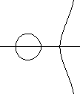
ECC

Slide 49


What is an Elliptic Curve?
Elliptic Curves:
  y² + xy = x³ + a₂x² + a₆ (a₂ , a₆ ∈ GF(q))
Elliptic Curve is not an ellipse => Cubic Curve
Elliptic Curve:
  E(F_{q})={(x,y)  F_{q}  F_{q} | y² + xy = x³ + a₂x² + a₆ } {O}
E(F_{q}) forms a group under addition

Slide 50
Operation of EC
Addition
  (x₁,y₁) + (x₂,y₂) = (x₃,y₃)
    x₃ = A² + A - a₂ - x₁ - x₂, y₃ = - (A + a₁ ) x₃ - B - a₃
    A = ( y₂ - y₁ ) / ( x₂ - x₁ ), B = ( y₁ x₂ - y₂ x₁ ) / ( x₂ - x₁ ) if x₁  x₂
Number of operations in finite field
needed for an addition of points in EC
  Mul : 4
  Div : 2
  Add or Sub : 9
Integer Multiplication :
  nP = P + P + … + P (n  Z, P  E(F₂^{n}))
  3P = P + P + P

Slide 51
D-H Key Exchange over ECC
Goal: Agree on shared secret over insecure channel
Key Generation
  Take a finite field F_{q} and an elliptic curve E over F_{q}
  Take a generator P of E(F_{q})
Alice
  Take a random integer a and send aP to Bob
Bob
  Take a random integer b and send bP to Alice
Shared Key: abP=a(bP)=b(aP) or its x-coordinate
aP or bP can be identified with its x-coor. plus one bit

Slide 52
Hard Problems in ECC
Hard Problem
  DL Problem: find a in Z/n from (P, aP)
  CDH Problem: find abP from (P,aP, bP)
  DDH Problem: determine whether cP=abP from (P,aP,bP,cP)
Consider a DLP on a group of order p
  DLP is equivalent to DHP if we can find an elliptic curve over F_{p} whose number of points are smooth.
  DDH is solved in poly.time on supersingular curve
DLP = DHP > DDHP=poly. time
  The second equality holds for supersingular EC

Slide 53
Security of ECC
General Attack
  Baby-Step Giant-Step for E(F_{q}): O(√q log q)
  Pollard rho for E(F_{q}): O(√q)
  Pohlig-Hellman
  Index calculus (not applicable) !!!
Special Attack
  Subexponential time: singular or supersingular
  Polynomial time: anomalous
Candidate of an EC for secure DLP
  Avoid singular, supersingular, or anomalous curve
  The order must be divided by a large prime factor
  Then breaking ECC takes exponential time!!

Slide 54
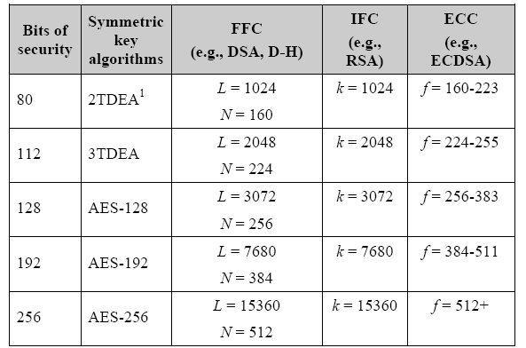
Comparable algorithm key size
Recommendation for the Transition of Cryptographic Algorithm and Key Sizes,
NIST800-121, Jan. 2010.

