Slide 1
Hash Function

Slide 2
Contents
Hash Functions
Dedicated Hash Functions
  Useful for lightweight authentication in RFID system
Message Authentication Codes
  CBC-MAC
  Nested MAC
Collusion Search Attacks
SHA-3

Slide 3
Hash function
Compress a binary string with an arbitrary
length into a fixed short message
Important primitive for digital signature, integrity, authentication, etc.
{0,1}^{d}
d > r
h()
hash, hash code/value/result
message digest, checksum, MIC,
authentication tag, seal, compression
digital fingerprint, imprint
{0,1}^{r}

Slide 4
Configuration
original input, x
hash function, h
append padding bits
preprocessing
append length block
formatted
input x=x₁,x₂,…,x_{t}
iterative processing
x_{i}
compression ft, f
H_{i-1}
f
H_{i}
H₀=IV
H_{t}
g
g : output transformation mapping, e.g., identity mapping
output h(x)=g(H_{t})

Slide 5
Requirements
Compression
One-wayness
  Prei-mage resistance: Given y, it is computationally infeasible to compute x with y=h(x)
  Second Pre-image resistance: Given x and h(x), it is computationally infeasible to compute x’ with h(x)=h(x’)
Collision-free (Prevent internal misuse)
  : It is computational infeasible to find a pair (x, x’), x≠ x’ satisfying h(x)=h(x’).
Efficiency
  Easy to compute h(x) for a given x.

Slide 6
Classification
Whether using key or not
  Keyed hash : MAC (Message Authentication Code)
  Un-keyed hash : MDC (Manipulation Detection Code)
    OWHF(One Way Hash Function)
    CFHF(Collision-Free Hash Function)
What purpose
  MAC
    Block Cipher-Based (DES-CBC MAC)
    Hash Function-Based(HMAC)
  MDC
    Dedicated Hash Functions (MD class, SHS, HAVAL)
    Block Cipher-Based (MDC-2, MDC-4)
    Modular Arithmetic: MASH-1, MASH-2

Slide 7
Birthday Paradox
Probability that 2 persons have the same birthday among r persons : p_{r}
(Assumption) each birthday is independent and uniform in the range 1 to m.
p_{r}=1-(m)^{r} / m^{r} =1- m! / m^{r}(m-r)! ≈ √ e^{-r2/(2m)}
where, (m)^{r} = m(m-1)…(m-r+1)
If r= √m, p_{r} ≈ 0.5 , e.g., m=365, r=23, p_{r}>0.5
↔ n-bit hash function will collide with probability 0.5 after √ (2^{n}) times operation

Slide 8
Merkle-Damgard Construction
Extend Compression ft to Hash ft so that the resulting hash ft to be collusion resistant if compression does.
H₀=IV, H_{i}=f(H_{i-1},x_{i}), 1≤i≤t, h(x)=H_{t}
x₁
x₂
x_{t}
padding
H₀
f
f
f
hashed code
f : h’s primitive hash function (a compression function)
H_{i} : connection variable from i-1 to I

Slide 9
Hash ft (MDC) by block cipher
Matyas-Meyer-Oseas
Davies-Meyer
Miyaguchi-Preneel
x_{i}
H_{i-1}
x_{i}
H_{i-1}
g
E
x_{i}
E
H_{i-1}
g
E
H_{i}
H_{i}
H_{i}
H₀=IV
H_{i}=E_{g(Hi-1)}(x_{i} )  x_{i}
H₀=IV
H_{i}=E_{xi}(H_{i-1} )  H_{i-1}
H₀=IV
H_{i}=E_{g(Hi-1)}(x_{i} )  x_{i} H_{i-1}

Slide 10
Comparison
Hash Function | (n,k,m) | Rate (k/m)
Matyas-Meyer-Oseas | (n,k,n) | 1
Davis-Meyer | (n,k,n) | k/n
Miyaguchi-Preneel | (n,k,n) | 1
MDC-2 (w/DES) | (64,56,128) | ½
MDC-4(w/DES) | (64,56,128) | 1/4
Yield m-bit hash using n-bit block cipher with k-bit key
All of them are secure assuming that a block cipher satisfies required randomness properties

Slide 11
Hash by modular operation
MASH: Modular Arithmetic Secure Hash algorithm
Weakness: Efficiency (and Insecurity)
Quadratic Congruential
  H_{i} = (x_{i} + H_{i-1})² mod N, H₀=0
    where N=Mersenne prime 2³¹-1
  H_{i} = (x_{i} ⊕ H_{i-1})² mod N ⊕ x_{i}
  H_{i} = (x_{i} ⊕ H_{i-1})^{e} mod N

Slide 12
Dedicated Hash Functions

Slide 13
Dedicated Hash Functions
MDx family: proposed by Rivest
  MD4, Crypt 90
  MD5, RFC 1992
SHA family: proposed by NIST
  SHA-0, FIPS-180, 1993
  SHA-1, FIPS-180-1, 1995
  SHA-2 (SHA-256/384/512), FIPS-180-2, 2002

Slide 14
MD4(I)
Preprocessing a message, x
1. Padding: d =(447 -|x|) mod 512
2. Length of a message: n= |x| mod 2⁶⁴,|n|=64 bit
3. M = x ||1||0^{d}||n ⇐ multiple of 512
where || denotes concatenation
* little-endian : W=2²⁴B₄+2¹⁶B₃+2⁸B₂+B₁
(B₁: lowest address)

Slide 15
MD4(II)
Message Block
A
B
C
D
Round
1
Round
2
Round
3
A
B
C
D

Slide 16
Round 1 in MD4
1. A=(A+f(B,C,D)+X[0])<<<3
2. D=(D+f(A,B,C)+X[1])<<<7
3. C=(C+f(D,A,B)+X[2])<<<11
4. B=(B+f(C,D,A)+X[3])<<<19
5. A=(A+f(B,C,D)+X[5])<<< 3
.
.
16. B=(B+f(C,D,A)+X[15])<<<19
where, f(X,Y,Z) = (X ∧ Y) ∨ ((¬X) ∧ Z) , ∨: OR, ∧: AND, ¬:complement, <<<s : circular left rotate by s

Slide 17
Pseudocode of MD4
1. Preprocess: M is 512 * N bits (512 bits=16 words)
2. Define 32 bits constants: A=67452301_{h}, B=efcdab89_{h}, C=98badcfe_{h}, D=10325476_{h}
3. for i=0 to N/16 -1 do (N mod 16=0)
3-1. for j=0 to 15 do X[j] =M[16i+j]
(M[i] : 32 bit string)
3-2. AA=A, BB=B, CC=C, DD=D
3-3. Round 1(for j=0..15), Round 2(for j=16..31),
Round 3(j=32..47)
3-4. A=A+AA, B=B+BB, C=C+CC, D=D+DD
where + is modular addition over 2³².
4. output A||B||C||D||

Slide 18
MD5(I)
Add 4-th rounds (16 steps) in MD4
Change g function in 2 round from symmetric ft (X∧Y) v (X∧Z) v (Y∧Z) to non-symmetric ft (X∧Z) v (Y∧(¬Z))
Modify the access order for message words in Rounds 2 and 3
Modify the shift amounts
Use unique constants in each of the 4×16 steps
Each step is added to the output of a previous step to achieve avalanche effect as earlier as possible.

Slide 19
MD5(II)
Message Block
A
B
C
D
Round
1
Round
2
Round
3
Round
4
A
B
C
D

Slide 20
Primitive ft in MD5
M_{j}
t_{i}
a
b
nonlinear
operation
c
<<<s
d
FF(a,b,c,d,M_{j},t_{i},s)

Slide 21
SHA-1(I)
W _{t}
K_{t}
e_{i-1}
e_{i}
d_{i-1}
d_{i}
c_{i-1}
nonlinear
operation
c_{i}
b_{i-1}
b_{i}
<<<30
a_{i-1}
<<<5
a_{i}
FF(a,b,c,d,M_{j},t_{i},s)

Slide 22
SHA-1(II)
160 bit hashed value (5 words), Big-endian
4 round hash, each round has 20 step
Change internal primitive ft and constants
  (B ∧ C) v ((¬B) ∧ D) 0 ≤ t ≤19
  Ft(B,C,D) = B C D 20 ≤t ≤39
  (B ∧ C) v ((¬B) ∧ D) 40 ≤t ≤59
  B C D 60 ≤t ≤79
Secure Hash Standard(SHS), FIPS Pub 180-1, 1995.

Slide 23
HMAC
Nested MAC algorithm from the composition of two (keyed) hash family
The Keyed-Hash Message Authentication Code (HMAC), FIPS Pub 198, 2002
HMAC_{k}(x) = SHA-1[(K opad) || SHA-1((K ipad) || x)]
where ipad = 3636 …. 36, opad = 5C5C … 5C
K : 512 bit key
x: message to be authenticated
Secure against unknown-key collusion attack



Slide 24
Dedicated Hash Functions
Name | Designer | Year | Bit | Characteristics | Security
MD4 | Rivest (US) | 1990 | 128 | - 32 bit Op., 3 R - Boolean ft of deg 4 | Collision(‘95) (2²⁰ Oper)
MD5 | Rivest (US) | 1991 | 128 | - Modified MD4 - 4 rounds | Primitive Ft Collision(’96)
SHA-1 | NIST | 1993 | 160 | - Modified MD4 - Federal Standard | Collusion Search(‘05)
HAVAL | Seberry et. al (Australia) | 1992 | Var. (128~256) | Exp. of MD5(3,4,5R) - Boolean ft of deg 7 | Collusion Search of HAVAL-128(‘05)
RIPEMD-160 | RIPE (Europe) | 1997 | 160 | - Modified MD4 - Indep. 2 ft | Collusion Search(‘05)
HAS-160 | KISA(Korea) | 1998 | 160 |  | -
SHS: Secure Hash Standard RIPE: Race Integrity Primitive Evaluation

Slide 25
Collusion Search Attack

Slide 26
Flow of Collusion Search by Wang et. al
Find disturbance vector with low Hamming weights (difference for subtractions mod 2³²)
Construct differential paths by specifying conditions so that the differential path will occur with high probabilities.
Generate a message randomly, modify it using message modification techniques, and find a collusion
X. Wang, Y.L. Yin and H.Yu, “Finding Collusions in the Full SHA-1”, Proc. of Crypto2005, pp.17-36, LNCS3621

Slide 27
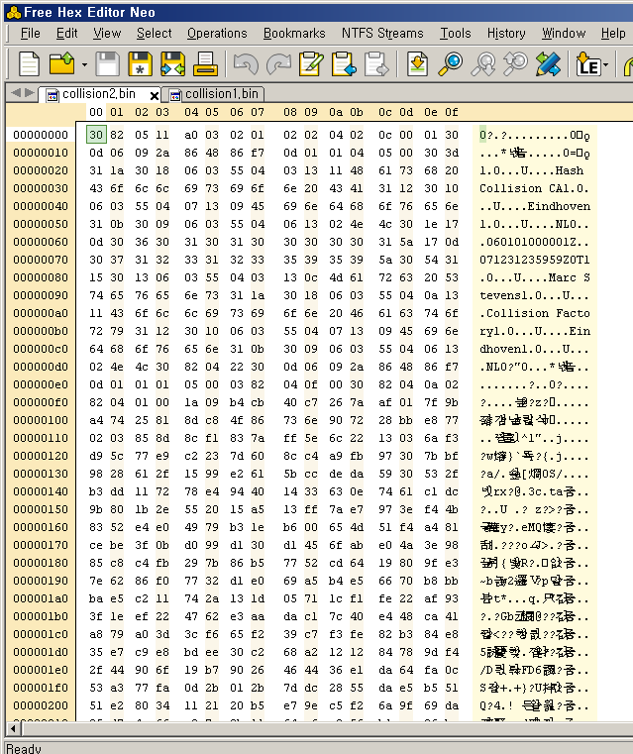
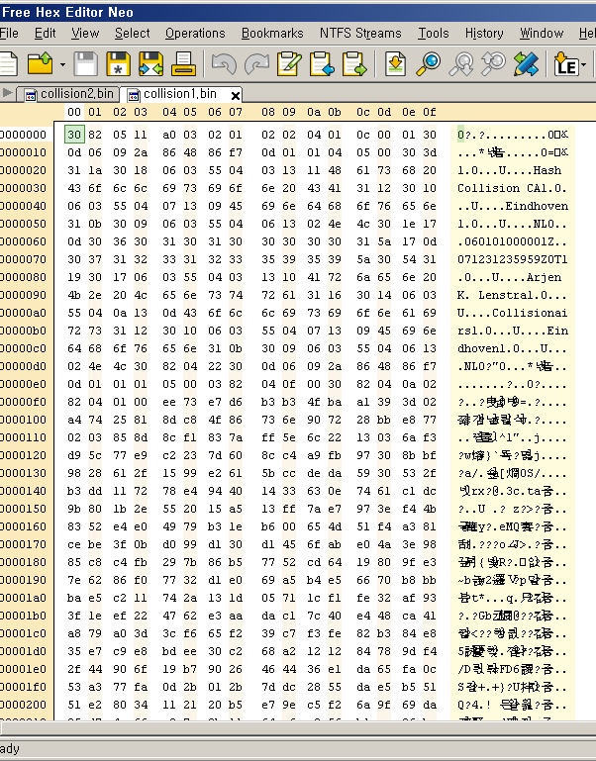
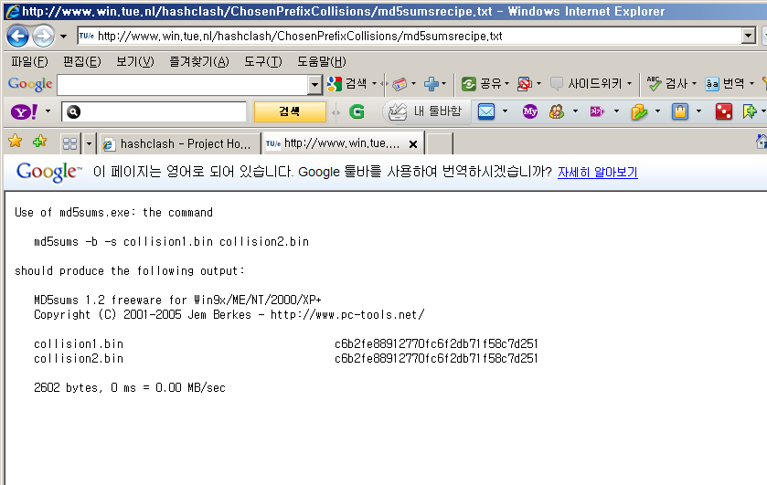
Ex. of MD5 Collisions
Collision1.bin
Collision2.bin
Same MD5 Hashed Value !!

Slide 28
Recent Collision Attack on Hash Functions (I)
Multi-block collision, Joux etc, Crypto 04 Rump Session, Formalized by Biham and Joux etc. in Eurocrypt 05
Independently proposed collision attack with two message blocks for MD5, Wang and Yu at Crypto 04 Rump Session

Slide 29
Collision Attacks and Practical Attacks (II)
PS editor files with same signature, Lucks and Daum, Rump Session in Eurocrypt’05
  R₁ and R₂ is a random collision pair
  Editor software with redundancy
Other editor softwares PDF,TIFF and Word 97, Gebhardt et.al, NIST Hash Function Workshop 2005

Slide 30
Collision Attacks and Practical Attacks (II)
Colliding valid X.509 certificates
  Lenstra, Wang, Weger, forged X.509 certificates， http://eprint.iacr.org/2005/067.pdf
  Same owner with different public keys (2048 bits)
  Stevens, Lenstra, Weger, Eurocrypt 2007
  8192-bit public key (8-block collision)
  Stevens etc. Crypto 2009 (see next slide)
  Pass the browser authentication, different owners, different public keys
  US-CERT：MD5 vulnerable to collision attacks

Slide 31
Real and Rogue Certificate

Slide 32
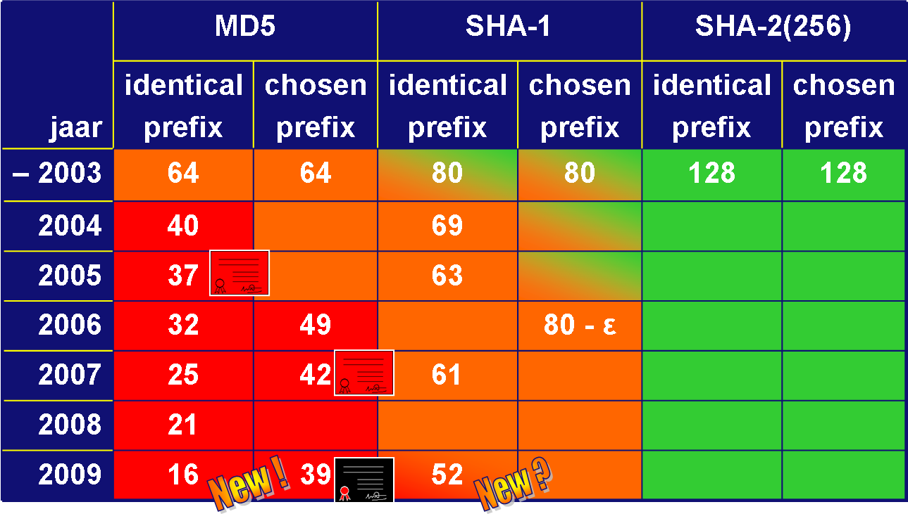
Progress of Collision Attacks
(logarithmic: 38 means 2³⁸ ¼ 1day on 1pc)

Slide 33
SHA-3 Project

Slide 34
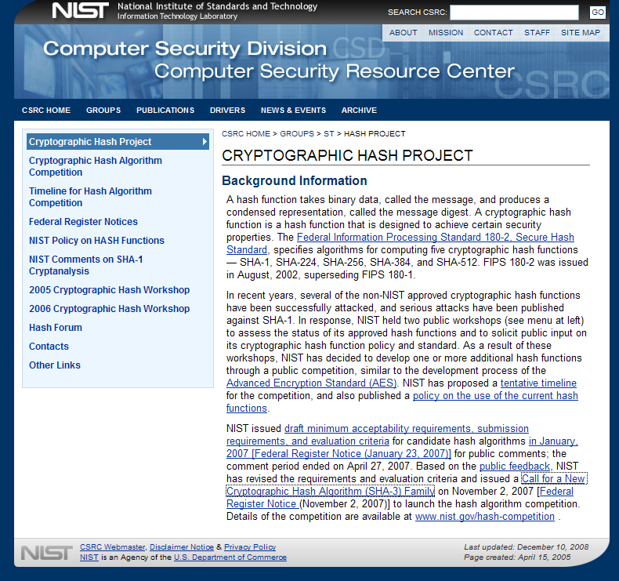
SHA-3 Project

Slide 35
Security Requirements of the Hash Fts
Collision resistance of approximately n/2 bits (2^{n/2} computations)
Pre-image resistance of approximately n bits
Second-preimage resistance of approximately n-k bits for any message shorter than 2^{k} bits (for MD
construction)
Resistance to length-extension attacks ( usually MD construction is prohibited)
Truncating m-bit of the candidate function’s output, the security parameter is m replacing n

Slide 36
Notes on the Security Requirements
Resistance to length-extension attacks
  Resistance to multi-block collision attacks
  Resistance to multi-collision attacks
  Resistance to second preimage attacks of long messages
  and herding attack
Second pre-image resistance of approximately n bits
for messages with any length (strong requirement)
  Security requirements for non-MD constructions

Slide 37
First Round Candidates
2008.10.31, NIST received 64 algorithms
  AES project received 21 algorithms
  More attention to hash functions
2008.12.10：51 algorithms satisfy the Minimum
Acceptability Requirements

Slide 38
Second Round Candidates
Algorithm | Structure
BLAKE | HAIFA
BMW | Wide Pipe
CubeHash | Sponge
ECHO | Wide Pipe, HAIFA
Fugue | Sponge
Grostl | Wide Pipe
Hamsi | Sponge
Algorithm | Structure
JH | Wide Pipe
Keccak | Sponge
Luffa | Sponge
Shabal | Wide Pipe
SHAvite-3 | HAIFA
SIMD | Wide Pipe
Skein | UBI chaining
5 Sponges，2 HAIFAs，5 Wide Pipes，1 Wide Pipe +HAIFA, 1 UBI (14 Candidates selected Jul. 24 2009)

Slide 39
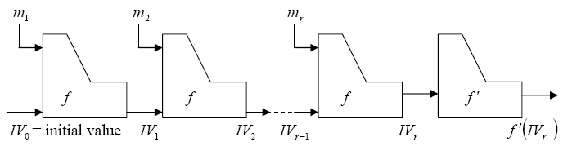
Main Structures of SHA-3 Candidates(1/4)
Wide Pipe, Lucks, Asiacrypt 2005
Compress function：f :{0,1}^{w} × {0,1}^{p} → {0,1}^{w}
Truncation function： f ' :{0,1}^{w} → {0,1}^{n}

Slide 40
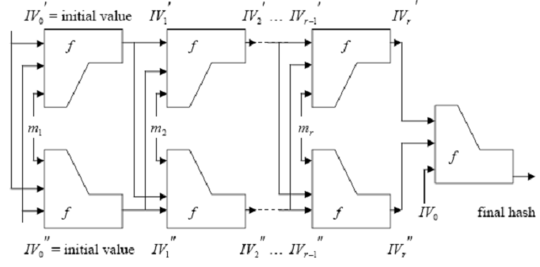
Main Structures of SHA-3 Candidates(2/4)
Double Pipe, Lucks, Asiacrypt 2005

Slide 41
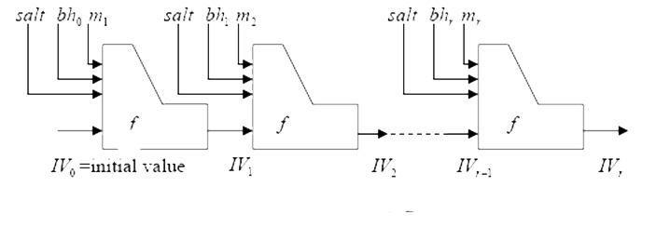
Main Structures of SHA-3 Candidates(3/4)
HAIFA, Biham etc., Cryptographic Hash WorkShop, 2006
Salt+bh_{i}：n/2 bits，the ideal strength for computing second
preimage seems to be 2^{n/2+n/2}
Computational efficiency is (m-n/2)/m times that of MD structure, where n is the output length and m is the message block
size e.g. the output length is 256 bits, message block size is 512 bits, then the efficiency is (512-128)/512=0.75 times

Slide 42
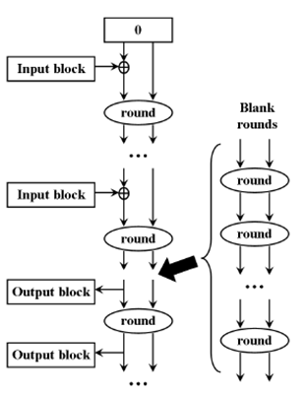
Main Structures of SHA-3 Candidates(4/4)
Sponge, Bertoni etc.，ECRYPT workshop on hash functions, 2007
Provable security
  If each iteration is secure
Building block is a reduced block cipher PANAMA ，RADIOGATúN etc
Building block is a full block cipher

Slide 43
Current Status of SHA-3 Candidates (Mar. 2010)
The SHA-3 Zoo (work in progress) ( http://ehash.iaik.tugraz.at/wiki/The_SHA-3_Zoo)
is a collection of cryptographic hash functions (in alphabetical order) submitted to the SHA-3 contest (see also here). It aims to provide an overview of design and cryptanalysis of all submissions. A list of all SHA-3 submitters is also available.
A year is allocated for the public review of these algorithms, and the Second SHA-3 Candidate Conference is being planned for August 23-24, 2010, after Crypto 2010.
Who will be a new hero in the world ?

