Slide 1

Advanced Information Security
Prof : Kwangjo Kim (Tel. x3550), kkj@kaist.ac.kr, http://vega.kaist.ac.kr/~kkj
TA : Mr. Junhyun Yim
junhyunv@kaist.ac.kr, HP:011-569-5460
Hour :14:40-16:00 (Tu. & Th.)
Credit/Hour : 3/3 Code: CS548
Web page : http://caislab.kaist.ac.kr/Lecture/data/2010/spring/cs548

Slide 2
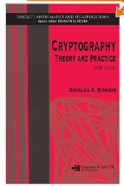
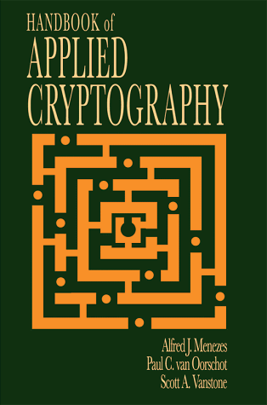
Syllabus
1. Course Description
Since the information security technology is changing fast and evolving each year like an endless battle between honest and dishonest parties, we need to catch up new technologies as early as possible. This course deals with the advanced level on information security and cryptology for the practical and up-to-date applications. The students are encouraged to challenge to understand the latest advances on information security and to practice to write the high-quality security paper based on his/her preference.
2. Textbook
- Handouts
- Douglas R. Stinson, Cryptography-Theory and Practice, 3rd Ed.
CRC Press, 2006, ISBN 1-58488-508-4
- Recommended Reading Material: A. Menezes et al, Handbook of Applied Cryptography, CRC Press, 1997, ISBN 0-8493-8523-7
3. Test and Evaluation
- Midterm Exam: 15%, Final Exam:15% Quiz:5% HW:10%
- Paper Presentation:25%, Term Project : 25% , Attendance 5%

Slide 3
Weekly Lecture
Wk | Contents | Cmt | Wk | Contents | Cmt
1 | Introduction(2/2)/Overview(2/4) |  | 9 | Public Key Cryptosystem (3/30, 4/1)
2 | Overview(2/9)/Classical Cipher(2/11)/ | PP(2/9) | 10 | Paper Presentation #3 (4/6, 4/8)
3 | No class(2/16)/ Block cipher I (2/18) | TP Prop. (2/18) | 11 | Digital Signature (4/13, 4/15)
4 | Paper Presentation #1(2/23, 2/25) |  | 12 | Paper Presentation #4 (4/20, 4/22)
5 | Block Cipher II (3/2), Stream Cipher( 3/4) |  | 13 | Identification / ZKIP(4/27) U-security(4/29)
6 | Paper Presentation #2(3/9,3/11) |  | 14 | TP Presentation#1 (5/4, 5/6)
7 | Hash Function(3/16, 3/18) |  | 15 | TP Presentation#2 (5/11. 5/13) | Term Paper(5/20)
8 | Midterm Exam(3/23) |  | 16 | Final Exam(5/18)

Slide 4
Lect.1 Introduction

Slide 5
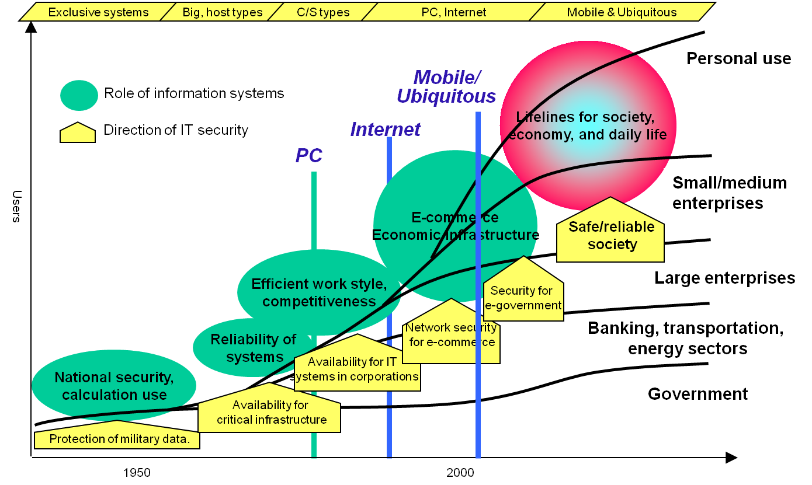
Trends of IT Security

Slide 6
Related Subject
Mathematics
- Number Theory
- Algebra : Group, Ring & Field Theory
- Elliptic curves
Probability/ Statistics
Information Theory / Coding Theory
Computational Complexity
- Algorithm, Turing machine
- NP-completeness
Quantum Computing, etc

Slide 7
Who are interested in cryptology?
Emerging Applications
Traditional
Industrial
Academic
Standard
Electronic Commerce
Internet Service Provider
DRM/ Digital Watermark
Ubiquitous Security
Law Enforcement
Cloud Computing
Future Internet, Smart Grid, etc.
Government
Diplomatic
Military
Finance
Police
Security anywhere

Slide 8
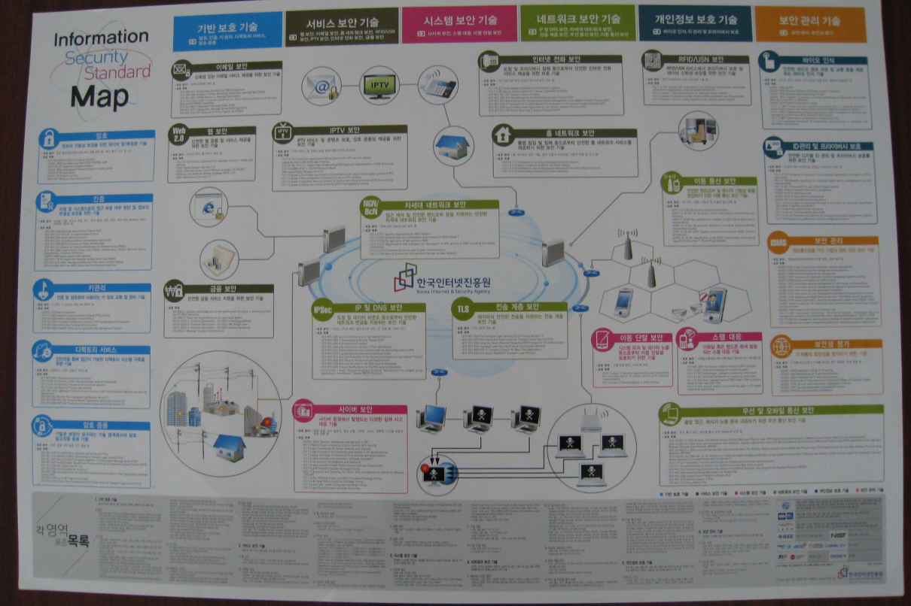
Security Standard Map

Slide 9



Worldwide Academic Research
USA
- IACR (International Association for Cryptologic Research) http://www.iacr.org/
: Crypto(‘81-), Eurocrypt(’82-), Asiacrypt(’91-), FSE, PKC, CHES, JoC.
- USENIX-security, IEEE-Symposium on Privacy and Security
- ACM-CCS (Comp. & Comm. Security), TISSEC, etc
Europe
- ESORICS(European Symposium on Research in Computer Security)
- EuroPKI(’04-), ECRYPT, etc.
Asia
- Korea : KIISC (Korea Institute of Information Security and Cryptology)
(’89-) http://www.kiisc.or.kr/, ICISC(‘97-), IWDW(’02-), WISA(‘00-)
- Australia : Auscrypt(‘90-’92), ACISP (‘95-)
- Japan : SCIS(‘84-), CSS(’02-), IWSEC(’06-) , Pairing(’07-)
- China : ICICS(‘00-),ACNS(’02-) - Malaysia : Mycrypt(’05-)
- India : Indocrypt (’99-), -Vietnam: Vietcrypt(’06-),
Africa AfricaCrypt(‘08-)

Slide 10
Term Project & Paper Presentation
Term Project
  Try security problem related on your major
  Refer to previous web page.
  Term Project Proposal
    Problem Statement
    My Approach
    Time Schedule
    Expected outcome
  2 times presentation
Paper Presentation
  Many good papers suggested
  You can select among basic and advanced papers
Consult TA for details.

Slide 11

Basic Concepts(I)
Cryptology
= Crypto(Hidden) + Logos (word)
= Cryptography + Cryptanalysis
= Code Writing + Code Breaking
Encryption(Decryption),Key,Plaintext,Ciphertext, Deciphertext
Adversary
C=E(P,Ke)
P=D(C,Kd)
E()
C
RQHZHV
D()
P
D
Insecure channel
ABCDEF
ABCDEF
Ke
Kd
Secure channel
Key

Slide 12
Basic Concepts(II)
Channel
  Secure : trust, registered mail, tamper-proof device
  Insecure : open, public channel
Entity
  Sender (Alice)
  Receiver (Bob)
  Adversary (Charlie)
    Passive attack : wiretapping ->Privacy
    Active attack : modification,impersonation
    -> Authentication

Slide 13
Basic Concepts(III)
Classification of crypto algorithms
  by date
    Traditional( ~19C): Caesar
    Mechanical(WW I, II ): Rotor Machine, Purple
    Modern(‘50~): DES, IDEA, AES and RSA, ECC
  by number of keys
    Conventional: {1,single,common} key, symmetric
    Public key cryptosystem: {2,dual} keys, asymmetric
  by size of plaintext
    Block Cipher
    Stream Cipher

Slide 14
Basic Security Requirements

Slide 15
Advanced Security Requirements
Authorization: conveyance, to another entity, of official sanction to do or be something.
Validation: a means to provide timeliness of authorization to use or manipulate information or services
Certification: endorsement of information by a trusted entity
Revocation: retraction of certification or authorization
Time stamping: recording the time of creation or existence of information
Witnessing : verifying the creation or existence of information by an entity other than the creator
Receipt: acknowledgement that information has been received
Ownership: a means to provide an entity with the legal right to use or transfer a resource to others
Anonymity: concealing the identity of an entity involved in some process

Slide 16
A taxonomy of cryptographic primitives
Arbitrary length hash functions
Unkeyed
Primitives
1-way permutations
RNG, PUF
Block ciphers
Symmetric-key ciphers
Security
Primitives
Symmetric-key
Primitives
Stream ciphers
Arbitrary length (keyed) hash functions(MAC)
Signatures
Identification primitives
Asymmetric-key
Primitives
Public-key ciphers
Signatures
Identification primitives
RNG(Random Number Generator), PUF(Physically Unclonable Function)

Slide 17
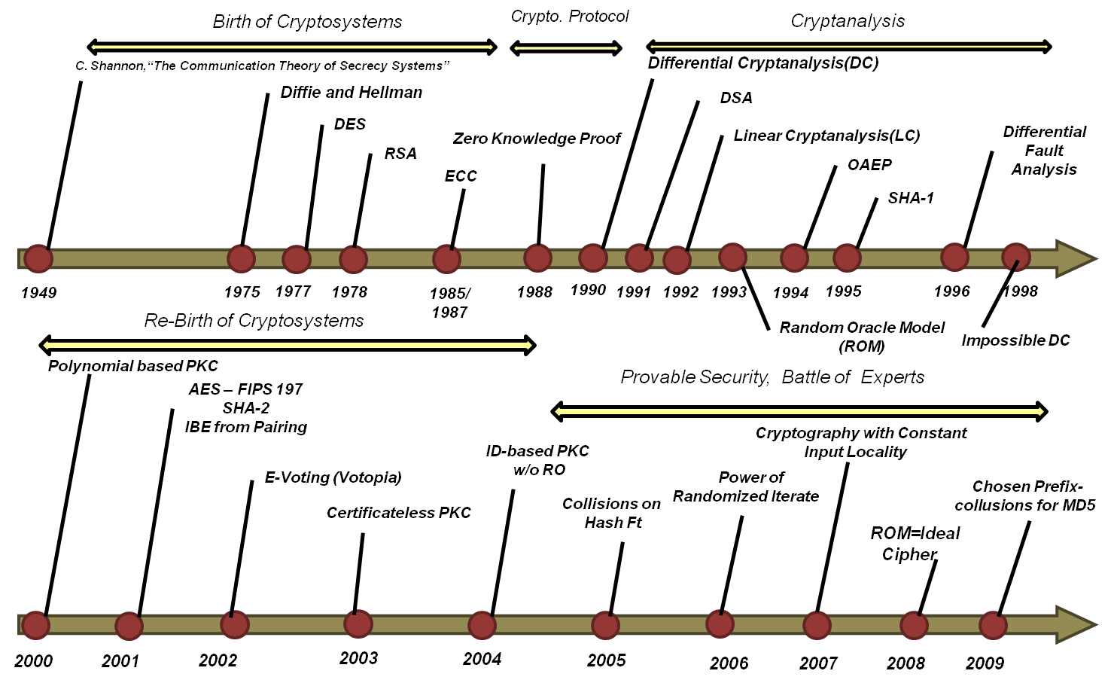
History of Modern Cryptography

Slide 18

Attacking Model(I)
By available information to attacker
  COA (Ciphertext Only Attack)
  KPA (Known Plaintext Attack)
  CPA (Chosen Plaintext Attack)
  CCA (Chosen Ciphertext Attack)
  Kerckhoff’s principle: knows the cryptosystem being used

Slide 19
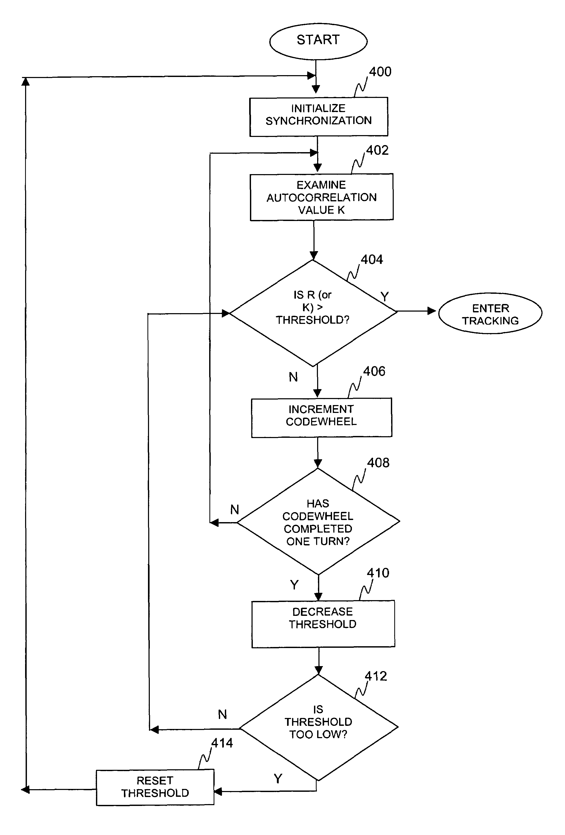
Attacking Model(II)
Exhaustive Key Search
: Time = O(n), Space=O(1)
(Pre-computed) Table Lookup
: Time=O(1), Space= O(n),
Time-Memory Tradeoff
: Time =O(n^{2/3}) , Space =O(n^{2/3})

Slide 20

Classification of Security
Unconditionally secure : unlimited power of adversary, perfect (ex. : one-time pad)
Provably secure : under the assumption of well-known hard mathematical problem
Computationally secure : amount of computational effort by the best known methods (Practical Secure)

