Slide 1
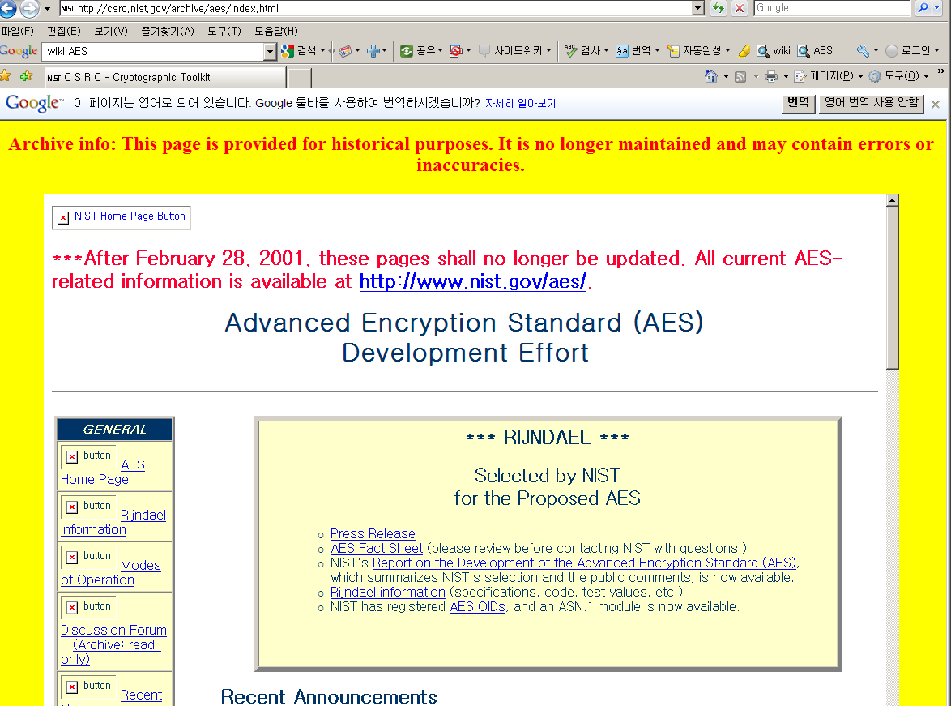
Lect. 8 : Advanced Encryption Standard
http://csrc.nist.gov/CryptoToolkit/aes/rijndael/

Slide 2
AES Contest
AES Contest Calendar
1997 : Call For AES Candidate Algorithms by NIST
128-bit Block cipher
128/192/256-bit keys
Worldwide-royalty free
More secure than Triple DES
More efficient than Triple DES
1998 : 1st Round Candidates – 15 Algorithms
Mars, Twofish, RC6, SAFER+, HPC, CAST256, DEAL, Frog, Magenta, Rijndael, DFC, Serpent, Crypton, E2, LOKI97
1999 : 2nd Round Candidates – 5 Algorithms
MARS, RC6, Rijndael, Serpent, and Twofish
2000. 10 : Rijndael selected as the finalist
2001. 12: official publication as FIPS PUB 197
* National Institute of Standards and Technology

Slide 3
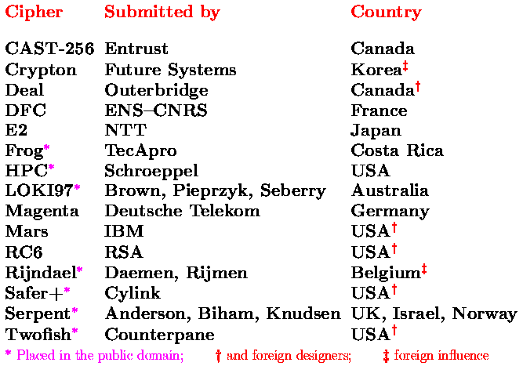
AES Contest
1st Round Candidates – 15 Algorithms

Slide 4
AES Contest
2nd Round Candidates – 5 Algorithms
Cipher | Submitter | Structure | Nonlinear Component
MARS | IBM | Feistel structure | Sbox DD-Rotation
RC6 | RSA Lab. | Feistel structure | Rotation
Rijndael | Daemen, Rijmen | SPN structure | Sbox
Serpent | Anderson, Biham, Knudsen | SPN structure | Sbox
Twofish | Schneier et. al | Feistel structure | Sbox

Slide 5
AES Contest
AES Contest
2000. 10 : Rijndael selected as the finalist
2001. 12: official publication as FIPS PUB 197
Joan Daemen and Vincent Rijmen, “The Design of
Rijndael, AES – The Advanced Encryption Standard”,
Springer, 2002, ISBN 3-540-42580-2
Vincent Rijmen

Slide 6
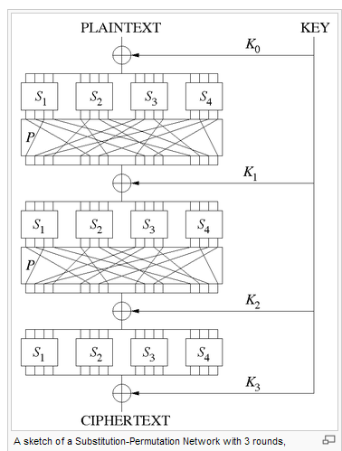
SPN- Structure Block Cipher
More constraints on the round function: must be invertible
Relatively new architecture than Feistel-structure
Faster than Feistel-structure
Parallel computation
Typically E ≠ D

Slide 7
Advanced Encryption Standard (AES)
AES External Format
Plaintext block
128 bits
AES
Ciphertext block
128 bits
Key
128, 192, 256 bits

Slide 8
AES Architecture
Plaintext
SPN-type block cipher
Block size = 128 bits
Key size / No. round
128 bits → 10 rounds
192 bits → 12 rounds
256 bits → 14 rounds
Round transformation
SubBytes
ShiftRow
MixColumn
AddRoundKey
Initial Key
AddRoundKey
SubByte
ShiftRow
Repeat
N-1 rounds
MixColumn
Round key
AddRoundKey
SubByte
ShiftRow
Final
round
Final round
key
AddRoundKey
Ciphertext

Slide 9
Finite Field
Every nonzero element has multiplicative inverse.
Prime number, Zp
Gcd, Extended Euclidean Algorithm
Representation of n-bit data
Binary
Hexadecimal
Polynomial
GF(p), GF(2^{n}) over irreducible polynomial
Ex) GF(2³) /x³ + x + 1
Addition and multiplication
AES uses GF(2⁸) /f(x)= x⁸ + x⁴ + x³ + x +1

Slide 10
Round Transformation
S-box
⊗ c(x)
a₀₀
a₀₁
a₀₂
a₀₃
b₀₀
b₀₁
b₀₂
b₀₃
a₀₀
a_{0j}
a₀₂
a₀₃
b₀₀
b_{0j}
b₀₂
b₀₃
a₁₀
a₁₁
a₁₂
a₁₃
b₁₀
b₁₁
b₁₂
b₁₃
a₁₀
a_{1j}
a₁₂
a₁₃
b₁₀
b_{1j}
b₁₂
b₁₃
a_{ij}
b_{ij}
a₂₀
a₂₁
a₂₂
a₂₃
b₂₀
b₂₁
b₂₂
b₂₃
a₂₀
a_{2j}
a₂₂
a₂₃
b₂₀
b_{2j}
b₂₂
b₂₃
a₃₀
a₃₁
a₃₂
a₃₃
b₃₀
b₃₁
b₃₂
b₃₃
a₃₀
a_{3j}
a₃₂
a₃₃
b₃₀
b_{3j}
b₃₂
b₃₃
SubBytes
MixColumns
a₀₀
a₀₁
a₀₂
a₀₃
No shift
a₀₀
a₀₁
a₀₂
a₀₃
a₁₀
a₁₁
a₁₂
a₁₃
Cyclic shift by 1 byte
a₁₁
a₁₂
The input block is XOR-ed
with the round key
a₁₃
a₁₀
Cyclic shift by 2 byte
a₂₀
a₂₁
a₂₂
a₂₃
a₂₂
a₂₃
a₂₀
a₂₁
AddRoundKey
Cyclic shift by 3 byte
a₃₀
a₃₁
a₃₂
a₃₃
a₃₃
a₃₀
a₃₁
a₃₂
ShiftRows

Slide 11
AddRoundKey
The input block is XOR-ed with the round key

Slide 12
Best Known Attack
related-key attack can break 256-bit AES with a complexity of 2¹¹⁹, which is faster than brute force but is still infeasible. 192-bit AES can also be defeated in a similar manner, but at a complexity of 2¹⁷⁶. 128-bit AES is not affected by this attack.
chosen-plaintext attack can break 8 rounds of 192- and 256-bit AES, and 7 rounds of 128-bit AES, although the workload is impractical at 2¹²⁸ - 2¹¹⁹. (Ferguson et al., 2000).

Slide 13
Feistel vs. SPN Structures
Feistel structure
SPN structure
64-bit block
128-bit block
128-bit block
64-bit block
DES/3DES
BLOWFISH
CAST128
RC5
SEED
TWOFISH
CAST256
RC6
MARS
SAFER
SAFER+
IDEA
AES
CRYPTON
SERPENT
Fewer constraints on the round function
More cryptanalytic experience
Serial in nature
Typically E = D with round keys in reverse order
More constraints on the round function: must be invertible
Less cryptanalytic experience: relatively new architecture
more parallel computation
Typically E ≠ D

