Slide 1
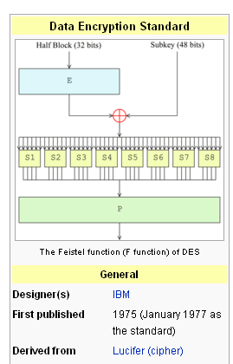
Lect. 7 : Data Encryption Standard

Slide 2
Data Encryption Standard (DES)
DES - History
1976 – adopted as a federal standard
1977 – official publication as FIPS PUB 46
1983, 1987, 1993 – recertified for another 5 years
* Federal Information Processing Standards
Design Criteria of DES
Provide a high level of security
Completely specify and easy to understand
Security must depend on hidden key, not algorithm
Available to all users
Adaptable for use in diverse applications
Economically implementable in electronic device
Able to be validated
Exportable
Plaintext block
64 bits
DES
Key
56 bits
Ciphertext block
64 bits

Slide 3
DES Overview
K
P
64
56
PC-1
IP
L0(32)
R0(32)
Rot
Rot
PC-2
f
16 Round
PC-2
R16
L16
FP
Key Scheduling
64
C
Round function

Slide 4
DES Overview
Plaintext M(64)
IP
LE₀(32)
RE₀(32)
f
K₁
LE₁(32)
RE₁(32)
f
K₂
LE₂(32)
RE₂(32)
f
K₃
LE₁₅(32)
RE₁₅(32)
f
K₁₆
RE₁₆(32)
LE₁₆(32)
IP ^{–1}
Ciphertext C(64)

Slide 5
Initial Permutation and Final Permutation
IP (Initial permutation)
IP ^{–1} (Final permutation)
58 | 50 | 42 | 34 | 26 | 18 | 10 | 2
60 | 52 | 44 | 36 | 28 | 20 | 12 | 4
62 | 54 | 46 | 38 | 30 | 22 | 14 | 6
64 | 56 | 48 | 40 | 32 | 24 | 16 | 8
57 | 49 | 41 | 33 | 25 | 17 | 9 | 1
59 | 51 | 43 | 35 | 27 | 19 | 11 | 3
61 | 53 | 45 | 37 | 29 | 21 | 13 | 5
63 | 55 | 47 | 39 | 31 | 23 | 15 | 7
40 | 8 | 48 | 16 | 56 | 24 | 64 | 32
39 | 7 | 47 | 15 | 55 | 23 | 63 | 31
38 | 6 | 46 | 14 | 54 | 22 | 62 | 30
37 | 5 | 45 | 13 | 53 | 21 | 61 | 29
36 | 4 | 44 | 12 | 52 | 20 | 60 | 28
35 | 3 | 43 | 11 | 51 | 19 | 59 | 27
34 | 2 | 42 | 10 | 50 | 18 | 58 | 26
33 | 1 | 41 | 9 | 49 | 17 | 57 | 25
cf.) The 58th bit of x is the first bit of IP(x)

Slide 6
Function f(k_{i},RE_{i-1})
RE_{i-1}(32bits)
E
Expansion E
48bits
K_{i} (48bits)
S₁
S₂
S₃
S₄
S₅
S₆
S₇
S₈
S-box
P
Permutation P
32bits

Slide 7
Expansion E and Permutation P
Expansion E
Permutation P
32 | 1 | 2 | 3 | 4 | 5
4 | 5 | 6 | 7 | 8 | 9
8 | 9 | 10 | 11 | 12 | 13
12 | 13 | 14 | 15 | 16 | 17
16 | 17 | 18 | 19 | 20 | 21
20 | 21 | 22 | 23 | 24 | 25
24 | 25 | 26 | 27 | 28 | 29
28 | 29 | 30 | 31 | 32 | 1
16 | 7 | 20 | 21
29 | 12 | 28 | 17
1 | 15 | 23 | 26
5 | 18 | 31 | 10
2 | 8 | 24 | 14
32 | 27 | 3 | 9
19 | 13 | 30 | 6
22 | 11 | 4 | 25
cf.) 32-bits are expanded into 48-bits.
Some bits are selected more than once.
32-bit → 32-bit
permutation

Slide 8
S-box (substitution box)
b₁ b₂ b₃ b₄ b₅ b₆
Look-up a value from the table using
b₁ b₆ : row
b₂ b₃ b₄ b₅ : column
S₁
Sb₁ Sb₂ Sb₃ Sb₄
b₁ b₆ : row
S₁-box table
 |  |  |  |  |  |  | Sb₁
14 | 4 | 13 | 1 | 2 | 15 | 11 | 8 | 3 | 10 | 6 | 12 | 5 | 9 | 0 | 7
0 | 15 | 7 | 4 | 14 | 2 | 13 | 1 | 10 | 6 | 12 | 11 | 9 | 5 | 3 | 8
4 | 1 | 14 | 8 | 13 | 6 | 2 | 11 | 15 | 12 | 9 | 7 | 3 | 10 | 5 | 0
15 | 12 | 8 | 2 | 4 | 9 | 1 | 7 | 5 | 11 | 3 | 14 | 10 | 0 | 6 | 13
0
1
2
3
0 1 2 3 4 5 6 7 8 9 10 11 12 13 14 15
b₂ b₃ b₄ b₅ : column

Slide 9
DES S-Boxes
S₃-box
10 0 9 14 6 3 15 5 1 13 12 7 11 4 2 8
13 7 0 9 3 4 6 10 2 8 5 14 12 11 15 1
13 6 4 9 8 15 3 0 11 1 2 12 5 10 14 7
1 10 13 0 6 9 8 7 4 15 14 3 11 5 2 12
S₄-box
7 13 14 3 0 6 9 10 1 2 8 5 11 12 4 15
13 8 11 5 6 15 0 3 4 7 2 12 1 10 14 9
10 6 9 0 12 11 7 13 15 1 3 14 5 2 8 4
3 15 0 6 10 1 13 8 9 4 5 11 12 7 2 14

Slide 10
DES S-boxes
8 S-boxes (6 → 4 bits)
some known design criteria
not linear
Any one bit of the inputs changes at least two output bits
S(x) and S(x ⊕ 001100) differs at least 2bits
S(x) ≠ S(x ⊕ 11ef00) for any ef
Resistance against DC etc.
The actual design principles have never been revealed (US classified information)
HW : For the S₄-box, check whether the following property holds
S₄ (x) and S₄ (x ⊕ 001100) differs at least 2bits

Slide 11
Key Scheduling
Key (64)
PC₁
C₀(28)
D₀(28)
LS₁
LS₁
C₁(28)
D₁(28)
PC₂
K₁
LS₂
LS₂
C₂(28)
D₂(28)
PC₂
K₂
LS₁₆
LS₁₆
C₁₆(28)
D₁₆(28)
PC₂
K₁₆

Slide 12
PC₁
57 | 49 | 41 | 33 | 25 | 17 | 9
1 | 58 | 50 | 42 | 34 | 26 | 18
10 | 2 | 59 | 51 | 43 | 35 | 27
19 | 11 | 3 | 60 | 52 | 44 | 36
63 | 55 | 47 | 39 | 31 | 23 | 15
7 | 62 | 54 | 46 | 38 | 30 | 22
14 | 6 | 61 | 53 | 45 | 37 | 29
21 | 13 | 5 | 28 | 20 | 12 | 4
64 bit -> 56 bit (Actual key size of DES is 56-bit)
cf.) Do not use the parity check bits preventing from input error.
8 16 24 32 40 48 56 64 was not selected.

Slide 13
PC₂
14 | 17 | 11 | 24 | 1 | 5
3 | 28 | 15 | 6 | 21 | 10
23 | 19 | 12 | 4 | 26 | 8
16 | 7 | 27 | 20 | 13 | 2
41 | 52 | 31 | 37 | 47 | 55
30 | 40 | 51 | 45 | 33 | 48
44 | 49 | 39 | 56 | 34 | 53
46 | 42 | 50 | 36 | 29 | 32
56 bit -> 48 bit
Note that 9, 18, 22, 25, 35, 38, 43 and 54 th positions was not selected.

Slide 14
Left Shift LS_{s}
Iteration | Shift | Iteration | Shift
LS₁ | 1 | LS₉ | 1
LS₂ | 1 | LS₁₀ | 2
LS₃ | 2 | LS₁₁ | 2
LS₄ | 2 | LS₁₂ | 2
LS₅ | 2 | LS₁₃ | 2
LS₆ | 2 | LS₁₄ | 2
LS₇ | 2 | LS₁₅ | 2
LS₈ | 2 | LS₁₆ | 1

Slide 15
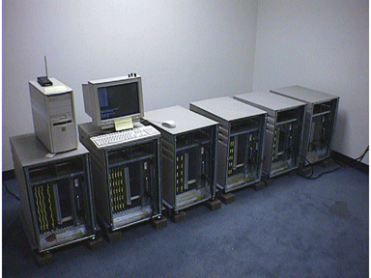
Breaking DES(1/2)
DES - Controversies
Unknown design criteria
Slow in software
Too short key size – 56 bits
DES Crack Machine
Can test over 90 billion keys per second
EFF's "Deep Crack" and the Distributed.Net computers were testing 245 billion keys per second
On Jan. 19, 1999, RSA DES-III Challenge was deciphered after searching 22h. and 15m.
Identifier: DES-Challenge-III Cipher: DES Start: January 18, 1999 9:00 AM PST Prize: $10,000 IV: da 4b be f1 6b 6e 98 3d Plaintext: See you in Rome (second AES
Conference, March 22-23, 1999)
http://www.rsa.com/rsalabs/node.asp?id=2108

Slide 16
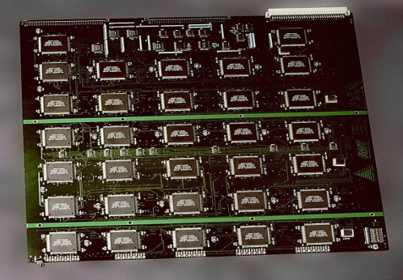
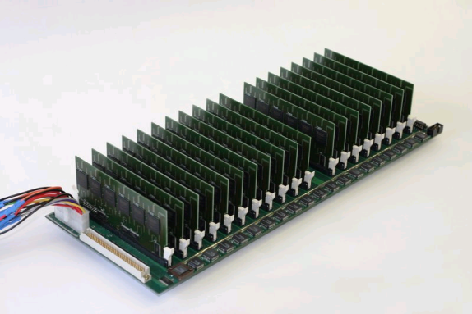
Breaking DES(2/2)
250,000$@1998
10,000$@2008

Slide 17
Double DES & Triple DES
How to strengthen existing DES implementations ?
Double DES
Essentially no security increase: E_{K1}(P) = X = D_{K2}(C) Meet-in-the-middle attack !
K₁
K₂
K₂
K₁
E
X
D
X
P
E
C
C
D
P
Triple DES
Three-key or Two-key 3DES: K₁ = K₃
K₁
K₂
K₃
K₃
K₂
K₁
A
B
D
B
E
A
D
P
E
D
E
C
C
P

