Slide 1
Lec. 5 : History of Cryptologic Research II
When and how long it was begun?
Why?

Slide 2
Hill Cipher
e_{K}(x) : (y₁,y₂,…,y_{m}) =(x₁,x₂,…,x_{m}) K
where K is m x m matrix and gcd(det K, 26) =1
d_{K}(y) = y K⁻¹
(Ex) K = 11 8 K⁻¹ = 7 18
3 7 23 11
x : july, (j,u)= (9,20), (l,y) = (11,24)
(9,20) K = (3,4) = (D,E),
(11,24) K = (11,22) = (L,W)

Slide 3
Monoalphabetic Substitution Ciphers
Example : 1-1 Substitution rule
Example : Encryption
Key space : 26!
Cryptanalysis: Using English character frequency analysis…

Slide 4
Homophonic Substitution Ciphers
Letters which occur frequently may be mapped into more than
one letter in the ciphertext to flatten the frequency distribution.
Alphabet is mapped into the numbers 0 to 99
For example,
E(12.7%) → 17, 19, 23, 47, 64
A(8.2%) → 8, 20, 25, 49
R(6.0%) → 1, 29, 65
T(9.1%) → 16, 31, 85, 87

Slide 5
Polyalphabetic Substitution Ciphers
Hide the frequency distribution by making multiple substitutions.
Apply d different permutations.
Vigenere cipher
Beauford cipher

Slide 6
Polyalphabetic Substitution Ciphers
Vigenère Ciphers
Multiple Caesar cipher
Beauford ciphers (used in US civil war)

Slide 7
Vigenère Ciphers
Plaintext
Keyword
Ciphertext
t
h
i
s
c
r
y
p
t
o
s
y
s
t
e
m
i
s
n
o
t
s
e
c
u
r
e
S
E
C
U
R
I
T
Y
S
E
C
U
R
I
T
Y
S
E
C
U
R
I
T
Y
S
E
C
L
L
K
M
T
Z
R
N
L
S
U
S
J
B
X
K
A
W
P
I
K
A
X
A
M
V
G

Slide 8
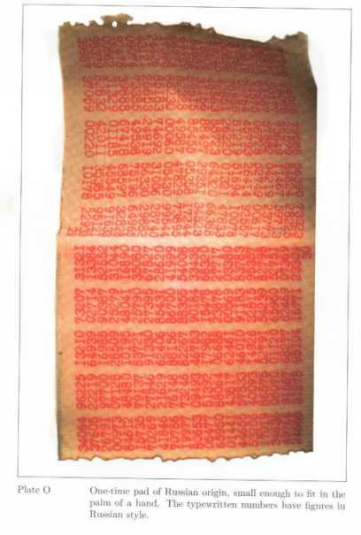
One-time Pad (Vernam cipher)
Use a random key as long as the message size and use the key only once
Unbreakable
Since ciphertext bears no statistical relationship to the plaintext
Since for any plaintext & any ciphertext there exists a key mapping one to other
Have the problem of safe distribution of key
Ex) Binary alphabet
P : o n e t i
P’: 01101111 01101110 01100101 01110100 01101001
K : 01011100 01010001 11100000 01101001 01111010
C : 00110011 00111111 10000101 00011101 00010011
Perfect Cipher : p (x|y) = p(x) for all x ∈ P, y ∈ C
Impossible COA

Slide 9
3. Transposition Ciphers
Transposition cipher
Scytale cipher
Rotor machines

Slide 10
Transposition Ciphers
Rearrange characters of plaintext to produce ciphertext
Frequency distribution of the characters is not changed by encryption
Example:
Encryption permutation
Decryption permutation
1
2
3
4
5
6
1
2
3
4
5
6
3
5
1
6
4
2
3
6
1
5
2
4
i | n | f | o | r | m | a | t | i | o | n | s | e | c | u | r | i | t | y | x | y | z | a | b
F | R | I | M | O | N | I | N | A | S | O | T | U | I | E | T | R | C | Y | A | Y | B | Z | X
plaintext
ciphertext

Slide 11
Transposition Ciphers
Cryptanalysis :
Period d is guessed by trying possible periods
A knowledge of the most frequent pairs and triples in a language is used with anagramming.
Use language characteristics
Frequent pairs on a relative scale to 10
TH : 10.00, HE : 9.50, IN : 7.17, ER : 6.65, RE : 5.92
Frequent triples on a relative scale to 10
THE : 10.00, AND : 2.81, TIO : 2.24, ATI : 1.67
Exercise: decrypt the following ciphertext
LDWEOHETTHSESTRUHTELOBSEDEFEIVNT

Slide 12
4. Product Ciphers
Shannon
SP Network

Slide 13
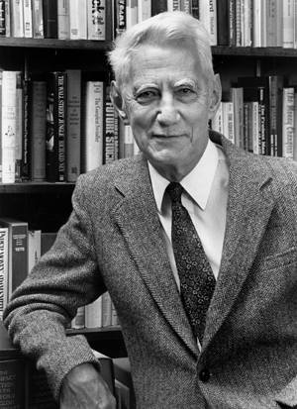
Shannon’s Proposal
C. Shannon, “Communication Theory for Secrecy Systems”, 1949
Compose different kind of simple and insecure ciphers to create complex and secure cryptosystems → called “product cipher”
Incorporate confusion and diffusion
Substitution-Permutation Network
http://www.bell-labs.com/news/2001/february/26/1.html
http://cm.bell-labs.com/cm/ms/what/shannonday/paper.html
Claude Shannon

Slide 14
Confusion and Diffusion
Confusion (substitution) :
The ciphertext statistics should depend on the plaintext statistics in a manner too complicated to be exploited by the enemy cryptanalyst
Makes relationship between ciphertext and key as complex as possible
Diffusion (permutation) :
Each digit of the plaintext should influence many digits of the ciphertext, and/or
Each digit of the secret key should influence many digits of the the ciphertext.
Dissipates statistical structure of plaintext over bulk of ciphertext

Slide 15
SP Network
Substitution-Permutation network
Substitution (S-box) : secret key is used
Permutation (P-box) : no secret key, fixed topology
Provide confusion and diffusion
S-P networks are expected to have
Avalanche property: a single input bit change should force the complementation of approximately half of the output bits
Completeness property: each output bit should be a complex function of every input bits
Theoretical basis of modern block ciphers

Slide 16
SP Network

Slide 17
Kerckhoff’s Principle
Auguste Kerckhoff, 1883
A cryptosystem should be secure even if everything about the system, except the key, is public knowledge.
Eric Raymond extends this principle in support of open source software, saying "Any security software design that doesn't assume the enemy possesses the source code is already untrustworthy; therefore, never trust closed source”.
The majority of civilian cryptography makes use of publicly-known algorithms. By contrast, ciphers used to protect classified government or military information are often kept secret

