Slide 1
Introduction to Information Security Chapter II: Classical Ciphers

Slide 2
Contents
History of cryptographic research
Substitution ciphers
Caesar ciphers
Affine ciphers
Monoalphabetic substitution cipher
Homophonic substitution cipher
Polyalphabetic substitution cipher
Vigenere cipher
Hill cipher
One-time pad
Transposition ciphers
Transposition cipher
scytale cipher
Product ciphers

Slide 3
Lec. 4 : History of Cryptologic Research
When and how long it was begun?
Why?

Slide 4
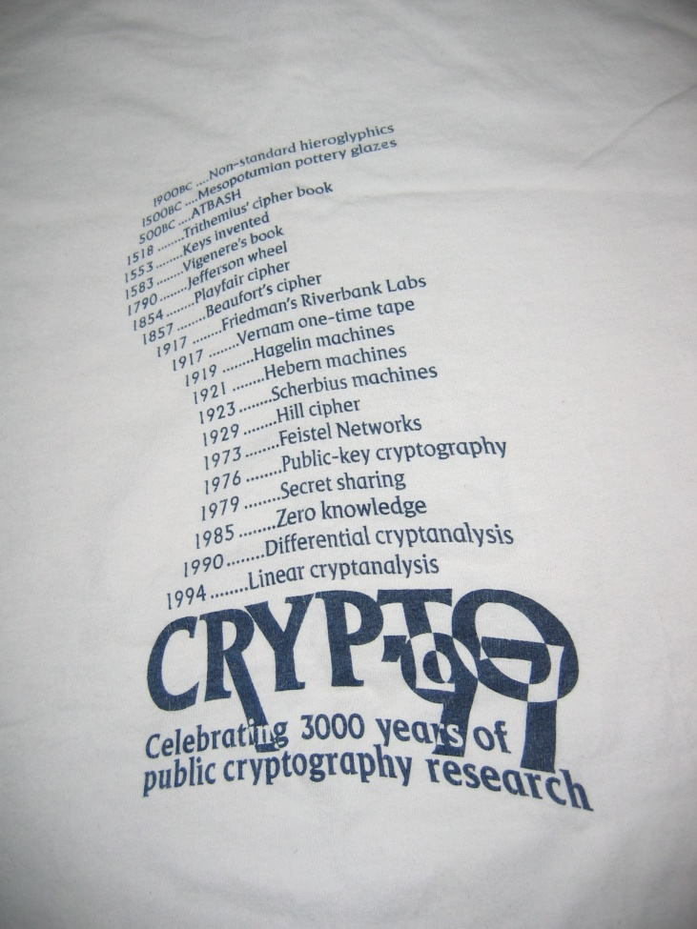
History of Cryptologic Research
1900BC : Non-standard hieroglyphics
1500BC : Mesopotamian pottery glazes
50BC : Caesar cipher
1518 : Trithemius’ cipher book
1558 : Keys invented
1583 : Vigenere’s book
1790 : Jefferson wheel
1854 : Playfair cipher
1857 : Beaufort’s cipher
1917 : Friedman’s Riverbank Labs
1917 : Vernam one-time pads

Slide 5
History of Cryptologic Research
1919 : Hegelin machines
1921 : Hebern machines
1929 : Hill cipher
1973 : Feistel networks
1976 : Public key cryptography
1979 : Secret sharing
1985 : Zero knowledge
1990 : Differential cryptanalysis
1994 : Linear cryptanalysis
1997 : Triple-DES
1998 ~ 2001 : AES
Modern Cryptography

Slide 6
History of Cryptologic Research
Period
Features
Examples
Manual
Crypto
ancient
~ 1920
Substitution
Transposition
Scytale, Caesar, Vigenere,
Beaufort (USA)
Machine
Crypto
1920 ~ 1950
Using complex machine
Enigma (Germany in 2nd WW)
M-209 (USA in 2nd WW)
Modern Crypto
Computer Crypto
DES, SEED, AES
RSA, ECC, KCDSA
1950 ~ current
Using computer
Shannon’s theory

Slide 7
Using Cryptologic Technology
Before modern crypto : limited usage
National security, diplomatic, war
Used by limited people
Researched by limited people
Current crypto : widely open, standardized, commerce
Internet, e-commerce
Anybody is using
Research and development by anyone

Slide 8
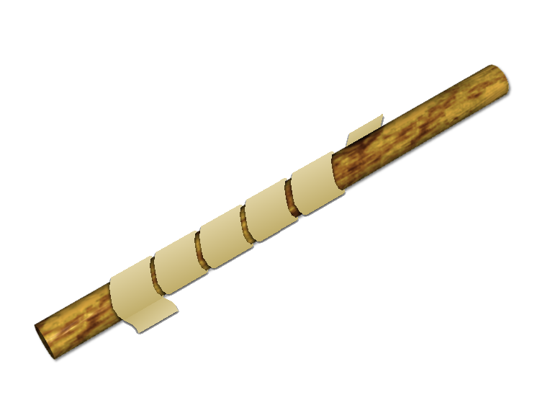
Scytale
a
s
b
c
c
y
d
t
e
a
f
l
g
e
as bc cy dt ea fl ge

Slide 9
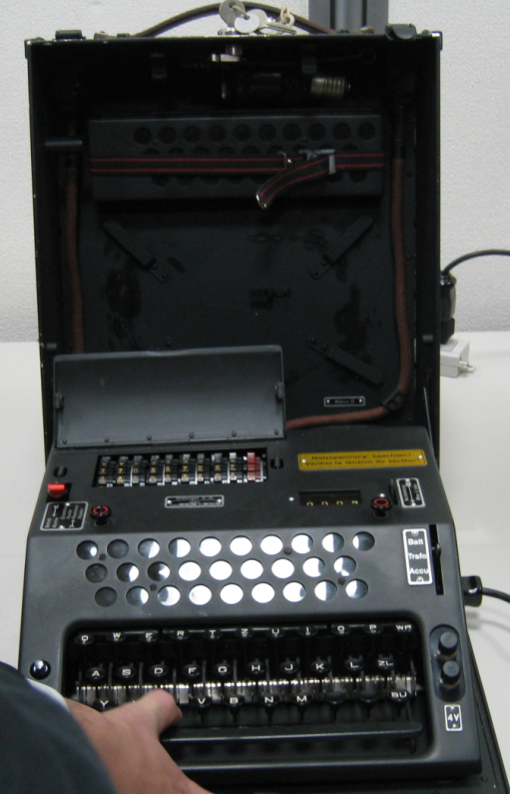
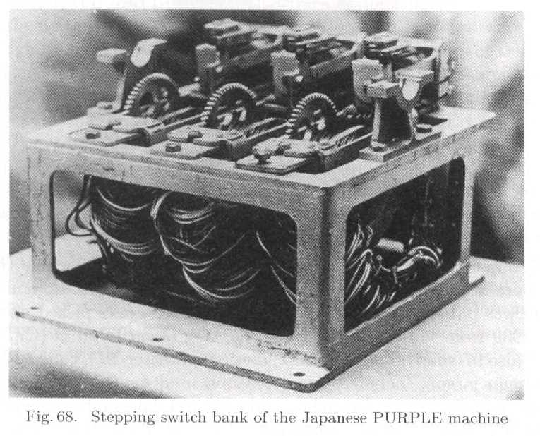
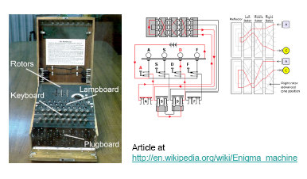
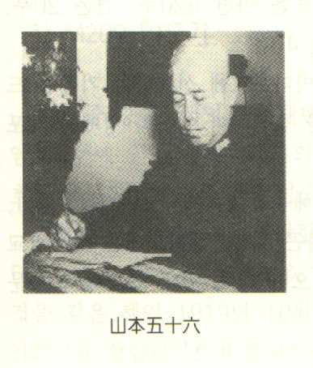
Enigma(German) vs. Purple (Japan)@WWII

Slide 10
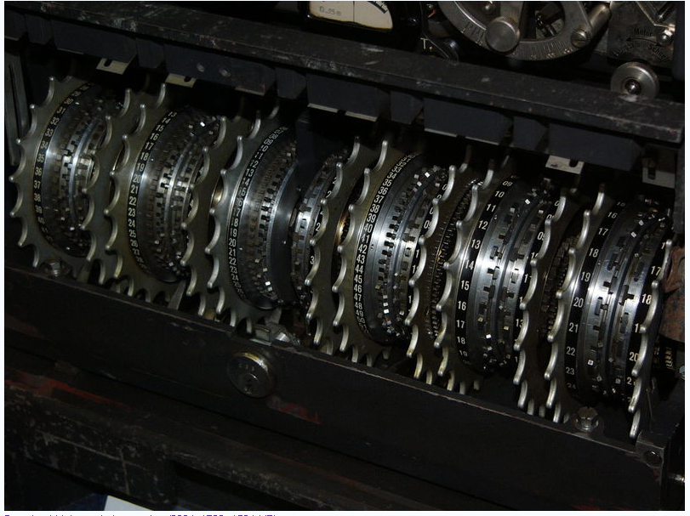
Lorenz SZ42 Cipher Machine

Slide 11
Classical Encryption Techniques
Basic building blocks of all encryption techniques
Substitution: replacement
Transposition: relocation
Substitution ciphers
Caesar cipher
Monoalphabetic ciphers
Playfair cipher
Hill cipher
Polyalphabetic ciphers: Vigenere cipher
Vernam cipher/One-time pad: perfect cipher
Transposition techniques
Rotor machines: Enigma, Purple

Slide 12
2. Substitution Cipher
Caesar ciphers
Affine ciphers
Hill cipher
Monoalphabetic substitution cipher
Homophonic substitution cipher
Polyalphabetic substitution cipher
Vigenere cipher
One-time pad

Slide 13
Caesar Ciphers
Julius Caesar, the Roman emperor
Also known as shift cipher
Mathematically assign numbers to each alphabet
Caesar cipher :
C = E_{K}(M) = M + K mod 26
K = 3
M = D_{K}(C) = C - K mod 26
K = 3

Slide 14
Caesar Ciphers
Define transformation as:
Encryption example
Weakness
Key space is too short – only 26 possible keys
Brute force search
Example: Break ciphertext “L ORYH LFX"

Slide 15
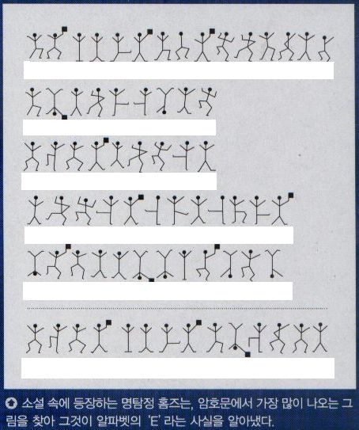
Affine Ciphers
Generalization of Caesar cipher
Encryption
Decryption
Example: decrypt the following ciphertext
WZDUY ZZYQB OTHTX ZDNZD KWQHI BYQBP WZDUY ZXZDSS
How? Using English character frequency analysis…

Slide 16
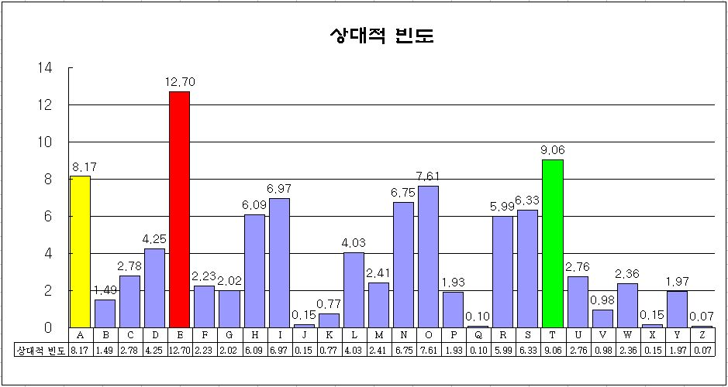
English Character Frequencies
Letter Frequency(%) Letter Frequency(%) Letter Frequency(%)
e 12.7 d 4.3 p 1.9
t 9.1 l 4.0 b 1.5
a 8.2 c 2.8 v 1.0
o 7.5 u 2.8 k 0.8
i 7.0 m 2.4 j 0.2
n 6.7 w 2.3 x 0.1
s 6.3 f 2.2 q 0.1
h 6.1 g 2.0 z 0.1
r 6.0 y 2.0
(1) Pr(e)=0.12, (2) Pr(t,a,o,i,n,s,h,r) = 0.06 ~0.09
(3) Pr(d,l)=0.04 (4) Pr(c,u,m,w,f,g,y,p,b)= 0.015~0.023
(5) Pr(v,k,j,x,q,z) <=0.01

