Slide 1
Lect. 21: Summary

Slide 2
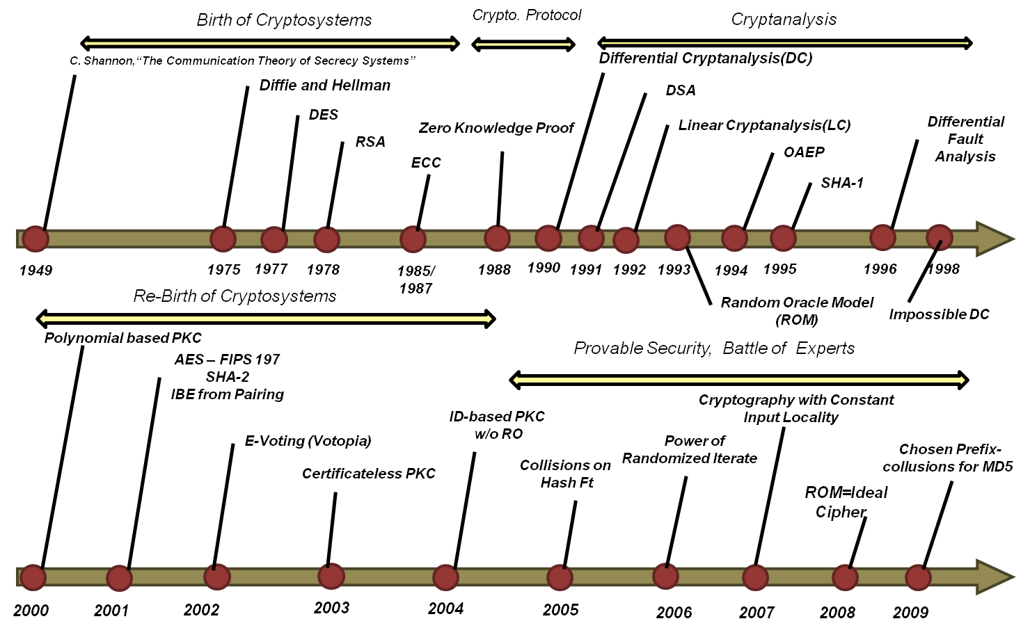
Modern Cryptography

