Slide 1
Lect. 20. Identification

Slide 2
Authentication
Entity Authentication (Identification)
Over the communication network, one party, Alice, shows to another party, Bob, that she is the real Alice.
Authenticate an entity by presenting some identification information
Should be secure against various attacks
Through an interactive protocols using secret information
Message Authentication
Show that a message was generated by an entity
Using digital signature or MAC
2
Notes:
2
Interactive Proofs have two properties, Completeness and Soundness
An Interactive Proof is considered Complete if the verifier accepts the proof given that the assertion is true. In other words, any TRUE theorem can be proven. For example, if a prover says he knows a secret value, and the assertion is true, and he can prove it to a verifier, then the Interactive Proof is said to be Complete.
The Soundness Property says that a Verifier Rejects the proof if the fact is false. That is, no false theorem can be proven.
In both cases the assumption is that the Prover and Verifier follow the protocol. They do not interact with other parties or try to learn information from other means.
Completeness – For every fact that is presented to the verifier, the verifier says “yes” after interacting with the prover
Soundness – for facts that are not true and for all provers, a verifier says no after interacting with all provers, with probability at least ½

Slide 3
Approach for Identification
Using Something Known
Password, PIN
Using Something Possessed
IC card, Hardware token
Using Something Inherent
Biometrics
3
Notes:
3
Interactive Proofs have two properties, Completeness and Soundness
An Interactive Proof is considered Complete if the verifier accepts the proof given that the assertion is true. In other words, any TRUE theorem can be proven. For example, if a prover says he knows a secret value, and the assertion is true, and he can prove it to a verifier, then the Interactive Proof is said to be Complete.
The Soundness Property says that a Verifier Rejects the proof if the fact is false. That is, no false theorem can be proven.
In both cases the assumption is that the Prover and Verifier follow the protocol. They do not interact with other parties or try to learn information from other means.
Completeness – For every fact that is presented to the verifier, the verifier says “yes” after interacting with the prover
Soundness – for facts that are not true and for all provers, a verifier says no after interacting with all provers, with probability at least ½

Slide 4
Approach for Identification
Method
Examples
Reliability
Security
Cost
What you
Remember
(know)
Password
Telephone #
Reg. #
M (theft)
L (imperso-
nation)
M/L
Cheap
What you have
Registered Seal
Magnetic Card
IC Card
L (theft)
M (imperso-
nation)
Reason-
able
M
Bio-metric
(Fingerprint,
Eye, DNA, face,
Voice, etc)
What you
are
H (theft)
H (Imperso-
nation)
Expen-
sive
H
4
Notes:
4
Interactive Proofs have two properties, Completeness and Soundness
An Interactive Proof is considered Complete if the verifier accepts the proof given that the assertion is true. In other words, any TRUE theorem can be proven. For example, if a prover says he knows a secret value, and the assertion is true, and he can prove it to a verifier, then the Interactive Proof is said to be Complete.
The Soundness Property says that a Verifier Rejects the proof if the fact is false. That is, no false theorem can be proven.
In both cases the assumption is that the Prover and Verifier follow the protocol. They do not interact with other parties or try to learn information from other means.
Completeness – For every fact that is presented to the verifier, the verifier says “yes” after interacting with the prover
Soundness – for facts that are not true and for all provers, a verifier says no after interacting with all provers, with probability at least ½

Slide 5
Approach for Identification
Password-based scheme (weak authentication)
crypt passwd under UNIX
one-time password
Challenge-Response scheme (strong authentication)
Symmetric cryptosystem
MAC (keyed-hash) function
Asymmetric cryptosystem
Using Cryptographic Protocols
Fiat-Shamir identification protocol
Schnorr identification protocol, etc

Slide 6
Identification by Password
Prover
Verifier
passwd table
passwd, A
A
A
h(passwd)
y
h
=
accept
passwd
n
Sniffing attack
Replay attack - Static password
reject
6

Slide 7
S/Key (One-Time Password System)
client
Host
Hash function f()
pass-phrase S
Hash function f()
pass-phrase S
compute
f(S), f(f(S)),....,
X₁,X₂,X₃, ...,X_{N}
Initial Setup
store X_{N+1}
1. login ID
6. compare
2. N
7. store
4. X_{N}
3. compute f^{N}(S) = X_{N}
5. compute f(X_{N}) = X_{N+1}
7
Notes:
7

Slide 8
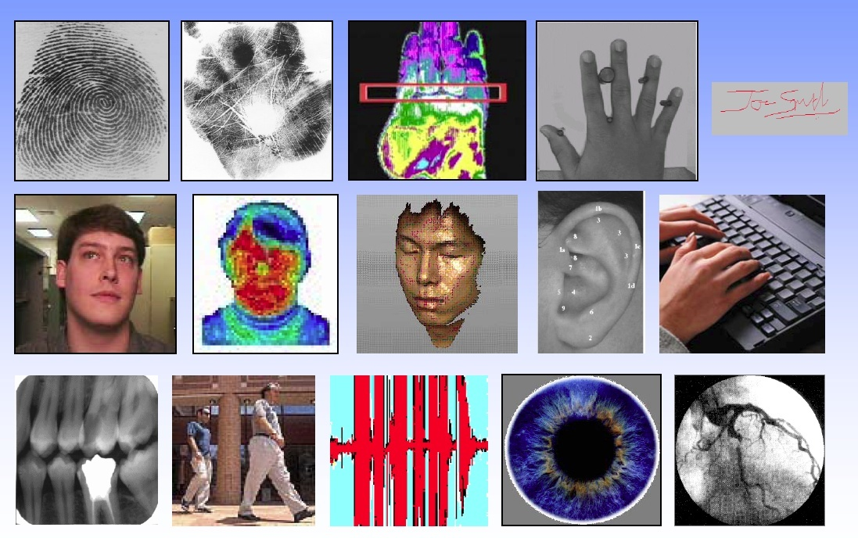
Identification using Biometric Trails

Slide 9
Biometric Recognition System

Slide 10
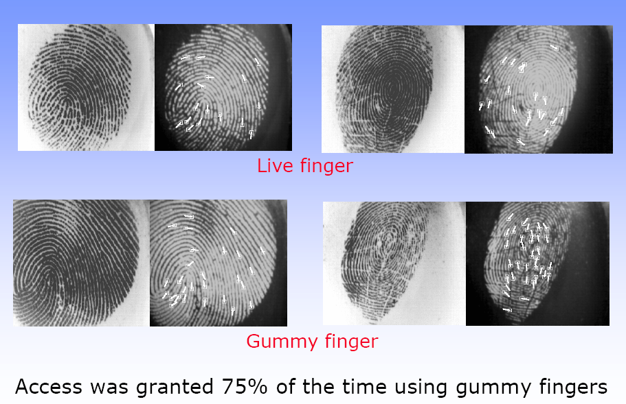
Fake Fingerprint
10

Slide 11
Applications

