Slide 1
Lect. 12: Number Theory

Slide 2
Contents
Prime and Relative Prime Numbers
Modular Arithmetic
Fermat’s and Euler’s Theorem
Extended Euclid’s Algorithm

Slide 3
Divisors
b|a (“b divides a”, “b is a divisor of a”) if a = kb for some k,
where a, b, and k are integers, and b ≠ 0
If a|1, then a = ±1
If a|b and b|a, then a = ±b
Any b ≠ 0 divides 0
If b|g and b|h, then b|(mg + nh) for arbitrary integers m and n

Slide 4
Prime Numbers
An integer p > 1 is a prime number if its only divisors are ±1 and ±p
Prime Factorization
Any integer a>1 can be factored in a unique way as
a = p₁^{α1} p₂^{α2} … p_{t}^{αt} where p₁ < p₂ < … < p_{t} are prime numbers and where each α_{i} > 0
If P is the set of all prime numbers, then any positive integer can be written uniquely in the following form
Multiplication of two numbers is equivalent to adding two corresponding exponents:
k = mn → k_{p} = m_{p} + n_{p} for all p
a|b → a_{p} ≤ b_{p} for all p

Slide 5
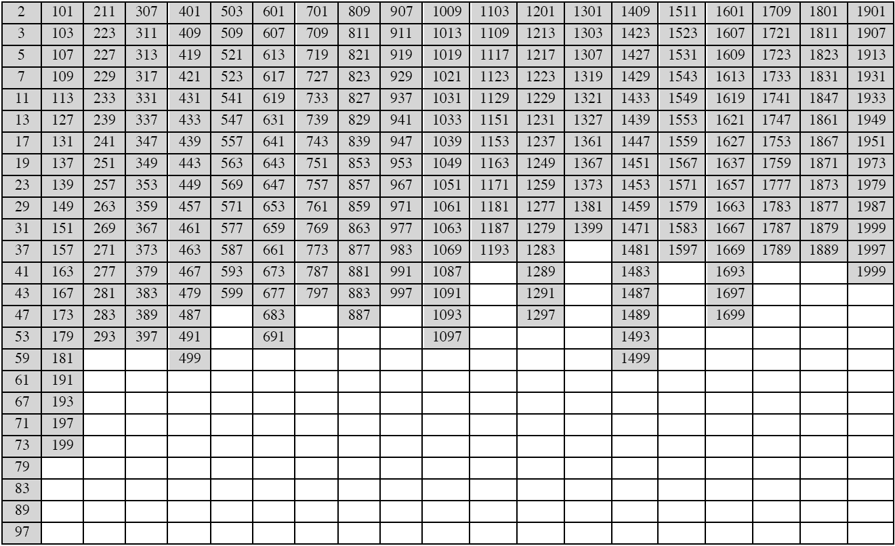
Primes Under 2000, How many ?

Slide 6
Relatively Prime Numbers
Greatest common divisor
c = gcd(a, b) if c|a and c|b and ∀d that divides a and b: d|c
Equivalently, gcd(a, b) = max{c: c|a and c|b}
k = gcd(a, b) → k_{p} = min(a_{p}, b_{p}) for all p
a and b are relatively prime if gcd(a, b) = 1

Slide 7
Modular Arithmetic
For any integer a and positive integer n, if a is divided by n, the following relationship holds:
a = qn + r 0 ≤ r ≤ n; q = ⎣a/n⎦ (q: quotient, r: remainder or residue)
If a is an integer and n is a positive integer, a mod n is defined to be the remainder when a is divided by n
a = ⎣a/n⎦ × n + (a mod n)
Two integers a and b are said to be congruent modulo n if (a mod n) = (b mod n), and this is written a ≡ b mod n
Properties of modulo operator
a ≡ b mod n if n|(a – b)
(a mod n) = (b mod n) implies a ≡ b mod n
a ≡ b mod n implies b ≡ a mod n
a ≡ b mod n and b ≡ c mod n implies a ≡ c mod n

Slide 8
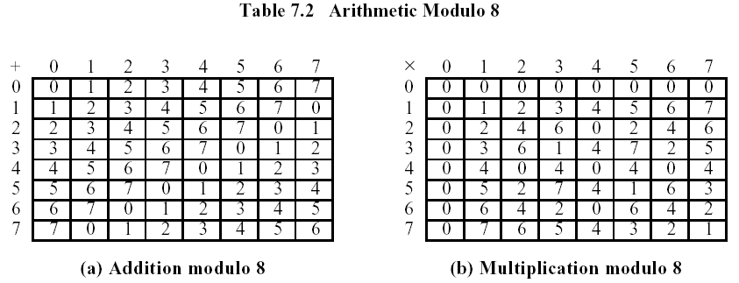
Modular Arithmetic Operations
Modulo arithmetic operation over Z_{n} = {0, 1, …, n-1}
Properties
[(a mod n) + (b mod n)] mod n = (a + b) mod n
[(a mod n) − (b mod n)] mod n = (a − b) mod n
[(a mod n) × (b mod n)] mod n = (a × b) mod n

Slide 9
Properties of Modular Arithmetic
Modulo arithmetic over Z_{n} = {0, 1, …, n-1} (called a set of residues of modulo n)
Integers modulo n with addition and multiplication form a commutative ring
Commutative laws (a + b) mod n = (b + a) mod n
(a × b) mod n = (b × a) mod n
Associative laws [(a + b) + c] mod n = [a + (b + c)] mod n
[(a × b) × c] mod n = [a × (b × c)] mod n
Distributive laws [a × (b + c)] mod n = [(a × b) + (a × c)] mod n
Identities (a + 0) mod n = a mod n
(a × 1) mod n = a mod n
Additive inverse (-a) ∀a ∈ Z_{n} ∃b s.t. a + b ≡ 0 mod n
Multiplicative inverse (a⁻¹) ∀a (≠0) ∈ Z_{n}, if a is relative prime to n, ∃b s.t. a × b ≡ 1 mod n
If n is not prime, Z_{n} is a ring, but not a field
Z_{p} is a field

Slide 10
Modular 7 Arithmetic

Slide 11
Groups, Rings, Fields
Group
A set of numbers with some addition operation whose result is also in the set (closure)
Obeys associative law, has an identity, has inverses
If also is commutative its an Abelian group
Ring
An Abelian group with a multiplication operation also
Multiplication is associative and distributive over addition
If multiplication is commutative, its a commutative ring
e.g., integers mod N for any N
Field
An Abelian group for addition
A ring
An Abelian group for multiplication (ignoring 0)
e.g., integers mod P where P is prime

Slide 12
Fermat’s Little Theorem
If p is prime and a is a positive integer not divisible by p, then
a^{p-1} ≡ 1 mod p
Proof
Start by listing the first p – 1 positive multiples of a:
a, 2a, 3a, …, (p-1)a
Suppose that ra and sa are the same modulo p, then we have
r ≡ s mod p, so the p-1 multiples of a above are distinct and nonzero; that is, they must be congruent to 1, 2, 3, …, p-1 in some order. Multiply all these congruences together and we find
a × 2a × 3a × … × (p-1)a ≡ 1 × 2 × 3 × … × (p-1) mod p
or better, a^{p-1}(p-1)! ≡ (p-1)! mod p. Divide both side by (p-1)! to complete the proof
Corollary
If p is prime and a is any positive integer, then
a^{p} ≡ a mod p

Slide 13
Euler’s Totient Function
Euler’s totient function φ(n) is the number of positive integers less than n (including 1) and relatively prime to n
φ(p) = p-1
φ(1) = 1 (Definition)
Let p and q be distinct prime numbers, n = pq. Then φ(pq) = φ(p)φ(q) = (p-1)(q-1)
Proof
Consider Z_{n} = {0, 1, …, pq-1}
The residues not relatively prime to n are 0, {p, 2p, …, (q-1)p}, and {q, 2q, …, (p-1)q}
So φ(pq) = pq - (1 + (q-1) + (p-1)) = pq - p - q + 1 = (p-1)(q-1)

Slide 14
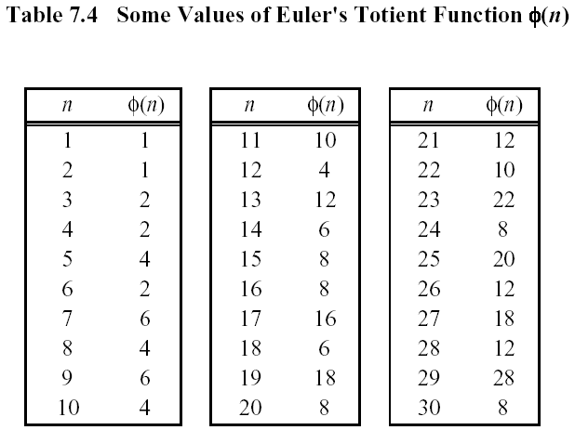
Euler’s Totient Function

Slide 15
Euler’s Theorem
Generalization of Fermat’s little theorem
For every a and n that are relatively prime, a^{φ(n)} ≡ 1 mod n
Proof
The proof is completely analogous to that of the Fermat's Theorem except that instead of the set of residues {1,2,...,n-1} we now consider the set of residues {x₁,x₂,...,x_{φ(n)}} which are relatively prime to n. In exactly the same manner as before, multiplication by a modulo n results in a permutation of the set {x₁, x₂, ..., x_{φ(n)}}. Therefore, two products are congruent:
x₁x₂ ... x_{φ(n)} ≡ (ax₁)(ax₂) ... (ax_{φ(n)}) mod n
dividing by the left-hand side proves the theorem.
Corollary
a^{φ(n)+1} ≡ a mod n

Slide 16
Euler’s Theorem
Corollaries
Given two prime numbers, p and q, and integers n = pq and m, with 0<m<n,
m^{φ(n)+1} = m^{(p-1)(q-1)+1} ≡ m mod n
(Demonstrate the validity of the RSA algorithm)
m^{kφ(n)} ≡ 1 mod n
m^{kφ(n)+1} ≡ m mod n

Slide 17
Euclid’s Algorithm – Finding GCD(1)
Based on the following theorem
gcd(a, b) = gcd(b, a mod b)
Proof
If d = gcd(a, b), then d|a and d|b
For any positive integer b, a = kb + r ≡ r mod b, a mod b = r
a mod b = a – kb (for some integer k)
because d|b, d|kb
because d|a, d|(a mod b)
∴ d is a common divisor of b and (a mod b)
Conversely, if d is a common divisor of b and (a mod b), then d|kb and d|[ kb+(a mod b)]
d|[ kb+(a mod b)] = d|a
∴ Set of common divisors of a and b is equal to the set of common divisors of b and (a mod b)
ex) gcd(18,12) = gcd(12,6) = gcd(6,0) = 6
gcd(11,10) = gcd(10,1) = gcd(1,0) = 1

Slide 18
Euclid’s Algorithm – Finding GCD(II)
Recursive algorithm
Function Euclid (a, b) /* assume a ≥ b ≥ 0 */
if b = 0 then return a
else return Euclid(b, a mod b)
Iterative algorithm
Euclid(d, f) /* assume d > f > 0 */
1. X ← d; Y ← f
2. if Y=0 return X = gcd(d, f)
3. R = X mod Y
4. X ← Y
5. Y ← R
6. goto 2

Slide 19
Extended Euclid’s Alg. – Finding Multiplicative Inverse(1)
If gcd(d, f) =1, d has a multiplicative inverse modulo f
Euclid’s algorithm can be extended to find the multiplicative inverse
In addition to finding gcd(d, f), if the gcd is 1, the algorithm returns multiplicative inverse of d (modulo f)
Extended Euclid(d, f)
(X1, X2, X3) ← (1, 0, f); (Y1, Y2, Y3) ← (0, 1, d)
If Y3 = 0 return X3 = gcd(d, f); no inverse
If Y3 = 1 return Y3 = gcd(d, f); Y2 = d⁻¹ mod f
Q = ⎣X3/Y3⎦
(T1, T2, T3) ← (X1 − QY1, X2 − QY2, X3 − QY3)
(X1, X2, X3) ← (Y1, Y2, Y3)
(Y1, Y2, Y3) ← (T1, T2, T3)
goto 2
Note: Always f × Y1 + d × Y2 = Y3

Slide 20
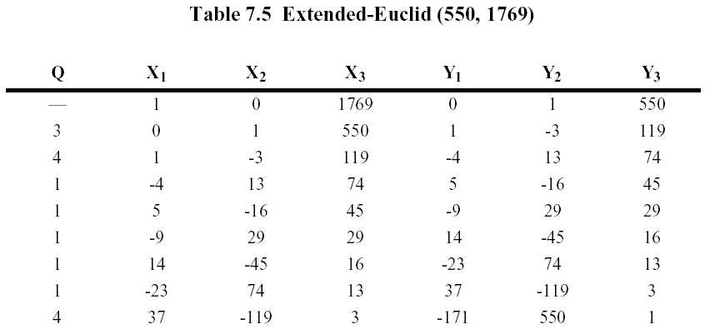
Extended Euclid’s Alg. – Finding Multiplicative Inverse(II)

