Slide 1
Lect. 11: Public Key Cryptography

Slide 2
Contents
Introduction to PKC
Hard problems
IFP
DLP
Public Key Encryptions
RSA
ElGamal
Digital Signatures
DSA, KCDSA
Schnorr
Key Exchange
Elliptic Curve Cryptosystems

Slide 3
1. Introduction to PKC
3
Notes:
3

Slide 4
Key Distribution Problem of Symmetric Key Crypto
In symmetric key cryptosystems
Over complete graph with n nodes, _{n}C₂ = n(n-1)/2 pairs secret keys are required.
(Example) n=100, 99 x 50 = 4,950 keys are required
Problem: Managing large number of keys and keeping them in a secure manner is difficult
a
Secret keys are required between
(a,b), (a,c), (a,d), (a,e), (b,c),
(b,d), (b,e), (c,d), (c,e), (d,e)
b
e
c
d
4
Notes:
4

Slide 5
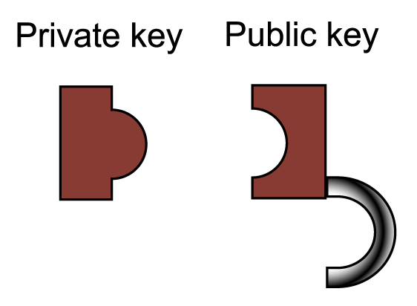
Public Key Cryptography - Concept
Using a pair of keys which have special mathematical relation.
Each user needs to keep securely only his private key.
All public keys of users are published.
In Encryption
Anyone can lock (using the public key)
Only the receiver can unlock (using the private key)
In Digital Signature
Only the signer can sign (using the private key)
Anyone can verify (using the public key)

Slide 6
Public Key Cryptography – Concept (1/3)
One-way functions
Given x, easy to compute y=f(x).
Difficult to compute x=f⁻¹(y) for given y.
easy
x,
domain parameters
f
y = f(x)
domain parameters
hard
Ex) f(x)= 7x²¹ + 3x³ + 13x²+1 mod (2¹⁵-1)
6
Notes:
6

Slide 7
Public Key Cryptography – Concept (2/3)
Trapdoor one-way functions
Given x, easy to compute f(x)
Given y, difficult to compute f⁻¹(y) in general
Easy to compute f⁻¹(y) for given y to only who knows certain information (which we call trapdoor information)
easy
x,
domain parameters
f
y = f(x)
domain parameters
hard
trapdoor info.
private key
public key
But, easy if trapdoor info. is given.
7
Notes:
7

Slide 8
Public Key Cryptography – Concept (3/3)
Concept
invented by Diffie and Hellman in 1976, “New directions in Cryptography”, IEEE Tr. on IT. ,Vol. 22, pp. 644-654, Nov., 1976.
Overcome the problem of secret key sharing in symmetric cryptosystems
Two keys used: public key & private key
Also known as two-key or asymmetric cryptography
Based on (trapdoor) one-way function
easy
x,
domain parameters
f
y = f(x)
domain parameters
hard
trapdoor info.
private key
public key
But, easy if trapdoor info. is given.
8
Notes:
8

Slide 9
Public Key Cryptography
Keys
A pair of (Public Key, Private Key) for each user
Public keys must be publicly & reliably available
Encryption schemes
Encrypt with peer’s Public Key; Decrypt with its own Private Key
RSA, ElGamal
Digital signature schemes
Sign with its own Private Key; verify with peer’s Public Key
RSA, DSA, KCDSA, ECDSA, EC-KCDSA …
Key exchange schemes
Key transport or key agreement for secret-key crypto.
RSA; DH(Diffie-Hellman), ECDH
All problems clear?
New Problem : How to get the right peer’s Public Key?
Public key infrastructure (PKI) required
Certificate is used to authenticate public key

Slide 10
Public Key Cryptosystems
Public key cryptography is based on hard problems.
Encryption schemes
RSA: based on IFP
ElGamal: based on DLP
Signature schemes
Signature schemes with message recovery: RSA
Signature with appendix: ElGamal, DSA, KCDSA
Key exchange schemes
Key transport: a trusted entity TA generates and distributes key
Key agreement: Diffie-Hellman key agreement. Both entity take part in the key agreement process to have an agreed key

Slide 11
Public Key Encryption vs. Digital Signature
Bob
Alice
E
Ciphertext
C
D
Plaintext
M
Plaintext
M
Alice’s Public Key
Alice’s Private Key
Authentic channel
Bob
Alice
Plaintext
M
S
Message + Signature
M + s
V
Yes / No
Bob’s private Key
Bob’s public Key
Authentic channel

Slide 12
Public Key Cryptosystems – History
RSA scheme (1978)
R.L.Rivest, A.Shamir, L.Adleman, “A Method for Obtaining Digital Signatures and Public Key Cryptosystems”,CACM, Vol.21, No.2, pp.120-126,Feb,1978
McEliece scheme (1978)
Rabin scheme (1979)
Knapsack scheme (1979-): Merkle-Hellman, Chor-Rivest, etc.
ElGamal scheme (1985)
Elliptic Curve Cryptosystem (1985): Koblitz, Miller
Non-Abelian group Cryptography (2000): Braid group
12
Notes:
12

Slide 13
Symmetric key vs. Asymmetric Key Crypto
O : Good X : Bad
Symmetric
Asymmetric
Key relation
Enc. Key
Dec. key
Algorithm
Example
Key Distribution
Number of key
Performance
Enc. key = Dec. key
Secret
Secret
Classified Open
SKIPJACK AES
Required (X)
Many (X)
Fast(O)
Enc. Key ≠ Dec. key
Public, {Private}
Private, {Public}
Open
RSA
Not required (O)
Small (O)
Slow(X)
13
Notes:
13

