Slide 1
Lect. 10 : Cryptanalysis

Slide 2
Block Cipher – Attack Scenarios
Attacks on encryption schemes
Ciphertext only attack: only ciphertexts are given
Known plaintext attack: (plaintext, ciphertext) pairs are given
Chosen plaintext attack: (chosen plaintext, corresponding ciphertext) pairs
Adaptively chosen plaintext attack
Chosen ciphertext attack: (chosen ciphertext, corresponding plaintext) pairs
Adaptively chosen ciphertext attack
E
D
K
K
Plaintext
Ciphertext
Ciphertext
Plaintext
Encryption Oracle
Decryption Oracle

Slide 3
Cryptanalysis of Block Ciphers
Statistical Cryptanalysis
Differential cryptanalysis (DC)
Linear Cryptanalysis (LC)
Various key schedule cryptanalysis
Algebraic Cryptanalysis
Interpolation attacks
Side Channel Cryptanalysis
timing attacks
differential fault analysis
differential power analysis, etc.

Slide 4
Cryptanalysis of Block Ciphers - DC
Differential Cryptanalysis
E. Biham and A. Shamir : Crypto90, Crypto92
Chosen plaintext attack, O(Breaking DES₁₆ ~ 2⁴⁷)
Look for correlations in Round function input and output (DES : 2⁴⁷)
high-probability differentials, impossible differentials
truncated differentials, higher-order differentials
* E.Biham, A. Shamir,”Differential Cryptanalysis of the Data Encryption Standard”, Springer-Verlag, 1993
ΔX = X ⊕ X′
Input difference
Statistically non-uniform probability distribution: higher prob. for some fixed pattern ΔX & ΔY
Prob.
E
K
ΔY = Y ⊕ Y′
Output difference

Slide 5
Cryptanalysis of Block Ciphers - LC
Linear Cryptanalysis
Matsui : Eurocrypt93, Crypto94
Known Plaintext Attack, O(Breaking DES₁₆) ~ 2⁴³
Look for correlations between key and cipher input and output
linear approximation, non-linear approximation,
generalized I/O sums, partitioning cryptanalysis
* M. Matsui, ”Linear Cryptanalysis Method for DES Cipher”, Proc. of Eurocrypt’93,LNCS765, pp.386-397
Input X
Linear equation between some bits of X, Y and K may hold with higher prob. than others
E
K
Output Y

Slide 6
Other Attacks on Block Ciphers
Algebraic Cryptanalysis
deterministic/probabilistic interpolation attacks
Key Schedule Cryptanalysis
Look for correlations between key changes & cipher input/output
equivalent keys, weak or semi-weak keys
related key attacks
Side-Channel Cryptanalysis
timing attacks
differential fault analysis
differential power analysis, etc.

Slide 7
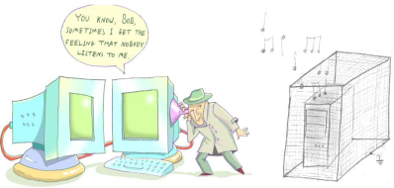
Side Channel
Traditional Cryptographic Model vs. Side Channel
Power Consumption / Timing / EM Emissions / Acoustic
Attacker
C=E(P,Ke)
P=D(C,Kd)
E()
C
D()
P
D
Insecure channel
Ke
Kd
Key
Secure channel
Radiation / Temperature / Power Supply / Clock Rate, etc.

Slide 8
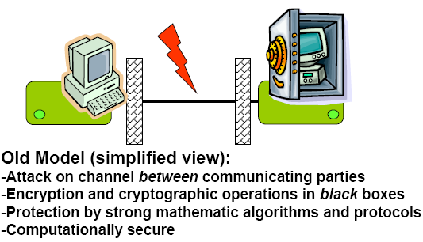
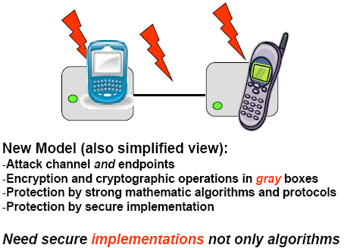
Model of Attack -Embedded security

